Slide 1
Patient/Family Engagement
Insert photo or snapshot of plan here or attach to email to Linda

Slide 2
Electronic resources
http://coa.peachnewmedia.com/streaming/interface-v7.php?topic=245273&band=1&stream=1&id=7475798&semid=104941&provider=509&custid=893068
https://www.lpfch.org/sites/default/files/field/publications/assessing_family_engagement_4.10.18.pdf

Slide 3
Updated Timeline for Change Ideas
Change Idea | Person Responsible | Deadline

Slide 4
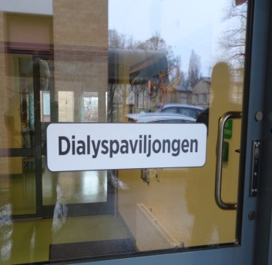
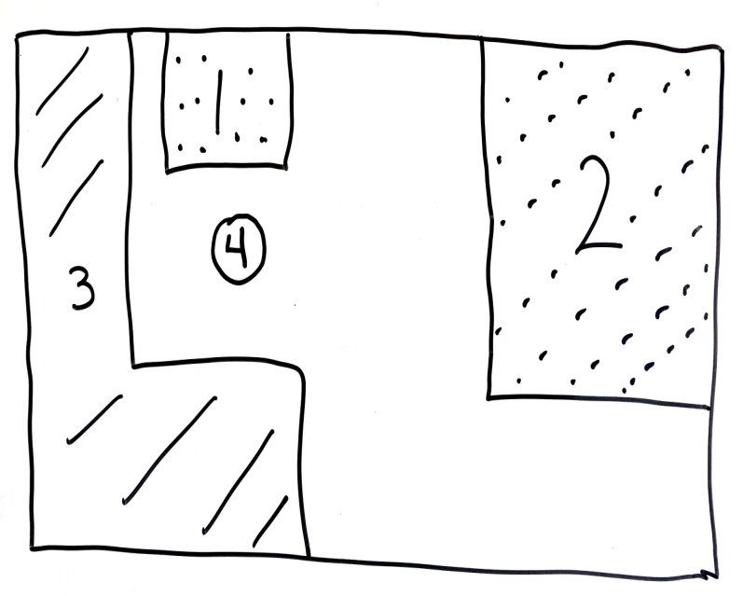
PPt-Nurse
Standardized
Service
Pts doing their own
dialysis in community
Single patient
Pts doing their own
dialysis in community
ffacilitator
NETWORK
Leader

