Slide 1
Faculty Onboarding Process in UAB PeopleAdmin
Office of the Provost
June 2022

Slide 2
Welcome to New Faculty Onboarding at UAB! This guide provides department administrators and others who manage new faculty onboarding with an introduction to the UAB PeopleAdmin Onboarding System. It also provides the step-by-step process for creating onboarding events for your new faculty hires. Please take a few minutes to review this how-to-guide so that you can easily onboard your new faculty. Thank you. Faculty Affairs

Slide 3
Introduction/Overview
This presentation covers:
Onboarding Workflow
Steps to onboard your new faculty
How to Manage & Monitor Onboarding
Onboarding for Full-time Temporary (02) Faculty
How to View and Approve Onboarding Forms

Slide 4
Steps for Onboarding Faculty in UAB PeopleAdmin
Department Administrator Moves Hiring Proposal to Offer Accepted.
New faculty hire is assigned a BlazerID (if they don’t already have one).
Background Check Coordinator starts background check process.
Faculty Affairs updates new hire’s information in PeopleAdmin with BlazerID and campus email address. Moves Hiring Proposal to Start Onboarding.
Faculty Affairs starts onboarding in UAB PeopleAdmin, and assigns the first checklists (Before First Day-Getting Started & Welcome, Background Check Coordinator Checklist, and Department Admins Checklist).
Department Admin must assign additional checklists using the schedule provided. Example: The First Day –Two Weeks Onboarding Checklist must be assigned on the hire date (i.e. August 15)

Slide 5
Workflow for Onboarding Faculty in UAB PeopleAdmin
Department Administrator Moves Hiring Proposal to Offer Accepted...
2. New faculty hire is assigned a BlazerID (if they don’t already have one).
3. Background Check Coordinator starts background check process.
4. Faculty Affairs updates new hire’s information in PeopleAdmin with BlazerID and campus email address. Moves Hiring Proposal to Start Onboarding.
5. Faculty Affairs starts onboarding in UAB PeopleAdmin, and assigns the first checklists (Before First Day-Getting Started & Welcome, Background Check Coordinator Checklist, and Department Admins Checklist).
6. Department Admin must assign additional checklists using the schedule provided. Example: The First Day –Two Weeks Onboarding Checklist must be assigned on the hire date (i.e. August 15).

Slide 6
Important Onboarding Reminders
Faculty Affairs Will Start Onboarding
The Supervisor in Onboarding is “you” the department administrator -- the person managing the onboarding process.
Department Administrators must assign the additional checklists.
Department Administrators will monitor the Onboarding progress and send reminders to faculty members to complete
Do Not Move Your Applicant to HIRED. The system does that for you.

Slide 7
Important Onboarding Reminders
Auto-generated BlazerID – UAB PEOPLEADMIN FEEDS YOUR NEW HIRES’ INFORMATION TO BLAZERID CENTRAL SO THAT THE SYSTEM AUTOMATICALLY GENERATES A BLAZERID FOR THEM. THE NEW HIRE RECEIVES AN EMAIL ASKING THEM TO “CLAIM” THEIR NEW BLAZERID AND SET-UP A CAMPUS EMAIL.
New Hires’ Email Accounts – WE MUST HAVE THE NEW HIRE’S UAB EMAIL ADDRESS BEFORE ONBOARDING CAN START. PROVIDE THE EMAIL ADDRESS TO FACULTY AFFAIRS TO MAKE SURE THAT ONBOARDING IS CORRECT.
Background Checks are initiated through the UAB PeopleAdmin Hiring Proposal Process
Electronic I-9: New hire information feeds to LawLogix

Slide 8
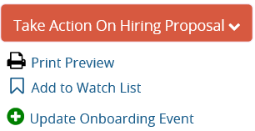
Your How To Guide for Faculty Onboarding
Faculty Affairs will start all onboarding in UAB PeopleAdmin for new faculty hires.
To continue the onboarding process, the Department Admin will:
GO TO and OPEN the Hiring Proposal.
Click on Update Onboarding Event.
Assign Checklists Using the Schedule Provided.
Set Due Dates for New Faculty to complete each checklist.
Notes:
The onboarding process begins as soon as your new hire accepts their offer. Onboarding in a timely manner is critically important for your new faculty member’s access to systems and services. To help manage the onboarding process, here are a few simple steps.

Slide 9
Assigning Additional Onboarding Checklists

Slide 10
Your How To Guide for Faculty Onboarding: Assigning Additional Checklists
As shown in the screen shot, be sure to click “x” to remove the checklists that have already been assigned.
This will keeps your faculty member from getting duplicate checklists.
Then assign your new checklists, such as FIRST 30 DAYS – UAB STANDARD – ALL FACULTY.
Remove Checklists Here

Slide 11
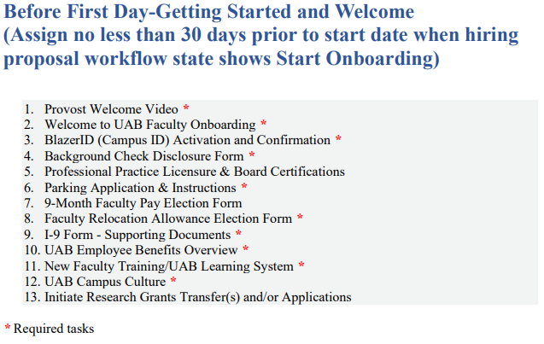
Schedule for Assigning Onboarding Checklists

Slide 12
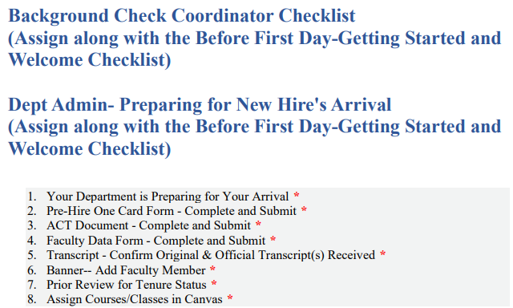
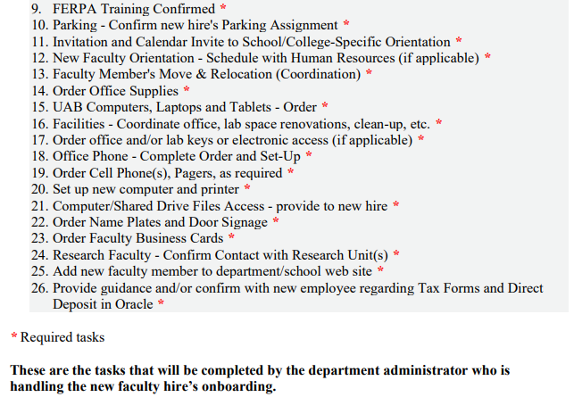
Schedule for Assigning Onboarding Checklists

Slide 13
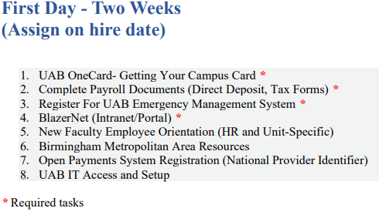
Schedule for Assigning Onboarding Checklists

Slide 14
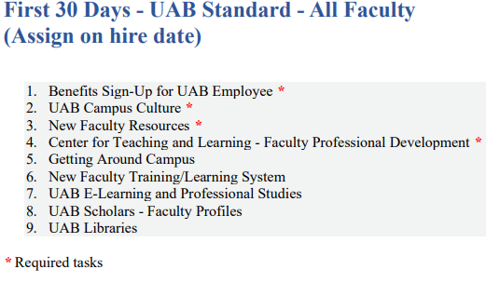
Schedule for Assigning Onboarding Checklists

Slide 15
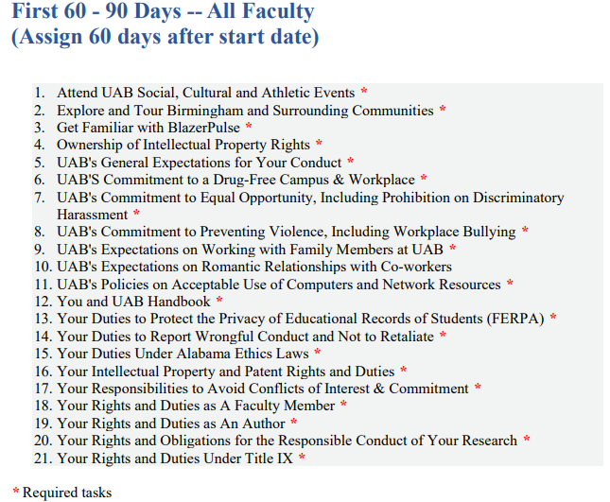
Schedule for Assigning Onboarding Checklists

Slide 16
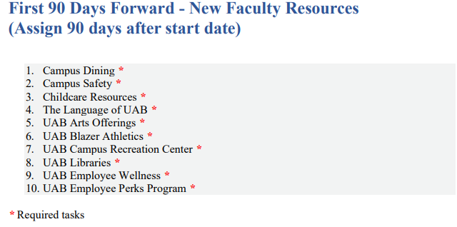
Schedule for Assigning Onboarding Checklists

Slide 17
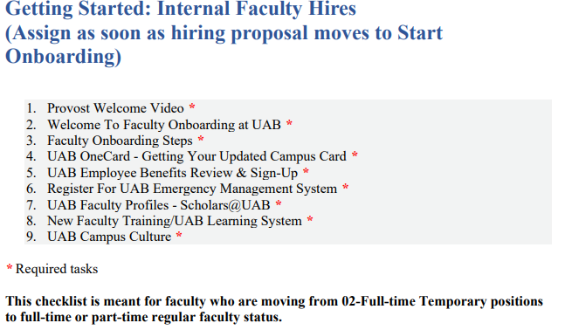
Onboarding Checklists for Internal Hires Only
Faculty Affairs will Assign this Checklist.
Internal Hires Refers to faculty who are moving from an 02 Adjunct/Visiting Faculty Appointment, from a CCI position, or an 04 Irregular Faculty Position to a full-time (01) or part-time (03) faculty appointment.

Slide 18
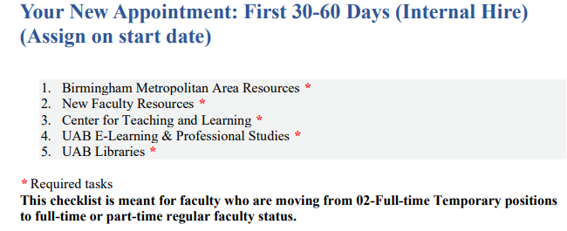
Onboarding Checklists for Internal Hires Only
Department Admin Must Assign This Checklist

Slide 19
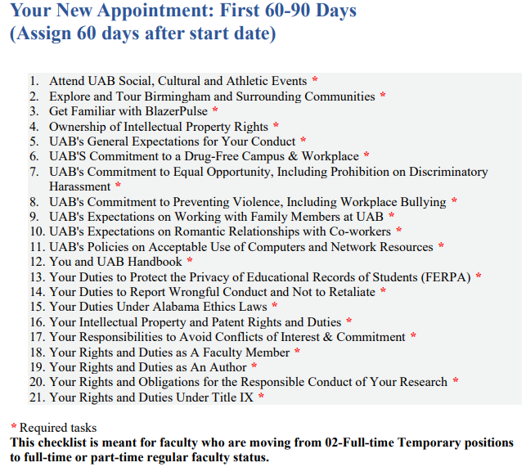
Onboarding Checklists for Internal Hires Only
Department Administrator Must Assign this Checklist.

Slide 20
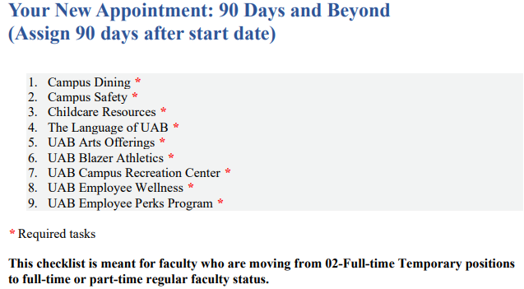
Onboarding Checklists for Internal Hires Only
Department Administrator Must Assign this Checklist.

Slide 21
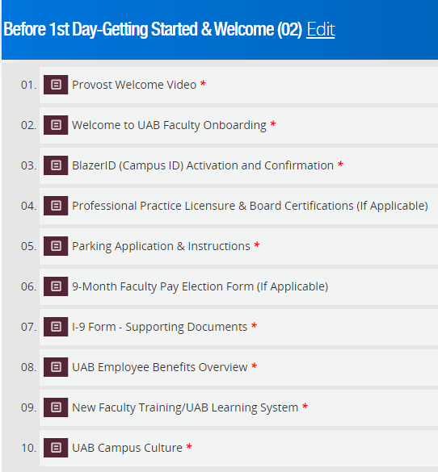
Onboarding Checklists 02 Full-time Temporary Faculty Only
Faculty Affairs will Assign this Checklist.

Slide 22
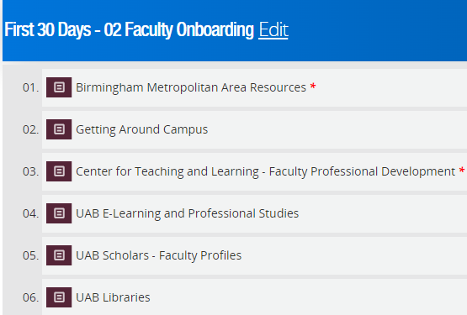
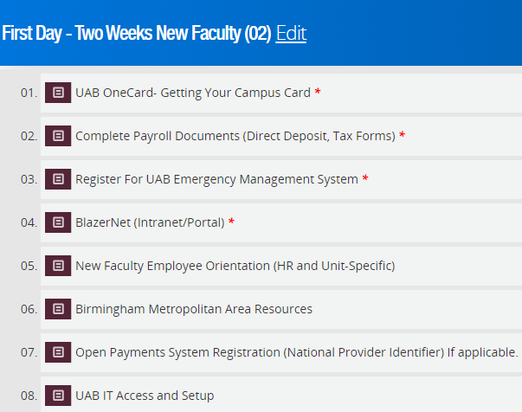
Onboarding Checklists 02 Full-time Temporary Faculty Only
Department Admin Must
Assign these Checklists on the Hire Date.

Slide 23
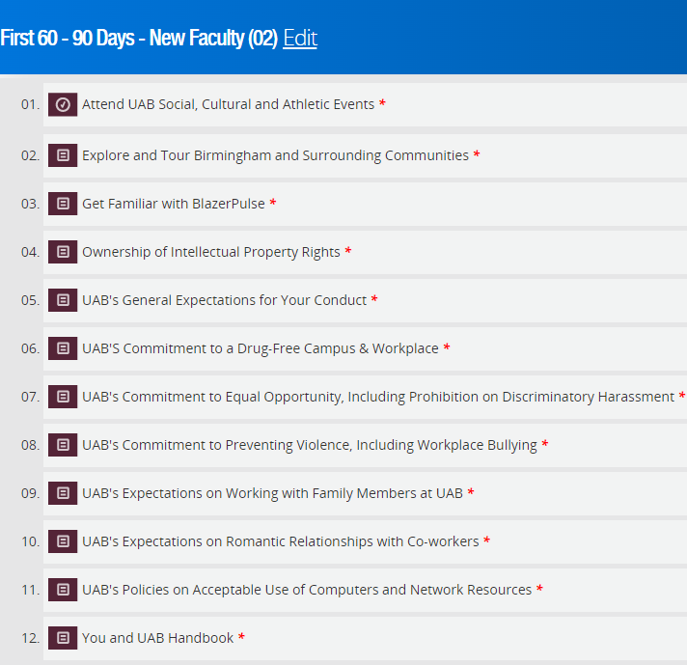
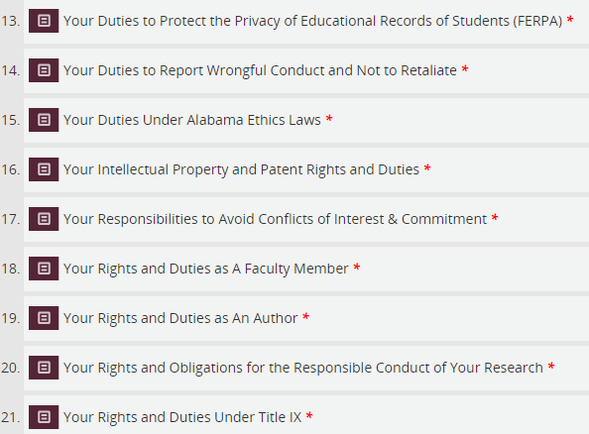
Onboarding Checklists 02 Full-time Temporary Faculty Only
Department Admin Must
Assign this Checklist 60 Days after the Hire Date.

Slide 24
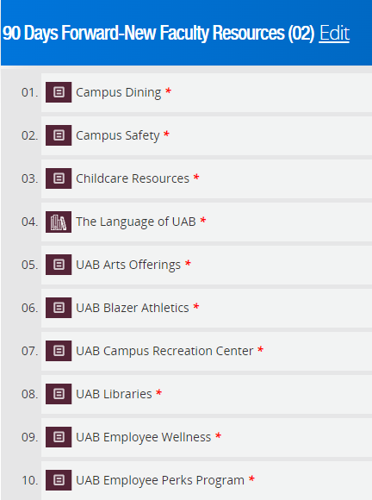
Onboarding Checklists 02 Full-time Temporary Faculty Only
Department Admin Must
Assign this Checklist 90 Days After the Hire Date.

Slide 25
Monitoring Onboarding Progress
THE GOAL IS 100% COMPLETION FOR ALL NEW FACULTY HIRES!

Slide 26
New Hire Onboarding Login
New Faculty Must Log in as shown here with their UAB BlazerID and password.

Slide 27
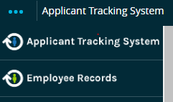
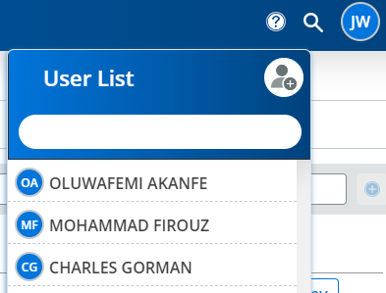
Monitoring the Status of New Hire’s Onboarding
Go to Employee Records Module in UAB PeopleAdmin
Click on Employee Records Icon to Open the module
Click on the Search Tool (Magnifying Glass) to search for your new hire. The new hire will appear in your User List or you can search for them.
Click on the faculty member’s name to see their “FILES.”

Slide 28
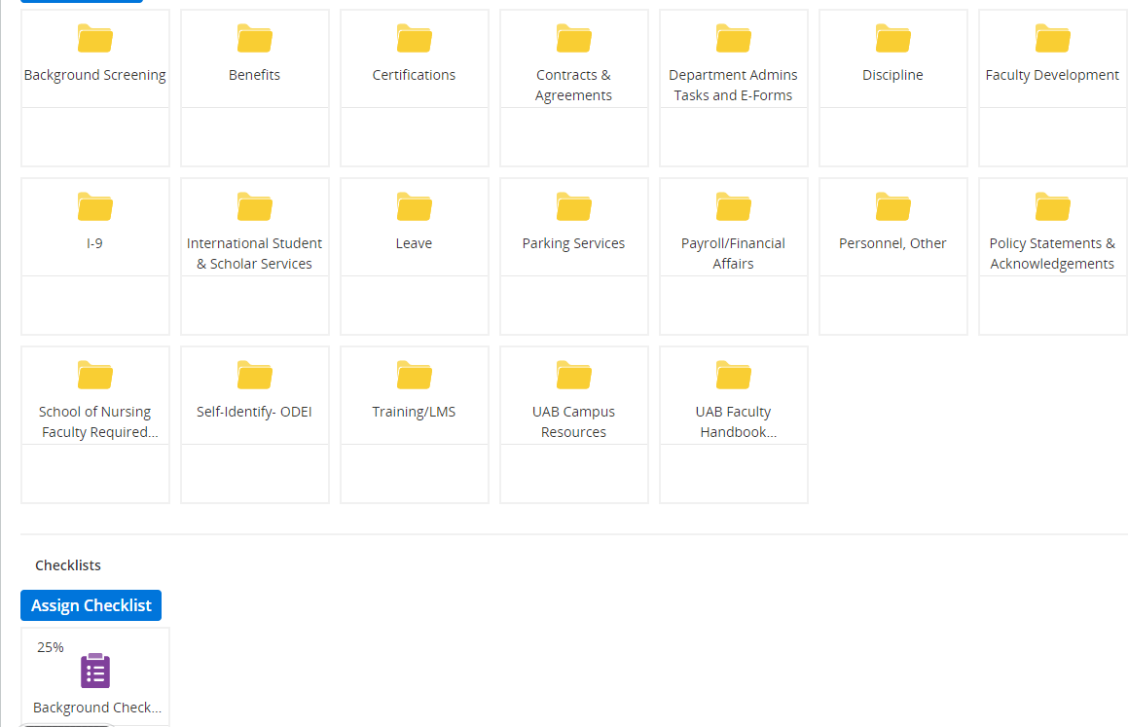
New Hire’s Onboarding Files and Checklists View

Slide 29
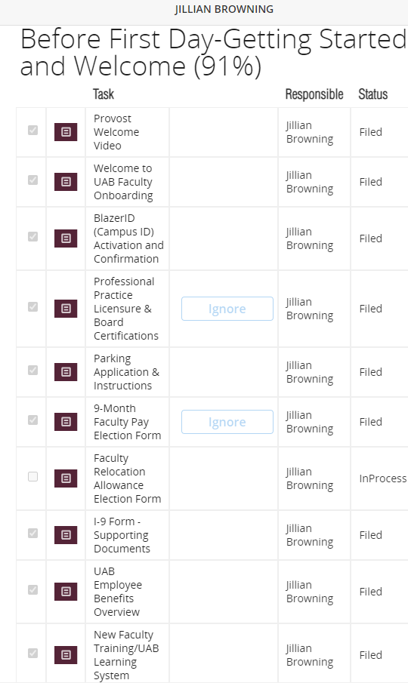
Monitoring Onboarding Progress

Slide 30
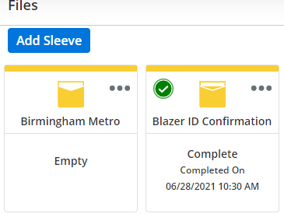
Monitoring Onboarding Progress
You can view completed Onboarding Documents and Tasks by clicking on the faculty member’s folder.

Slide 31
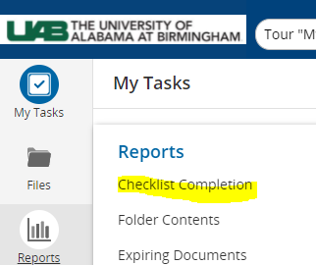
Monitoring the Status of New Hire’s Onboarding Option 2
3
Go to the Onboarding (Employee Records) module from your UAB PeopleAdmin dashboard.
Click on the Reports Icon
Click Checklist Completion and select a checklist to view (Ex: Before First Day Getting Started and Welcome.)
See your new hire’s onboarding progress
Download report to Excel
2
5
4

Slide 32
Viewing And Approving Forms in Onboarding

Slide 33
Viewing & Approving New Hire’s Onboarding Forms
Two essential forms are routed through UAB PeopleAdmin Onboarding that require an ACTION from the Department Administrator:
Relocation Allowance Election Form
9-Month Faculty Pay Election Form
The faculty member does not need to complete the paper version of these forms. That creates confusion for the faculty member and Payroll Services.

Slide 34
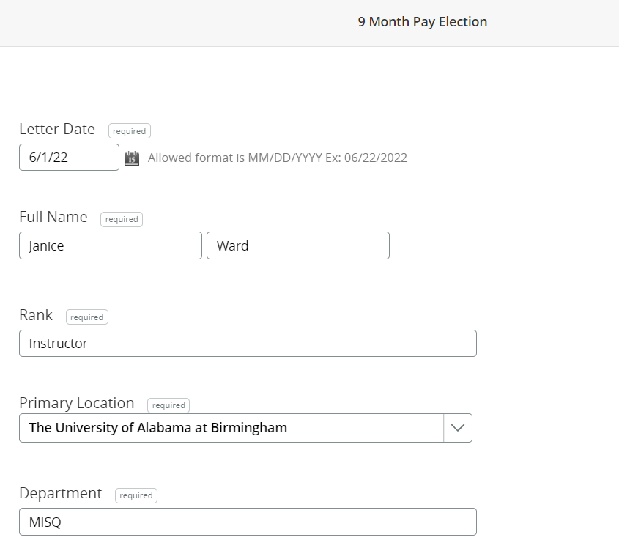
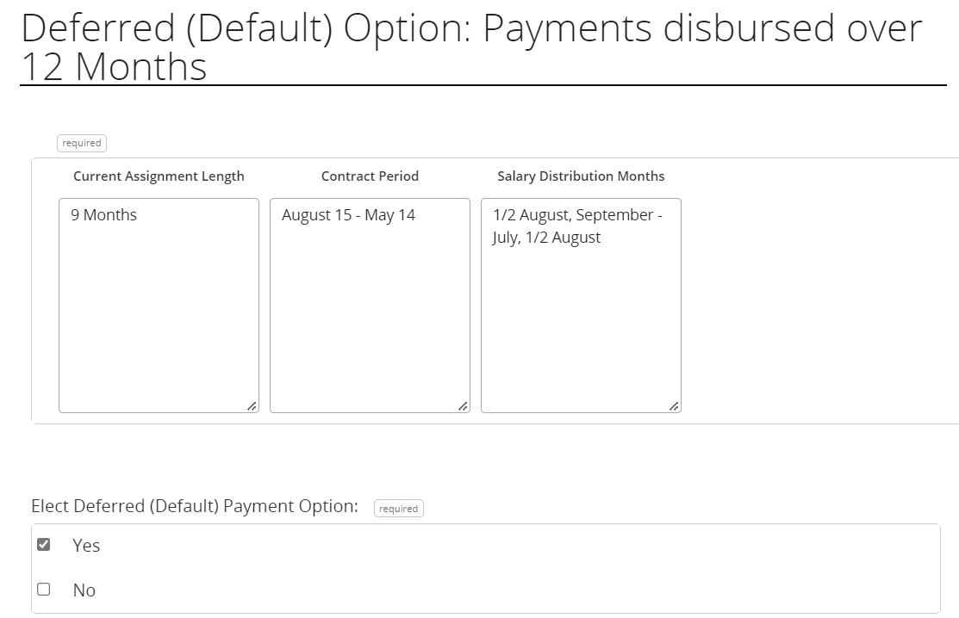
New Hire completes forms as instructed.

Slide 35
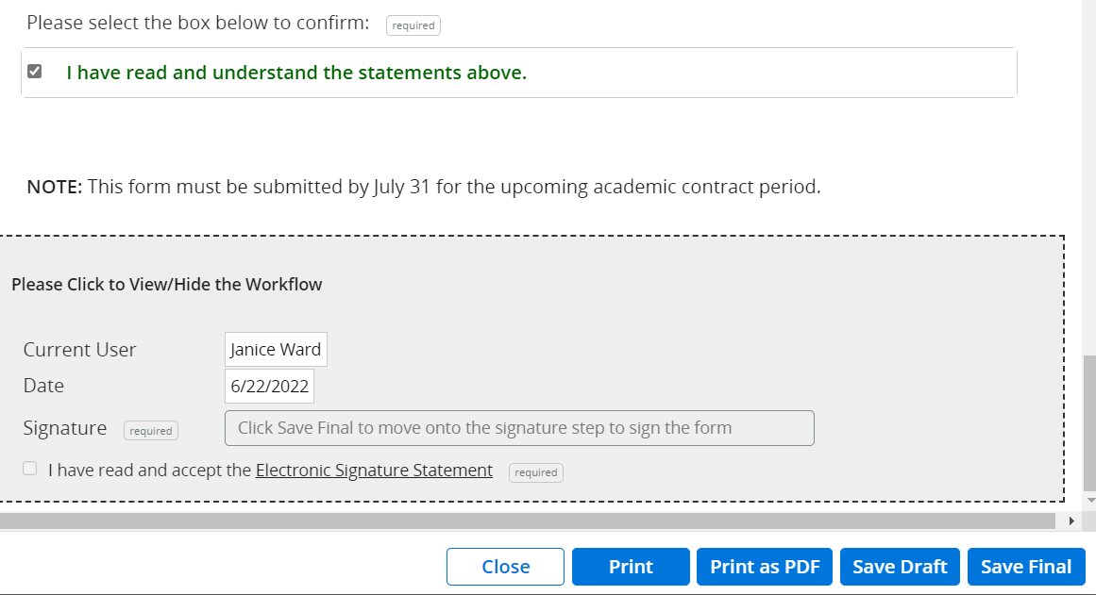
New Hire Signs and Submits Forms
Click Save Final
Complete Electronic Signature Section
Submit

Slide 36
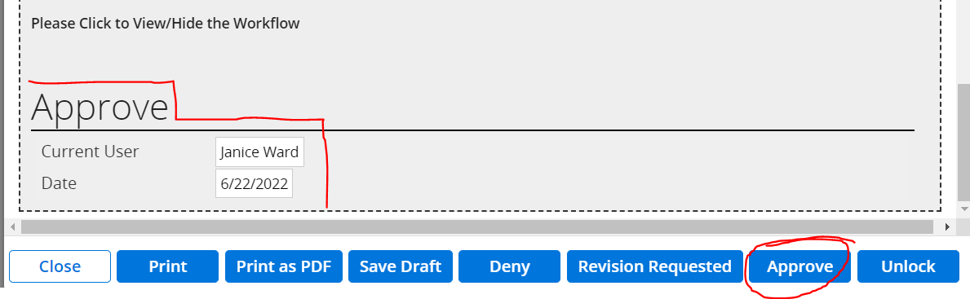
Approve Form
When the new hire signs and submits the form, it moves to the Hiring Manager/Department Administrator for APPROVAL. Please be sure to complete the form as instructed, and upload attachments as needed.
The Form will route to Payroll after the department administrator approves it.

Slide 37
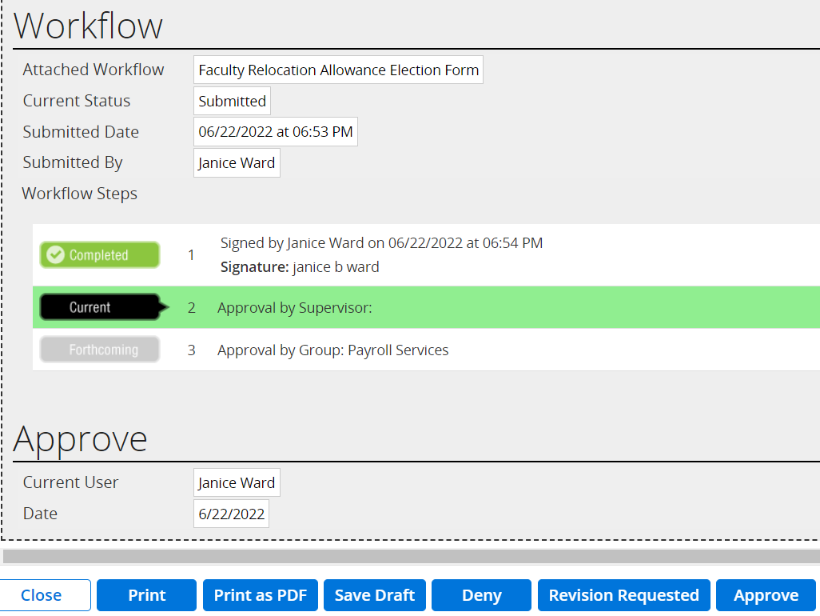
Approval Workflow for Faculty Relocation Allowance Election Form
You can return the form to the new hire for revisions.
They receive an email notification from UAB PeopleAdmin Onboarding to revisit their form.

Slide 38
Faculty Onboarding Resources:
UAB Faculty Onboarding Web pages and resources: Faculty Onboarding Department Resources Web pages
For questions or additional information, please contact facultyaffairs@uab.edu or 202-934-0513.
It is vitally important that you, as the administrator, manage the Onboarding process for your faculty member. You may keep up with the assignment due dates for the next checklists by using options such as your Outlook Calendar or a spreadsheet.

