Slide 1
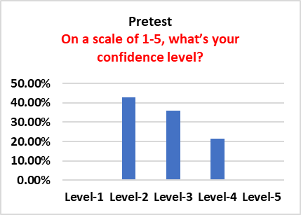
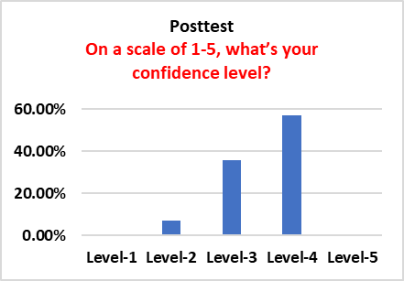
Social Media Use & Self-esteem in Adolescent Girls Aja Amison ,OTS | Valley McCurry PhD, MBA,OTR/L,FAOTA Department of Occupational Therapy | University of Alabama at Birmingham Marlesa Willis, MBA | Girls Inc. of Central Alabama
Introduction
Results
Discussion continued
Previous studies have shown that social media use is the number one leading cause of low self-esteem in adolescent girls. Occupational therapy (OT) can significantly improve adolescent girl's self-esteem by promoting meaningful activities such as coping strategies.
This study aims to evaluate adolescent girl's response to behavioral modification approaches provided by an OT student using an educational seminar to increase their self-esteem.
Initially respondents primarily
used four leading apps: YouTube, TikTok, Facebook, X (formerly Twitter), and Instagram, but in the final trial, they reduced the number to two.
Girls typically spent over two hours on social media platform, decreasing to at most one hour .
Participants understanding and perceptions of online cyberbullying with a significant increase from 57% to 79%.
Respondents had a significate increase in their confidence after a three-month period using meaningful activities to increase their self-esteem.
Regular feedback sessions in OTPs support groups allow participants to share changing views and preferences about social media, influencing the creation of more effective interventions for young girls.
Implications
Create a 14-question questionnaire to understand adolescent girl's views towards their self-esteem, online cyberbullying knowledge, frequency use of social media, and level of confidence.
Limitations
Small sample size
Anonymity in the study limits follow-up with participants .
Conclusion
Methods
This study offers valuable insights for OTs on helping adolescent girls navigate the digital world, particularly in the face of low self-esteem. It emphasizes the need for professional assistance and considering factors. This can also include social support networks, social media benefits, social comparison techniques, young girl's perspectives, and program constraints. The findings can guide the development of interventions for OTs to utilize to improve self-image satisfaction among adolescent girls.
An OT student provided an educational seminar for adolescent girls and assessing maladaptive behaviors before and after the seminar, using a questionnaire about social media.
Criteria for this study
Adolecent ages 10-16 years of age
A member of Girls Inc. of Central Alabama
4th-10th grade
Female
Primary Measures
Effects on Mood and self-esteem
Frequency of use of social media apps
Online Cyberbullying knowledge
Level of confidence
A total of 14 participants completed a questionnaire approved by UAB IRB were analyzed and categorized from excel spreadsheet into 4 themes.
Discussion
Main Findings
Occupational therapy partitioners (OTPs) can use support groups to establish a safe place where girls can talk about issues about their self-worth, exchange coping mechanisms, and get advice.
OTPs can help young girls engage in non-screen activities to lower screening time, including mindfulness exercises, leisure, and self-care. This will help them achieve required psychological well-being, such as greater self-esteem.
OTPs support groups can incorporate educational modules that address media literacy and assist adolescent girls in differentiating between curated online personas and real-life experiences.
References
Valkenburg, P., Beyens, I., Pouwels, J. L., van Driel, I. I., & Keijsers, L. (2021). Social media use and adolescents’ self-esteem: Heading for a person-specific media effects paradigm. Journal of Communication, 71(1), 56-78.
Lokithasan, K., Simon, S., Jasmin, N. Z. B., & Othman, N. A. B. (2019). Male and female social media influencers: The impact of gender on emerging adults. International Journal of Modern Trends in Social Sciences, 2(9), 21-30. https://doi.org/10.35631/IJMTSS.29003
Kramer, P. (2018). Frames of reference for pediatric occupational therapy. Lippincott Williams & Wilkins.
Acknowledgement & Contact information
Aja Amison Aja1999@uab.edu Dr. McCurry valley@uab.edu

