Slide 1
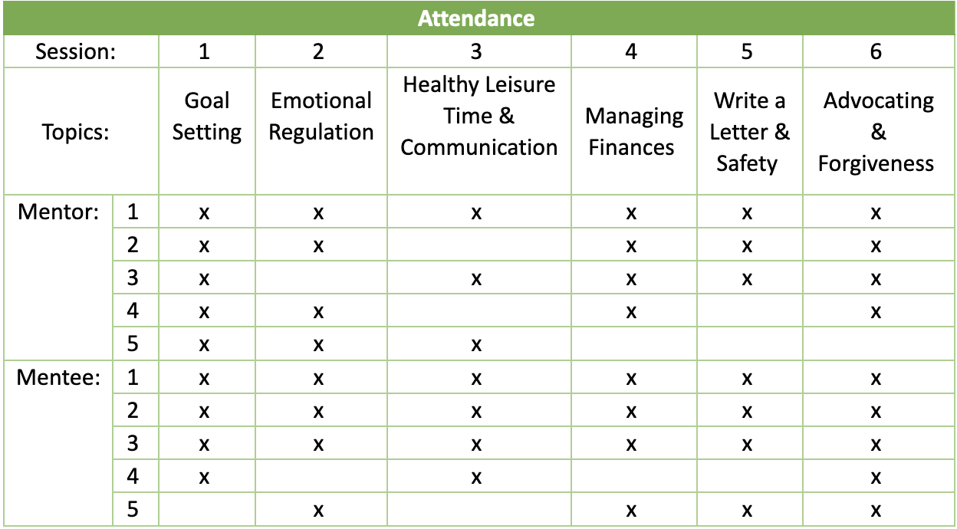
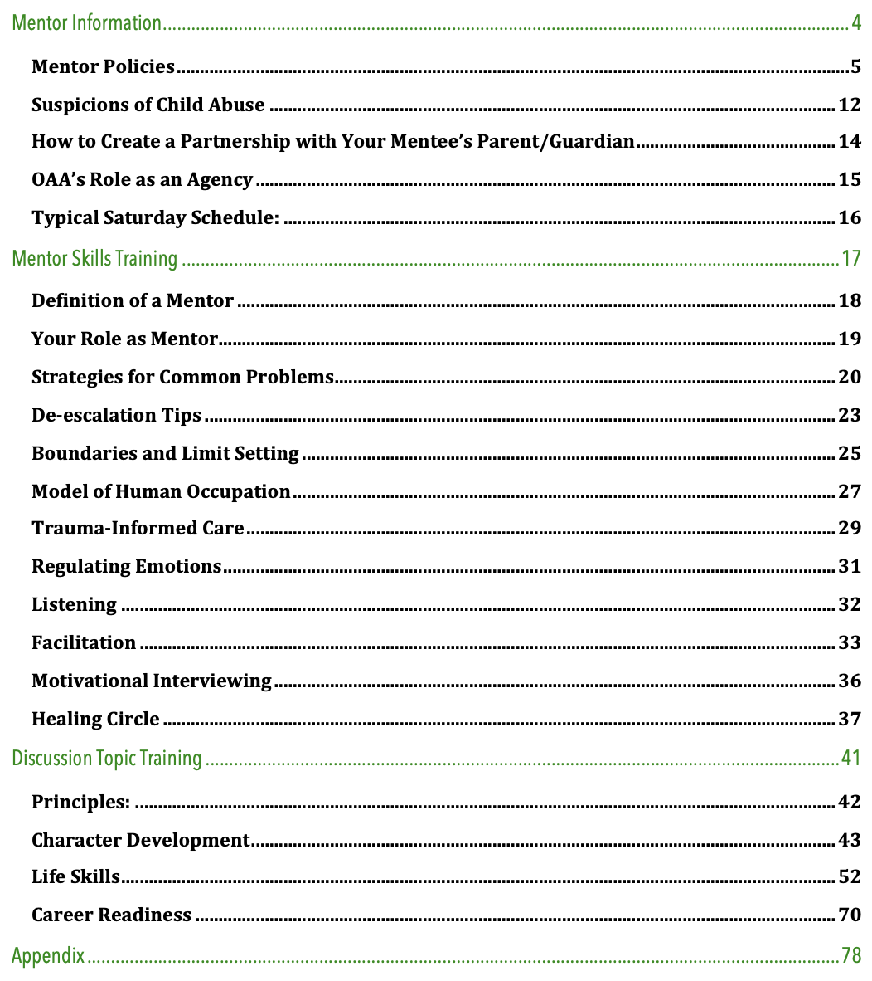
Life and Career Skills Impacting Self-Efficacy and Transition Planning of At- Risk Youth Jane Frances Armour, OTS; Dr. Sarah Tucker, Ph.D., OTR/L Department of Occupational Therapy | University of Alabama at Birmingham Dena Dickerson | Offender Alumni Association
Introduction
Results
Discussion
Literature Review
At-risk Youth:
Less likely to transition successfully into adulthood due to experiences and risk factors (Grell & Smith, 2022); parental incarceration is the most strongly associated trauma with future criminal justice involvement, while physical abuse, sexual abuse, witnessed violence, and threatened with violence are also strongly associated (Scanlon et al., 2019).
Occupational Therapy’s Role:
Helps empower individuals with independently participating in occupations and transition planning from one stage of life to another for groups and populations is within their scope of practice (AOTA, 2020).
Mentorship Programs:
Youth had an increase in skills, capabilities, confidence, and life satisfaction after mentoring program (Powers et al., 2018); youth valued self-direction, self-determination, and the importance of quality and consistent support with mentors and peers (Powers et al. 2018); intervention topics of community, self-awareness, cultural celebration, and interpersonal relationships seemed to help participants in self-reflection and consider life skills (Shea & Siu, 2016).
Overview of Study
Purpose:
Implement a program of life and career skills training for at-risk youth to increase their self-efficacy and transition planning to help them successfully become independent adults.
Mentor Results
5 Participants:
100% African-American and male
2 = 35-49 years , 3 = >50 years old
All but 1 were existing mentors with OAA
Mentee Results
5 Participants:
100% African-American and male
3 = 14 years, 1 = 16 years, 1= 18 years
None had previously participated with OAA
Survey results give little conclusive data due to the small population size and short-term study, therefore the Likert scale was flawed in qualifying results and limited the number of topics taught.
Interviews may be a better way to assess self-efficacy and transition readiness with a small population size.
Topics ranked higher were character developing and life skills, over career readiness.
Participants may have been over-confident in the pre-surveys, then after being taught the information realize they may not know as much as they initially thought.
It is difficult to know the endeavor and thoroughness participants used when taking the surveys.
Results from the surveys and the interview may be misrepresented because participants know the goal of this study and want to appease the researcher.
Surveys and interviews have conflicting results with these items: emotional regulation & managing finances.
Based on interview results:
- It appears that having mentors provide a welcoming and safe space, using trauma-informed care aspects,
allows mentees to express their emotions freely
-Mentees are starting to think and prepare for adulthood because of this mentoring program.
-A manual may provide more structure to a program and increase the confidence of mentors when teaching
mentees topics
Limitations
Short-term study Small sample size Unable to generalize results
Further Research
Use in depth interviews for small population size to assess self-efficacy and transition readiness.
Instead of using a Likert scale, change the formative and summative assessments with clarifying questions.
Complete pre and post survey after each day of the program.
Gather a larger population size with varying demographics
Administer post self-efficacy survey after training, assessing both knowledge and confidence of topics.
Focus on assessing the effectiveness of the mentor training manual and program evaluation.
Heroes in the Hood youth program of Offender Alumni Association (OAA):
One-year youth initiative program for young men between the ages of 13-18 who are either violence-impacted or justice-impacted; weekly 4-hour mentoring program to empower at-risk youth for independence.
Self-Efficacy:
2 mentors ranked most items high from beginning.
2 mentors reported at least a 2-point improvement on the Likert scale for the items in self-efficacy for teach/training. 1 increased in 12/14 topics, another increased in 10/14 items.
Overall, the mentors had a mix between improving and declining self-efficacy for varying items.
Interviews:
All mentors expressed the manual/training was helpful and that they feel confident being a mentor.
Self-Efficacy:
1 mentee ranked all items high from beginning
4 mentees had a mix between improving and declining self-efficacy for varying items.
There was no significant pattern of increase or decrease of mentees self-efficacy in a particular item.
Transition Readiness Assessment Questionnaire:
All mentees reported a mix of increased and decreased transition readiness in the questionnaire for varying items
Interviews:
All mentees expressed that the program allowed them to express themselves, their feelings, and/or be open.
Conclusion
Methods
Occupational therapy has a role within transitional services for at-risk youth.
Mentees will express themselves in a safe environment and think about their future with this type of program.
Having a guide, like the manual, can amplify the confidence of the mentors and provides structure.
Steps
Create “Mentor Training Manual”
- Contents of manual incorporated OT concepts,
evidence-based practice; informed by mentor
experiences and organization’s needs
2. Implement training with mentors
Implement program with mentees
Discussion Topics
Selected based on goals of OAA
Data Collection
Demographic and pre/post self-efficacy surveys for mentor and mentees
Pre and post Transition Readiness Assessment Questionnaire and ranking of topics for mentees
- Assess youth health and healthcare readiness
- Ranking determined curriculum
Post implementation semi-structured interviews for mentors and mentees
*Unexpected small sample size and delayed start of program effected data retrieval.
Mentor Training Manual, Table of Contents
References
“What you brought to the table makes a difference, no one has ever brought this to the table, the way you set it up (manual).”
“Really start thinking about more...colleges and stuff I want to do, like trades”
American Occupational Therapy Association. (2020). Occupational therapy practice framework: Domain and process (4th ed.). American Journal of Occupational Therapy, 74(Suppl. 2), 7412410010. https://doi.org/10.5014/ajot.2020.74S2001
Grell, B. & Smith, R. (2022, March 1). What is an at-risk youth? Study.com. Retrieved from https://study.com/academy/lesson/what-is-at-risk-youth-definition-statistics.html
Powers, L. E., Fullerton, A., Schmidt, J., Geenen, S., Oberweiser-Kennedy, M., Dohn, J., Nelson, M., Iavanditti, R., Blakeslee, J., & Research Consortium to Increase the Success of Youth in Foster Care. (2018). Perspectives of youth in foster care on essential ingredients for promoting self-determination and successful transition to adult life: My life model. Children and Youth Services Review, 86, 277–286. https://doi.org/10.1016/j.childyouth.2018.02.007
Scanlon, F., Schatz, D., Scheidell, J. D., Cuddeback, G.S., Frueh B. C., & Khan, M. R. (2019). National study of childhood traumatic events and adolescents and adulthood criminal justice involvement risk: Evaluating the protective role of social support from mentors during adolescence. The Journal of Clinical Psychiatry, 80(5). https://www-ncbi-nlm-nih-gov.uab.idm.oclc.org/pmc/articles/PMC6820137/
Shea, C. K., & Siu, A. M. (2016). Engagement in play activities as a means for youth in detention to acquire life skills. Occupational Therapy International, 23(3), 276–286. https://doi.org/10.1002/oti.1432
“Helping us understanding some stuff we need to know before going out to the real world”
“The information you have presented I see as most valuable and I see how it can help me, being a mentor for a few years, become a better mentor.”
“A chance to see the world from a different perspective, gained a lot of knowledge and stuff that will help me with the real world”
“Things have shifted gears to move into a better position because you have an outline (manual) and an agenda”
Acknowledgement & Contact information
Discussion Topics Implemented: Goal Setting, Emotional Regulation, Healthy Leisure Time, Communication, Managing Finances, Write a Letter, Safety, Advocating, and Forgiveness
I would like to thank Dr. Sarah Tucker and Ms. Dena Dickerson for their assistance and guidance throughout this study, the mentors and mentees of Heroes in the Hood for investing in this program, and everyone involved in Offenders Alumni Association for their support.
Contact Janey Armour at jfarmour@uab.edu or (205) 799-9921

