Slide 1
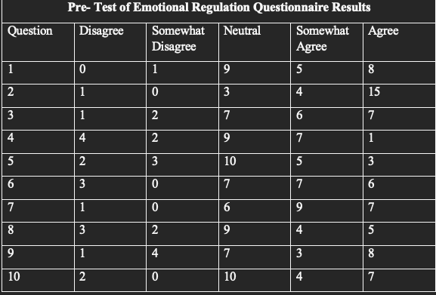
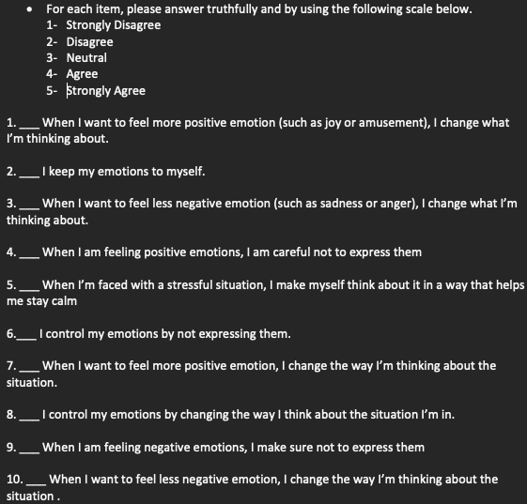
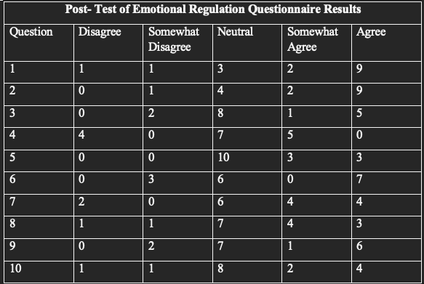
Can a Behavioral Program Help Children with Emotional Behavior Disorders? Ge’Keira Ashford, OTS; Dr. Brooks Wingo, PhD and Dr. Sarah Tucker, PhD OTR/L Department of Occupational Therapy | University of Alabama at Birmingham Dena Dickerson | Offender Alumni Association
Introduction
Results
Conclusion
Literature Review:
Emotional Behavior Disorder:
According to the Georgia Department of Education, an emotional behavior disorder is characterized by an individual who consistently expresses inappropriate behaviors and feelings, displays moods of unhappiness and unreasonable fears associated with personal or school problems, and the inability to build and maintain interpersonal relationships with peers, teachers, and other caregivers. (Bridgett Still, Georgia Department of Education, Emotional and behavioral disorder, 2023)
Behavioral Program:
Research on two behavioral interventions—parent management training (PMT) and cognitive-behavioral training—was done by Sukhodolsky et al. in 2016. (CBT). The study only served to highlight the need for additional investigation into the best ways to treat children with violent temper, mood, and anxiety issues (Sukhodolsky, et.al., 2016). The information collected shows a gap in or a lack of information about behavioral programs for the intended audience (children with EBD) in a school-based setting.
Overview of the Program:
Purpose:
Implement an 8- week behavioral program with focus on creating interventions catering to emotional regulation and coping skills for outburst behaviors to improve the participants emotional regulation and coping skills throughout a classroom and community-based setting. The following sections will explain the results of the pre/post survey and constructive commentary from the participants about their experience during the program.
Pre- Test Survey Results
Results
The results of the created and implemented 8- week emotional behavioral program highlight significant improvements in participants’ emotional regulation, behavioral management, and overall well-being. The data illustrates the effectiveness of the program in fostering love languages, positive changes, and enhancing participants’ coping mechanisms. Data also show that the results were inclusive due to more participants being involved in the program pre-survey vs. post- survey. These findings suggest the value of continued implementation and refinement of such programs to address emotional and behavioral challenges effectively.
In conclusion, while emotional behavioral programs play a vital role in supporting adolescents' mental health and emotional regulation, they are subject to various limitations that warrant attention and proactive mitigation strategies. By addressing issues of accessibility, cultural upbringing, sustainability, can work collaboratively to enhance the effectiveness and inclusivity of this program, ultimately empowering adolescents to thrive in their emotional intelligence and behavioral development. Future research endeavors aimed at exploring emotional behavioral programs offer tremendous potential for advancing the field of adolescent mental health and enhancing the effectiveness of intervention strategies. By addressing critical gaps in literature, embracing innovative methodologies, and fostering interdisciplinary collaborations, future researchers can contribute to the development of evidence- based practices that empower adolescents to thrive emotionally, socially, and psychologically.
References
Survey Questions
Post- Test Survey Results
Sukhodolsky, D. G., Smith, S. D., McCauley, S. A., Ibrahim, K., & Piasecka, J. B. (2016). Behavioral interventions for anger, irritability, and aggression in children and adolescents. Journal of Child and Adolescent Psychopharmacology, 26(1), 58–64. https://doi.org/10.1089/cap.2015.0120
Georgia Department of Education/ Bridgett Still “Program Specialist” . (n.d.). Emotional and behavioral disorder &nbsp; // Special Education Services and Supports. https://www.gadoe.org/Curriculum-Instruction-and-Assessment/SpecialEducation Services/Pages/Emotional%20and%20Behavioral%20Disorder.aspx#:~:text=%E2%80%8BAn%20emotional%20and%20behaioral,would%20include%20other%20care%20providers.
Gross, J.J., & John, O.P. (2003). Individual differences in two emotion regulation processes: Implications for affect, relationships, and well-being. Journal of Personality and Social Psychology, 85, 348-362.
Methods
Steps
Meet and Build Rapport with the participants for a week
Complete Pre-Test Survey
Based off survey, communicate with participants what they would like to improve and/or talk about when discussing emotions/behaviors
2. Create 8-Week Emotional Behavioral Program
5 Weeks of Gary Chapman’s “Five Love Languages”
3 Weeks of Proper/ Redirected Behavior Techniques
3. Implement 8- Week Program
Discussion/Intervention Topics Implemented:
Data Collection
Pre/post emotional behavior questionnaire from participants
Age demographic
Ranking of topics from participants determined intervention topics when creating program
Post implementation commentary on program from participants
*Inconsistency participating sample size each session, delayed start of program, and designated closed school days for holidays effected data retrieval.
Discussion
Limitations
Inconsistency of participation with adolescents each group intervention
Limited amount of time/ program not fully implemented due to school holiday breaks
Implications
Mental health- Awareness of mental health issues and impact on their education
Academic and social- Stress of pressure from social dynamics, parental academics expectations, and their own personal goals prompts the need for targeted interventions to support emotional regulation.
Family and peer dynamics- The support of peer involvement and community resources to address underlying stressors through interventions implemented in the program.
Positive classroom environment- Addressing and prioritizing interventions for emotional and behavioral issues in the classroom setting and community.
Key Areas for Future Research
Long- term outcomes- To be able to assess sustained benefits and identifying factors that contribute to lasting positive outcomes
Effectiveness across populations- Informs the development of culturally sensitive approaches that address the unique needs and challenges of different demographic groups
Integration of technology- Investigation of the efficacy of technology- driven approaches in delivering personalized interventions, facilitating remote support, and real- time monitoring of emotional well- being of an adolescent.
Preventive interventions- Focused on early identification of risk factors; protective strategies can inform targeted interventions that intervene proactively before problems escalate.
Family and community engagement- Exploration of the impact of family- centered interventions, peer support networks, and community based initiatives can inform holistic approaches that will promote resilience and well-being.
Neurological mechanisms- Investigating the underlying emotional regulation, stress response, and resilience can enhance our knowledge and understanding how emotional behavioral programs exert their effects at the neural level.
Acknowledgement & Contact information
I would like to thank my faculty and site mentors Dr. Brooks Wingo, Dr. Sarah Tucker, and Ms. Dena Dickerson for giving me assistance and guidance throughout completing this project. I would also like to thank the coaches and players of the Fairfield Preparatory High School football team for participating in my emotional behavioral program.
For any additional questions, Contact Ge’Keira Ashford at keira.ashford@yahoo.com or (205) 960- 7630

