Slide 1
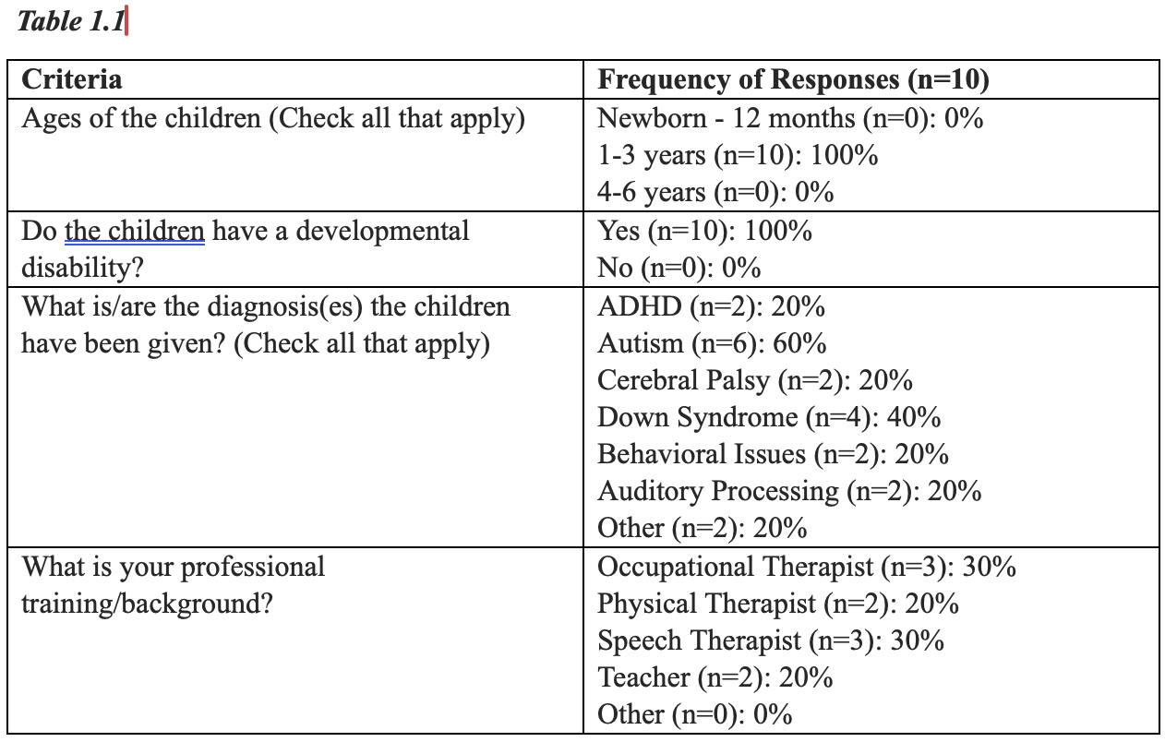
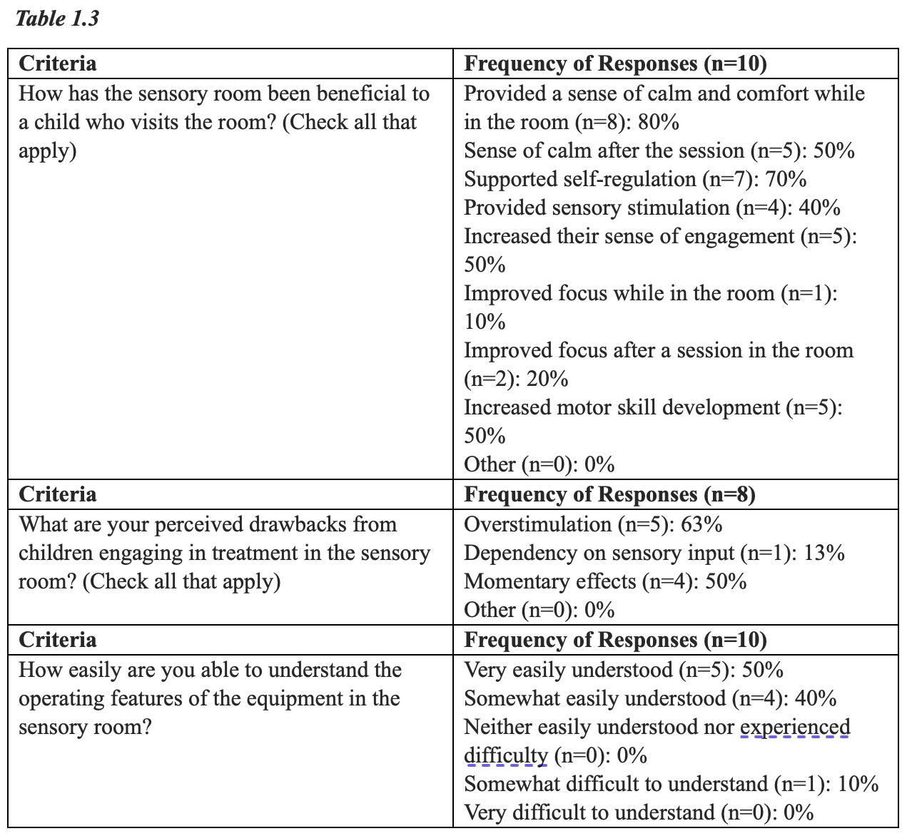
The Perspectives of Professionals of Behavior Exhibited by Children with Disabilities after Engagement in a Snoezelen Sensorimotor Room Treatment Rikia Baker, OTS; Megan Carpenter, OTD, OTR/L, SCFES Department of Occupational Therapy | University of Alabama at Birmingham Mary Laura Day, MSOT, OTR/L | The Bell Center
Introduction
Results continued
Discussion continued
The percentage of children diagnosed with a developmental disability (DD) increased significantly from 2009 to 2017, resulting in one out of every six children having one or more developmental disabilities (Zablotsky, 2019).
The National Health Interview Survey examined the prevalence of ten DDs in children aged three to seventeen in the U.S., revealing an overall increase from 16.2% to 17.7% (Zablotsky, 2019).
It is crucial to identify interventions for children with DDs and understand professionals' experiences with these interventions and their impact on children's behavior.
Multi-Sensory Environments (MSEs), like Snoezelen rooms, can assist with learning/development, relaxation, or energization for individuals with sensory processing issues (Snoezelen Multi-Sensory Environments, n.d.).
Snoezelen rooms, found in over 40 countries worldwide, are relatively new, requiring more research to demonstrate effectiveness on children with disabilities (Snoezelen Multi-Sensory Environments, n.d.).
These perspectives not only will enrich practitioners understanding, but also serve as a catalyst for inspiring additional research into the intricate features, techniques, and personalized strategies within the domain of MSE.
Respondents expressed a clear understanding of sensory room equipment, with majority reporting a positive impact on the therapeutic relationship. There was unanimous support for recommending sensory rooms in other facilities. Additional feedback emphasized the importance of therapist training in MSEs.
Drawbacks of MSE engagement:
Overstimulation common in MSEs, potentially leading to negative behavioral outcomes.
Negative behaviors attributed to overstimulation emphasize the need to tailor sensory experiences in MSEs to meet each child's specific needs.
Momentary effects result from immediate and intense sensory input.
Perceived drawbacks underscore potential challenges associated with MSEs.
Essential to consider these perceived drawbacks in designing and implementing MSEs for a balanced and effective approach addressing individual needs.
Additional Comments:
Varied ease in understanding sensory room features reported
Importance of therapist training emphasized in additional comments.
Practitioners advocate for recommending sensory rooms with proper training.
Engaged practitioners crucial for positive outcomes in MSEs.
Implications:
Findings can inform clinical practitioners in designing and implementing sensory interventions.
Implications for professional development and training in sensory rooms.
Educational settings can optimize sensory experiences for students.
Parents can make informed decisions about incorporating sensory interventions at home.
Insights used to improve the quality of sensory environments in facilities.
Limitations:
Limited sample size (10 participants).
Survey method may limit depth of insights.
Practitioner viewpoints dominate; children's perspectives not included.
Future research needed for a more comprehensive understanding.
Future Research:
Explore specific sensory room characteristics for different populations.
Investigate enduring effects of sensory interventions.
Delve into personalized approaches to sensory support.
Enrich wider research on sensory interventions for children.
Methods
Population: Practitioners, aged 18 or older, who treat a child(ren), aged birth to 14 years, with a disability in Snoezelen based therapy.
Recruitment Methods: Flyers were shared on UAB social media platforms. Recruitment also involved spreading the word through investigators, Bell Center Staff, and reaching out to organizations affiliated with the Christopher Douglas Hidden Angel Foundation.
Participate Information and Consent: Participants were given study details and the investigator's contact information. In the case of an interview, participants sign a HIPAA authorization form and are provided with a physical copy of the information sheet. Alternatively, survey questionnaire participants receive an electronic information sheet and give their consent through a Qualtrics click box.
Interview/Survey Process: Only survey questionnaires were conducted. If an interview had been chosen, participants could have opted for a face-to-face, videoconferencing, or teleconferencing format using the HIPAA-compliant Zoom platform. The HIPAA Zoom platform was designed to furnish a written transcription for the selected interview mode.
Data Storage and Access: All data was stored on a password-protected computer. Only the primary and co-investigator had access.
Data Analysis: Data was analyzed for common themes and sub-categories. Investigators discussed findings for theme and sub-theme validity. Final analysis established validity for practitioners perceptions and noted behavior changes
Conclusion
Discussion
A survey was conducted to examine the perspectives of professionals of behavior exhibited by children with disabilities after engagement in a Snoezelen sensorimotor room treatment. The findings suggest that sensory rooms can positively impact therapeutic relationships, foster engagement, and support self-regulation. However, there are also considerations such as the potential for overstimulation, monetary effects, and the importance of practitioner knowledge and training. These implications have relevance for clinical practice, educational settings, parental guidance, and further research endeavors. The study underscores the need for thoughtful design, individualized approaches, and ongoing professional development to optimize the effectiveness of sensory interventions for children.
Prevalence of Developmental Disabilities in MSE:
Autism was most prevalent.
MSEs are often used with autistic children due to their design promoting tranquility, focus, and comfort.
MSEs are designed for various interaction modalities, beneficial for all DDs mentioned in the survey.
Professional Diversity in MSE engagement:
Majority respondents were occupational and speech therapists.
OTs commonly use sensory rooms, but other professionals such as PTs, STs, and teachers also utilize them.
Research explores perspectives of teachers and teacher assistants in MSEs.
Sensory rooms often incorporated into group sessions for enhanced therapeutic experiences.
Therapeutic Benefits in MSEs:
Collective emphasis suggests a consensus among practitioners on the importance of emotional regulation strategies during sensory room sessions.
Visually captivating nature, engagement of auditory senses, and providing a multisensory experience were frequently cited contributing factors.
Positive impact extends to potential transferability of the established relationship to other settings, including the classroom.
Augmentation of peer interactions within the sensory room indicates broader implications of sensory interventions on interpersonal dynamics and relationships.
References
Snoezelen Multi-Sensory Environments (n.d.). History. https://www.snoezelen.info/history/
Zablotsky, B., Black, L., Maenner, M., Schieve, L., Danielson, M., Bitsko, R., Blumberg, S.,
Kogan, M. & Boyle, C. (2019). Prevalence and trends of developmental disabilities
among children the united states: 2009-2017. Pediatrics, 144(4). https://doi.org/10.1542/
peds.2019-0811
Results
This study involved 11 participants, of whom 8 successfully completed the survey. Initial questions were designed to screen participants according to inclusion criteria. Demographic data revealed respondents, primarily occupational and speech therapists, engaged with children aged 1-3 with developmental disabilities, such as autism and down syndrome. Findings indicated a concentration on behavior interventions, identifying bubble tubes as the most beneficial feature. Positive outcomes included calmness, self-regulation, engagement, and motor skill development, while drawbacks included overstimulation and momentary effects.
Acknowledgement & Contact information
Special thanks to Dr. Megan Carpenter, OTD, OTR/L, SCFES for guidance throughout this project and to Mary Laura, OTR/L.
For inquiries, please contact Rikia Baker at rbaker3@uab.edu. Your interest is valued.

