Slide 1
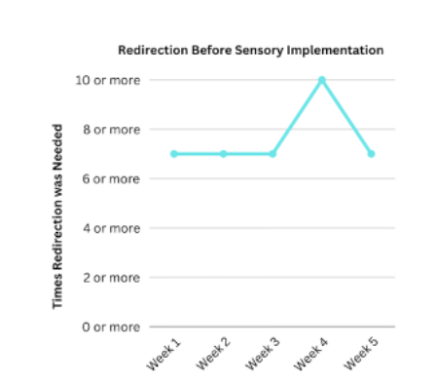
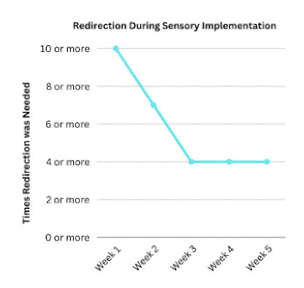
The Influence of Sensory Strategies on Focus and Success in School When Implemented in a Classroom from a Teacher's Perspective Allison Davis, OTS; Dr. Haley Curry, OTD, OTR/L Department of Occupational Therapy | University of Alabama at Birmingham MacKenzie Saunders | Woodland Pines Elementary School
Introduction
Results
Conclusion
The attention span of school-aged children has affected performance in the classroom due to ongoing technological advances. (Lai & Chang, 2020). Multi-sensory Environments (MSEs) are commonly incorporated in special-needs classrooms in schools to give the students a sense of control with the stimuli in their environment to increase their attention span (Unwin et al., 2021). Sensory strategies are used in children to influence learning and adaptive behaviors by incorporating auditory, vestibular, proprioceptive, tactile, and visual systems (Schaaf et al., 2010). By using these strategies effectively, distractions are minimized and the child’s ability to learn is enhanced (Roley et al., 2015).
Occupational therapists use sensory strategies in school settings to increase educational participation and task performance. The purpose of this study is to determine if providing sensory strategies in a typical classroom will positively affect focus and success in school-age students compared to students with no sensory equipment available during class. This project takes place at Woodland Pines Elementary school in MacKenzie Saunders' second-grade classroom.
Before the use of sensory equipment:
Students participated 60% of the time during class without needing redirection
Redirection needed 7-9 times daily
During the use of sensory equipment:
Students participated 69% of the time during class without needing redirection
Redirection needed 4-6 times daily after week one of sensory implementation
IMPLICATIONS
Data implies sensory equipment use during class can increase focus with students
Utilizing data within other schools/classrooms
FUTURE RESEARCH
Increase sample size and longer duration to increase reliable data
Study the effects of sensory equipment on health and wellness and academic grades in students
Further explore benefits of the Move 'N Sit cushion
References
1. Lai, Y. J., & Chang, K. M. (2020). Improvement of Attention in Elementary School Students
through Fixation Focus Training Activity. International journal of environmental research and public health, 17(13), 4780. https://doi.org/10.3390/ijerph17134780
2. Roley, S. S.., Bissell, J., & Clark, G. F. (2015). Occupational therapy for children and
youth using sensory integration theory and methods in school-based practice. The American Journal of Occupational Therapy, (69) 1. https://www.proquest.com/openview/70efbfefb9c2c2b0e8006e3729c1f73f/1?pq-origsite=gscholar&cbl=47935
3. Schaaf, R. C., Schoen, S. A., Roley, S. S., Lane, S. J., Koomar, J., & May-Benson, T. A.
(2010). A frame of reference for sensory integration. Frames of reference for pediatric occupational therapy (3rd ed., 99-186).
4. Unwin, K. L., Powell, G., & Jones, C. R. (2021). The use of Multi-Sensory
Environments with autistic children: Exploring the effect of having control of sensory changes. Autism: The International Journal of Research and Practice. https://doi.org/10.1177/13623613211050176
Methods
Implementing three pieces of sensory equipment into a second-grade classroom for 5 weeks for the students to use with collection of data through an in-person interview with the teacher at the end of each week.
15 participants; 7-8 years of age
Data Collection:
5 in-person interviews pre-sensory equipment implementation with Mrs. Saunders
5 in-person interviews during sensory equipment implementation with Mrs. Saunders
1 in-person interview post-sensory equipment implementation with Mrs. Saunders
Equipment used:
Move 'N Sit cushion
Clip with rough/soft Velcro pieces attached
TheraBand foot swing
Discussion
Redirection needed during class decreased with use of sensory equipment.
It took one week for the students to use the sensory equipment correctly and for it to not be distracting
The Move 'N Sit cushion was found most beneficial with students.
The clip with Velcro was found to be least beneficial and not used for intended purpose.
LIMITATIONS & AREA FOR IMPROVEMENT:
Small sample size
Weeks shortened due to Thanksgiving break
Not all children in class participated in study
Acknowledgement & Contact information
SPECIAL THANKS TO: MacKenzie Saunders, Dr. Haley Curry, Dr. Megan Carpenter
CONTACT INFO: Allison Davis; adavis2@uab.edu

