Slide 1
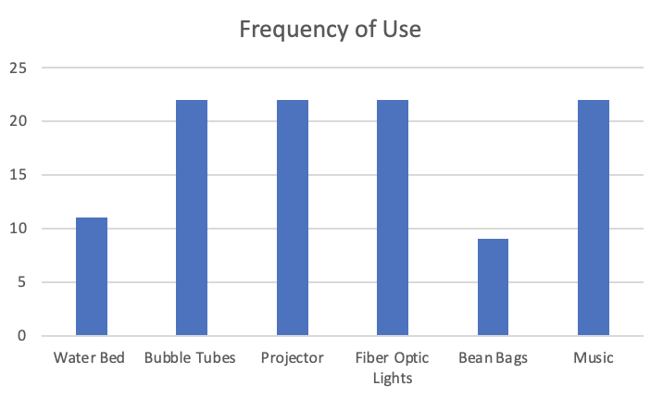
The Influence of Sensory Equipment in a Sensory Room on Students in a School System Allie Dillard, OTD/S; Haley Curry, OTD, OTR/L Department of Occupational Therapy | University of Alabama at Birmingham Karmen Mitchell, MS, OTR/L and Alisha Watson, OTR/L | Burkett Center
Introduction
Results
Discussion continued
Approximately 5% to 16.5% of people in the United States struggle with sensory integration (Miller et al., 2017).
Sensory processing challenges can have an impact on a person’s social interactions, emotional regulation, motor performance, and day-to-day functioning.
Sensory processing challenges become more evident as a child begins school. These challenges can create several barriers for a child in a classroom (Ayres, 2005).
Practitioners found that a sensory room provides benefits such as increasing levels of motivation, provides a child with a sense of control, and improves relationship building (Unwin et al., 2021).
The purpose of this study is to to research and identify the most beneficial sensory equipment to put in a sensory room for children. This study took place at Burkett Center, a Multi-Handicapped Center for students ages 3 through 21 years of age.
Implications: OTs have the unique ability to implement sensory equipment into their school-based interventions. This study bridges the gap in literature with results displaying the benefits student receive from the use of a sensory room. OTs can educate teachers and paraprofessionals on the uses of the sensory equipment. The teachers will be more likely to take their students into the sensory room if they feel comfortable and prepared to utilize the equipment properly.
Limitations: The results are based solely on the primary investigator’s observations. Different individuals may have varying opinions on the behavioral reactions to specific pieces of sensory equipment. Another limitation to this study is the varied response times from the parents.
Future Research: There is limited research on the benefits of sensory rooms, especially on this specific age group. Continued research could assist schools and other settings interested in building a sensory room.
The results from this study revealed that every piece of sensory equipment is being utilized with varying frequency.
The most utilized pieces of sensory equipment include the bubble tubes, fiber optic lights, music, and the projector.
No students cried or were upset when using the sensory room.
All students responded well. Students showed signs of relaxation through yawning and laying down, and signs of arousal by smiling and laughing.
Students who touched the equipment show more signs of increased stimulation and excitement. Students who observed the sensory equipment only, showed more signs of a calming effect.
Conclusion
All 15 students seemed to positively benefit from their time in the sensory room.
This was further evidenced by the lack of negative behaviors demonstrated by students in the sensory room.
Students either displayed signs of arousal through smiling or laughing, or signs of calmness through yawning and dozing off.
Continuing to provide the children with time in the sensory room will benefit their overall behavior and could lead to better classroom behavior.
Methods
Discussion
References
The recruitment process consisted of sending 54 flyers and consent forms home in the student’s backpacks.
32 consent forms were returned, and 15 students used the sensory room during the six-week observation period. Six students used the sensory room more than once during these six weeks.
A focus group was conducted with the school OTs to gather additional information on the sensory room.
Data was collected solely by observation, recording how often each piece of equipment is used with tally marks on a spreadsheet.
Practitioners found that a sensory room provides benefits such as increasing levels of motivation, provides a child with a sense of control, and improves relationship building (Unwin et al., 2021).
Bubble tubes, fiber optics, and projectors provide visual stimulation. Bubble tubes also provide tactile feedback through vibration.
Additional stimuli, such as music, whether quiet or lively, can be utilized to target the auditory system, creating a relaxing or stimulating environment.
Ayres, J. A. (2005). Sensory Integration and the Child: Understanding Hidden Sensory Challenges. Western Psychological Services.
Miller, L. J., Schoen, S. A., Mulligan, S., & Sullivan, J. (2017). Identification of sensory processing and integration symptom clusters: A preliminary study. Occupational Therapy International, 2017, 2876080. https://doi.org/10.1155/2017/2876080
Unwin, K. L., Powell, G., & Jones, C. R. G. (2021). A sequential mixed-methods approach to exploring the experiences of practitioners who have worked in multi-sensory environments with autistic children. Research in Developmental Disabilities, 118, 104061. National Library of Medicine. https://doi.org/10.1016/j.ridd.2021.104061
Acknowledgement & Contact information
I would like to thank both of my site mentors Karmen and Alisha for being so helpful throughout the capstone process. I would also like to thank my faculty mentor, Dr. Curry, for her academic guidance and support. Please contact me at eadillar@uab.edu.

