Slide 1
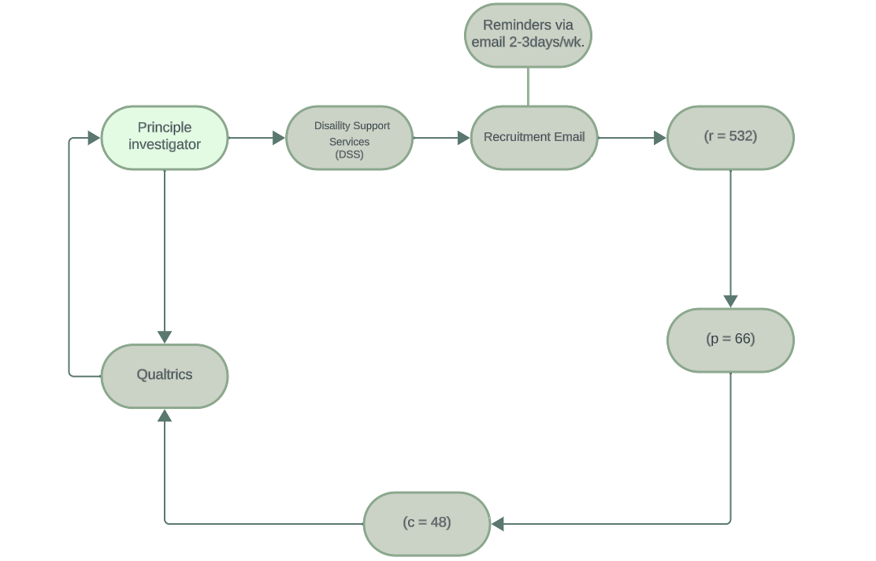
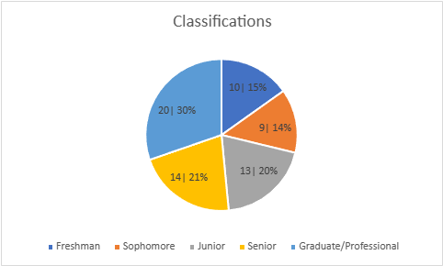
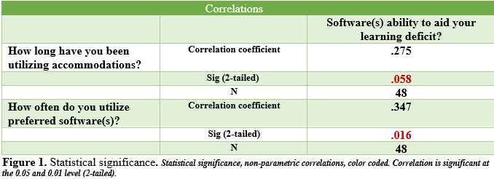
The Impact of Online Learning Aids on Academic Performance in Undergraduate Students with ADHD Jalysia Donaldson, OTS; Gavin Jenkins, PHD, OTR/L, ATP Department of Occupational Therapy | University of Alabama at Birmingham Jalan Cunningham, M. Ed , Case manager | UAB Disability Support Services
Introduction
Discussion continued
Attention Deficit Hyperactivity Disorder (ADHD) is a prevalent neurodevelopmental condition among college students registered with the Department of Disability Support Services (DSS) at an inner-city university. Of the student population registered, 30% are documented as having a diagnosis of ADHD and 9% other learning disabilities. The number of students pursuing post-secondary degrees with ADHD has increased over time. With the increase in diagnoses, accommodations have become a prevalent aid provided to these students. Aside from traditional accommodations, assistive technology or online learning software have become popular options offered by DSS of institutions nationwide. Disability support services for institutions of higher learning have increased efforts toward providing efficient academic accommodations. College students with learning disabilities have ranked assistive technology (online learning aids) highest among other accommodations^{4,5}. Furthermore, de-implementing inappropriate accommodations and straying from the one-size-fits-all approach of preliminary services is critical in efforts to better tailor accommodations to the specific needs of students with learning disabilities^{2,3}.
The purpose of this study was to investigate the perceptions held by students with ADHD/Learning Disabilities who utilize online learning aids provided by their university, and whether they feel the learning aids enhance their learning experience.
Online learning aids (software) of focus:
Notability
Glean
Otter AI
Dragon
Implications
The findings of this study have implications for how online learning software’s design influences the learning of students but more importantly innovative potentials that would allow students’ learning styles to have equal influence on software design. Foresight following outcomes underscore the potential for OT’s to serve as intermediary between students with ADHD/learning disorders and learning software (assistive technology).
Limitations
The way in which the survey questions were formulated, that is, multiple answer selections, reduced the efficiency of the statistical analysis run and both the quantity as well as the specificity of the correlations found.
Future Research
In-person satisfaction inquiry (survey)
Direct observation of online learning aid (software) utilization- investigation of user compatibility
Recipients (r = 532)
Participants (p = 66)
Completed (c = 48)
Nearly 10% of recipients participated in completion of the survey.
Results
Conclusion
Select variables (out of 14)
Respondents (27%) most commonly reported memory(recall) as primary learning deficit.
Frequency of utilization was reported “As necessary” (42%) and “5+ days/week” (24%).
Respondents reported duration of utilizing software at 1yr (38%) with 2yrs being the second most selected choice (24%).
Respondents (38%) reported “neither satisfied nor dissatisfied” with software’s simplification of course material.
Respondents reported general satisfaction (40%) with the presence of interactive components offered by the software utilized, and general satisfaction (42%) with software’s ability to aid their individualized learning deficits.
There was statistical significance (correlation) found amongst 3 variables
1) Duration of utilization
2) Frequency of utilization
3) Satisfaction with efficiency in addressing learning deficits
The study found that the longer students utilized online learning aid accommodations, the more likely they were to perceive them as beneficial. Over time, students become more familiar with features and learn to navigate the software more easily, which results in general satisfaction. Similarly, the study found that the more often students utilized the assigned software the more likely they were to perceive it as effective in aiding their learning deficit. Though the majority of respondents reported satisfaction with the software they utilized, feedback gathered through student commentary suggested the desire for specific modifications to learning aid software features that better address students’ individualized learning deficits.
Methods
References
A 15-question satisfactory survey (multiple choice, likert scale, and open-ended) was formulated by the principal investigator of this study and was distributed from August to November by the department of disability support service (DSS) at an inner-city, research-based institution of higher learning. Informational recruitment flyers were posted at specified locations on the university’s campus. Participants assigned learning aids (software)/assistive technology were recruited from an email listing of DSS cases registered under ADHD. Participants (n= 532) received a recruitment email, including an information letter as well as a direct link to the survey. The survey was made available through the online platform Qualtrics, and consent was gathered through the initial question. In-person observations, accommodation planning meetings (n= 55), were conducted for the duration of the survey’s accessibility. Inclusion criteria included registration with DSS under the diagnosis of ADHD and/or other learning disabilities alike; documented as receiving online learning aid accommodations; utilization of accommodations for at least one year. The criteria were selected to target college students with learning disabilities who were able to provide feedback relevant to the survey. All procedures were approved (exempt) by the institution’s office of the IRB.
The Spearman correlation coefficient (Spearman rho) was conducted to determine correlations between each of the survey’s variables. This method is used to determine the strength amongst two variables with ordinal data by way of ranking their numerical significance¹.
[1] Cronk, B. C. (2014). How to use SPSS statistics: a step-by-step guide to analysis and interpretation. [Internet Archive]. Glendale, CA: Pyrczak Publishing. (Accessed: 10 November 2023).
[2] Hsiao, F., Zeiser, S., Nuss, D., & Hatschek, K. (2018). Developing effective academic accommodations in higher education: A collaborative decision-making process. International Journal of Music Education, 36(2), 244-258.
[3] Lovett, B. J., & Harrison, A. G. (2021). De-implementing inappropriate accommodations practices. Canadian Journal of School Psychology, 36(2), 115-126
[4] Malcolm, M. P., & Roll, M. C. (2017). Assistive technology outcomes in post-secondary students with disabilities: the influence of diagnosis, gender, and class-level. Disability and Rehabilitation: Assistive Technology, 12(8), 857-867.
[5] Reinschmiedt, H. J., Sprong, M. E., Dallas, B., Buono, F. D., & Upton, T. D. (2013). Post-Secondary Students with Disabilities Receiving Accommodations: A Survey of Satisfaction & Subjective Well-Being. Journal of Rehabilitation, 79(3).
Discussion
Survey Results
The most commonly reported deficits were in executive function, attention, memory (recall), and processing. Although the software platforms help compensate for delays in translating speech to text when writing, delayed reading comprehension, and the ability to finish exams within the required period, they do not address more individualized, complex cognitive and functional deficits.
Trends found in responses and commentary reflect that DSS may use a one-size-fits-all method of assigning default accommodations across the broad spectrum of learning deficits experienced by students with ADHD/learning disabilities. However, overall general satisfaction was a result of prolonged and/or frequent utilization.
Acknowledgement & Contact information
Thanks to Dr. Jenkins, Dr. Carpenter, and Jalan Cunningham.
Contact information: Jalysia Donaldson donaldsj@uab.edu

