Slide 1
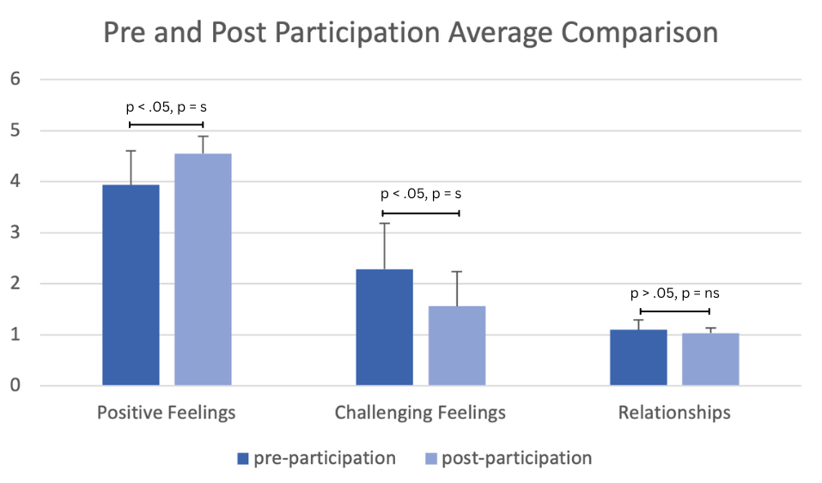
The Implementation of a Creative Occupations After-School Program Within Rural Elementary Schools Grace G. Elliott, OTS; Hon K. Yuen, Ph.D., OTR/L Department of Occupational Therapy | University of Alabama at Birmingham Sandra Groger, OTD, OTR/L | Limestone County School System
Introduction
Results
Discussion continued
Rural school systems face barriers such as lack of funding and resources that deprive students in rural school systems of many opportunities and benefits associated with involvement in creative arts activities.
Studies show arts and creative occupations are effective for:
Increasing student well-being
Positive youth development
Increasing self-esteem
Positive peer interactions
PERMA theory developed by Seligman claims the five measurable elements of one’s well-being include:
Positive emotion
Engagement
Relationships
Meaning
Accomplishment.
The PERMA model has been applied to a variety of interventions to investigate their effects on well-being.
Piney Chapel Elementary school is a Title I school in rural Alabama.
To qualify for Title I, a school must have a high concentration of students who are from low SES families.
The purpose of this study is to create and implement a creative occupations program for rural school students and assess its effects on student well-being.
Participants
12 male (60$)
8 female (40%)
Grades K-2: 12 participants (60%)
Grades 3-5: 8 participants (40%)
10 students (50%) were involved in extracurricular sports.
0 participants had participated in a creative occupations program.
20 participants (100%) reported they would participate again.
Significant increase in frequency of positive emotions (happy, excited, loved, safe).
Significant decrease in frequency of challenging emotions (sad, lonely, mad, worried).
No significant change in relationships, however higher number of participants reported possessing all 3 relationships (friend, teacher, and family member they can trust) post study.
Survey Results Continued:
The overwhelming majority of responses reported feeling positive emotions (happy, excited, fun) when asked about the program.
There was an overwhelming response favoring this program over other after-school programs.
Limitations and Areas of Improvement:
Small sample size.
Broaden study to more sites.
Inconsistencies among participation due to absences or changed pick-up time.
Social desirability response bias as Principal Investigator led group and distributed surveys.
Conclusion
Implications:
Pilot data supports the use of creative occupations program to boost the well-being among rural elementary school students.
Creative occupations can be integrated within interventions in a variety of settings to boost well-being while working towards specific patient goals (gross and fine motor control, executive functioning, attention etc.).
Future Research:
Increase literature regarding creative occupations and well-being within this population and others.
Integration of arts into other subject matter to support learning and classroom participation.
Methods
Created and implemented a 7-week creative occupation program.
Program themed Around the World:
Each week of activities were based on a different continent.
Students created a passport that was stamped each week.
Sessions included creative activities such as:
Dancing
Painting
Origami
Gross motor activities
Acting
Individual and group games
Two sessions per week at Piney Chapel Elementary School during after-school care.
Sessions split between two 45-minute groups.
Participants:
20 total participants; all students in a rural elementary school.
Pre and Post Participation Data:
PERMA Well-Being Survey used to assess well-being both before and after participating in program.
20 surveys collected pre and post participation.
Exit survey provided post-program..
Quantitative survey results regarding positive emotions, challenging feelings, and relationships were analyzed and compared pre- and post-participation.
Pre- and post-survey averages were compared and used a paired t-test to determine significance.
Trends among qualitative data noted in the discussion.
References
Martin, A. J., Mansour, M., Anderson, M., Gibson, R., Liem, G. A. D., & Sudmalis, D. (2013). The role of arts participation in students’ academic and nonacademic outcomes: A longitudinal study of school, home, and community factors. Journal of Educational Psychology, 105(3), 709–727. https://doi.org/10.1037/a0032795
Moula Z. (2021). "I didn't know I have the capacity to be creative": Children's experiences of how creativity promoted their sense of well-being. A pilot randomised controlled study in school arts therapies. Public Health, 197, 19–25. https://doi.org/10.1016/j.puhe.2021.06.004
Müllersdorf, M., and Ivarsson, A. (2016) What, why, how – Creative activities in occupational therapy practice in sweden. Occupational Therapy International, 23: 369– 378. doi:10.1002/oti.1438.
Zarobe, L., & Bungay, H. (2017). The role of arts activities in developing resilience and mental wellbeing in children and young people a rapid review of the literature. Perspectives in Public Health, 137(6), 337–347. https://doi.org/10.1177/1757913917712283
Discussion
Survey Results:
All students reported they would participate in a creative occupations program again.
Qualitative data shows great participant support for the program with positive themes regarding the study.
Qualitative data through interviews show increase in support and relationships from peers throughout this program along with more participants reporting having more relationships post program.
Acknowledgement & Contact information
SPECIAL THANKS TO: Dr. Megan Carpenter; Dr. Hon K. Yuen; Dr. Sandra Groger; Limestone County Schools
CONTACT INFO: Grace Elliott: jggraves@uab.edu

