Slide 1
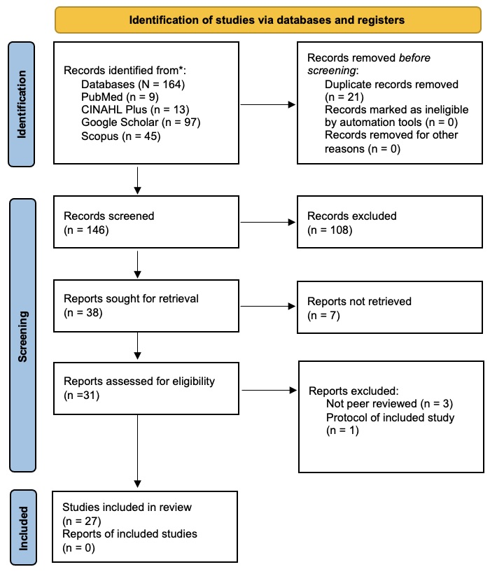
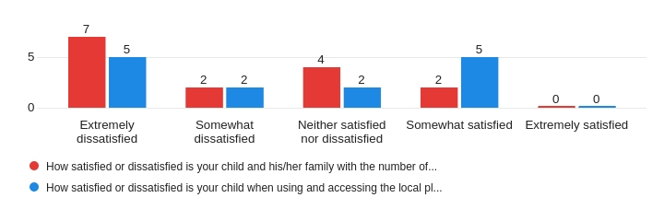
Inclusive Playgrounds: The Role of Occupational Therapy Michaelea Pass Gonder, OTD Student; Dr. Eidson, DOT Department of Occupational Therapy | University of Alabama at Birmingham Jeff Sharp, founder | Everyday Sunshine, Nonprofit Organization
Introduction
Results
Discussion continued
Play's Importance
Play holds significant importance in children’s development across cultures, especially when experienced outdoors. This outdoor play offers freedom and child-directed experiences, enhancing self-confidence, independence, and imaginative engagement.
Advocacy for Play
Various organizations, like the American Academy of Pediatrics (AAP) and the United Nations Convention on the Rights of the Child (UNCRC), stress play as a fundamental right for children. Despite this, legal support for children’s play remains inadequate in certain regions, impacting accessibility for children with disabilities.
Barriers to Play
Challenges related to accessibility and usability persist in community playgrounds, even those complying with ADA standards. These issues affect the experiences of children with disabilities, leading to isolation and limited participation.
Occupational Therapy’s Role
Occupational therapists (OTs) are committed to ensuring play opportunities for all children. Their expertise in adapting environments and understanding play dynamics positions them as potential leaders in designing inclusive playgrounds.
Capstone Purpose
Everyday Sunshine’s initiative aims to design an inclusive playground in Decatur, AL, focusing on evidence- and theory-based recommendations. This effort includes a mixed methods survey involving caregivers and OTs to gather insights and recommendations for the future playground, aligning with Everyday Sunshine’s vision and highlighting the potential role of OTs in designing inclusive spaces.
A total of 164 documents were screened in Covidence, resulting in 38 meeting the inclusion criteria after removing duplicates and conducting title/abstract screenings. Ultimately, 32 articles were included in the review (see Figure 1), including five found through manual searches. Of these, 15 were primary research utilizing qualitative, quantitative, or mixed methods, while 17 were various review types.
The comprehensive review identified four main themes in evidence-based playground design recommendations: accessibility, diverse play experiences, safety, and community engagement
The caregiver survey gathered insights on their child's playground visits and barriers hindering inclusion. Responses from 20 caregivers revealed diverse disabilities: autism spectrum disorder (4), ADHD (2), disruptive mood dysregulation disorder (1), and various other conditions. Seven children had cognitive ages younger than 14 despite being older. Playground visit frequency varied: some visited less than three times in a year, while others went multiple times a week. Figure 2 illustrates the correlation between caregiver satisfaction and local playground visit frequency.
Occupational Therapy's Role
OTs play a pivotal role in inclusive playground design due to their understanding of physical and social environmental impacts on children's play engagement and performance (supported by literature).
Insights from surveyed OTs indicate their potential contributions across different levels, such as providing education to families, advocating for inclusive design, and engaging with governmental bodies for funding and support.
Limitations
Exclusion of specific databases might have missed relevant articles from other sources.
Relying solely on peer-reviewed literature might have overlooked valuable insights.
Future research could explore broader criteria and less empirically supported practices for more inclusive playground designs.
The limited number of survey respondents affected the reliability of caregiver and OT responses.
However, qualitative survey data further supported recommendations found in the literature.
Figure 1
The PRISMA diagram of the study selection process (Moher et al. 2009)
Figure 2
Satisfaction with local playground visits, accessibility, and Usage
Conclusion
Conclusion
Study findings offer evidence-based and theory-based recommendations for inclusive playgrounds.
Recommendations enhance peer interaction among children with diverse abilities.
Theoretical approaches shed light on various factors influencing playground environments.
Insights from the study have broader implications for organizations, architects, and schools aiming to create or improve inclusive playgrounds.
This study contributes to expanding research for more inclusive playgrounds globally, recognizing the needs of all children.
Promotes the engagement of occupational therapy in planning inclusive playgrounds and underscores the profession's impactful role in supporting these initiatives.
Methods
Discussion
References
A literature review and a mixed-methods web-based survey were conducted to provide Everyday Sunshine with a summarized description of evidence-based playground design recommendations for children with and without disabilities. These methods aimed to answer the following question: Are there evidence-based playground design recommendations to promote inclusion among children with and without disabilities?
Research Protocol: Literature Review
Following PRISMA guidelines, the author used the following databases: CINAHL Plus, Scopus, Google Scholar, and PubMed.
The criteria required articles to focus on outdoor play spaces like community or school-based playgrounds. They needed to address playground design factors impacting use and be published in peer-reviewed journals. Participants could include children with or without disabilities, caregivers, or professionals specializing in children with disabilities. Articles measuring outcomes other than play, like reducing undesirable behaviors or enhancing physical activity, were excluded.
The search focused on terms like "children with and without disabilities," "playgrounds," "inclusive design," "recommendations," and "play," combined using MeSH terms, Boolean operators, and wildcards (*) for broader results
Research Protocol: Survey
The University of Alabama at Birmingham’s (UAB) Institutional Review Board (IRB) approved the study's involvement of human subjects. A web-based survey, open for two months, engaged caregivers of children with disabilities and professionals. It included multiple-choice, closed-ended, open-ended, and Likert-scale questions. The survey covered demographics, quantitative data on playground use and satisfaction, and qualitative insights into barriers faced by children with disabilities. Questions were designed in collaboration with Everyday Sunshine's founder, Jeff Sharp, to align with their inclusive playground mission
The survey targeting occupational therapists (OTs) used open-ended questions to gather their insights on inclusive design recommendations, occupational therapy's role in removing inclusion barriers, and their perception of their role in promoting inclusive playgrounds. These questions were chosen after a thorough literature review.
The study population for the survey included caregivers of children with disabilities who were cognitively younger than 14 years old. OT professionals who specialize in children with disabilities were also included and had to be employed in a child-based setting to participate in the survey.
The survey was sent via email to nonprofits like Everyday Sunshine, The Arc of Morgan County, and the Alabama Disabilities Advocacy Program (ADAP), and shared on Everyday Sunshine's social media. Pediatric therapy clinics were asked to distribute the survey flyer. Participants accessed the survey through a QR code or link, received a study consent letter, and took less than 30 minutes to complete it. No compensation was provided, and participants could withdraw anytime without consequences
The survey was developed and orchestrated using Qualtrics (https://www.qualtrics.com), accessed by the UAB. The survey results were organized using a deductive approach to the value codes related to the research questions. These codes include physical and nonphysical barriers, and physical and nonphysical design recommendations. The themes identified after completing a thematic analysis and a summary of the survey responses will be discussed in further detail.
This review revealed key playground design elements crucial for inclusivity: safety, accessibility, community engagement, and diverse play experiences. Caregiver feedback emphasized the need for inclusive playgrounds, correlating their non frequent visits with negative experiences. Caregivers and OTs highlighted design insights to overcome barriers. The discussion used the Person-Environment-Occupation-Performance (PEOP) model to explore the interaction among individuals, the playground environment, and play occupation, shaping participation and performance. Integrating evidence-based design, survey insights, and the PEOP model aimed to comprehensively understand playground design for fostering inclusion.
The PEOP Model: Person
Involves psychological, neuro-behavioral, cognitive, and physiological traits (Christiansen, Bass, & Baum, 2015).
An inclusive playground accommodates diverse individuals and populations..
Both typical and non-typical children possess unique abilities aligned with their development, influencing their play and learning during experiences.
Playground designs should cater to varying levels of play experience.
Christiansen, C. H., Bass, J. D., & Baum, C. M. (2015). Occupational therapy: Performance, participation, and well-being. (4th ed). SLACK Incorporated.
Bento, G., & Dias, G. (2017). The importance of outdoor play for young children’s healthy Development. Porto Biomedical Journal, 2(5), 157–160. https://doi.org/10.1016/j.pbj.2017.03.003
Brown, D. M. Y., Ross, T., Leo, J., Buliung, R. N., Shirazipour, C. H., Latimer-Cheung, A. E., & Arbour-Nicitopoulos, K. P. (2021). A scoping review of evidence-informed recommendations for designing inclusive playgrounds. Frontiers in Rehabilitation Sciences, 2, 664595. https://doi.org/10.3389/fresc.2021.664595
Burke, J. (2013). Just for the fun of it: Making playground accessible to all children. World Leisure Journal, 55(1), 83-95. https://doi.org/10.1080/04419057.2012.759144
Brussoni, M., Gibbons, R., Gray, C., Ishikawa, T., Sandseter, E., Bienenstock, A. & Tremblay, M. (2015). What is the relationship between risky outdoor play and health in children? a systematic review. International Journal of Environmental Research and Public Health, 12(6), 6423-6454. https://doi.org/10.3390/ijerph120606423
Dalpra, M. (2022). Rethinking play environments for social inclusion in our communities. Studies in Health Technology and Informatics, 297, 218–225. https://doi.org/10.3233/SHTI220842
Fernelius, C. L. & Christensen, K. M. (2017). Systematic review of evidence-based practices for inclusive playground design. Children, Youth and Environments, 27(3), 78-102. https://doi.org/10.7721/chilyoutenvi.27.3.0078
Gately, K.A., Zawadzki, A. H., Mosley, A. M., Badua, A. K., Swanberg, J. E., & Rosenthal, S. R. (2023). Occupational injustice and the right to play: A systematic review of accessible playgrounds for children with disabilities. The American Journal of Occupational Therapy, 77(2). https://doi.org/10.5014/ajot.2023.050035
Ginsburg, K. R., Committee on Communications, & Committee on Psychosocial Aspects of Child and Family Health. (2007). The Importance of play in promoting healthy child development and maintaining strong parent-child bonds. In Pediatrics, 119 (1), 182–191. https://doi.org/10.1542/peds.2006-2697
Dyment, J. & O'Connell, T. S. (2013). The impact of playground design on play choices and behaviors of pre-school children. Children's Geographies, 11(3), 263-280. https://doi.org/10.1080/14733285.2013.812272
Eichengreen, A., Rooijen, M. V., Klaveren, L.M.V., Nasri, M., Tsou, Y.T., Koutamanis, A., Baratchi, M., & Rieffe, C. (2023). The impact of loose-parts-play on schoolyard social participation of children with and without disabilities: A case study. Child: Care, Health and Development, 1–15. https://doi.org/10.1111/cch.13144
Harper, N. J., Lim, C., Alqallaf, H., & Naylor, P. J. (2021). A case study exploring the “real world” process of “naturalizing” school playgrounds. International Journal of Environmental Health Research, 31(3), 298–314. https://doi.org/10.1080/09603123.2019.1656174
Harris, K., Rosinski, P., Wood-Nartker, J., & Hill, R. (2022). Developing inclusive playgrounds that welcome all children—Including those with autism. Review Journal of Autism and Developmental Disorders. https://doi.org/10.1007/s40489-022-00345-3
James, M. E., Jianopoulos, E., Ross, T., Buliung, R., & Arbour-Nicitopoulos, K. P. (2022). Children’s usage of inclusive playgrounds: A naturalistic observation study of play. Int. J. Environ. Res. Public Health, 19(20), 13648. https://doi.org/10.3390/ijerph192013648
Jansens, R., Prellwitz, M., Olofsson, A., & Lynch, H. (2023). The representation of children’s participation in guidelines for planning and designing public playspaces: A scoping review with “best fit” framework synthesis. Int. J. Environ. Res. Public Health, 20, 5823. https://doi.org/10.3390/ijerph20105823
Kianfar, K., & Brischetto, A. (2021). All play together: Design concepts of a sensory play equipment aimed to an inclusive play experience. In S. S. Editor., B. D. Editor., F. S. G. Editor., Y. G. M. Editor., C. C. Editor (Eds.), Advances in Industrial Design, (pp. 435 -445). Springer International Publishing. https://doi.org/10.1007/978-3-030-80829-7_54
Mejeur, M., Schmitt, G., & Wolcott, H. (2013). A systematic review of the best practices for playground inclusion. Pediatrics, 1. https://scholarworks.gvsu.edu/ot_pediatrics/1
Movahed, M., Martial, L., Poldma, T., Slanik, M., & Shikako, K. (2023). Promoting health through accessible public playgrounds. Children, 10(8), 1308. https://doi.org/10.3390/children10081308
Moore, A., Boyle, B., & Lynch, H. (2023). Designing for inclusion in public playgrounds: A scoping review of definitions, and utilization of universal design. Disability and Rehabilitation. Assistive Technology, 18(8), 1453-1465. https://doi.org/10.1080/17483107.2021.2022788
Moore, A., Lynch, H., & Boyle, B. (2022). A national study of playground professionals universal design implementation practices. Landscape Research, 47(5), 611-627. https://doi.org/10.1080/01426397.2022.2058478
Moore, A., Lynch, H., & Boyle, B. (2020). Can universal design support outdoor play, social participation, and inclusion in public playgrounds? A scoping review. Disability and Rehabilitation, 44(13), 3304-3325, https://doi.org/10.1080/09638288.2020.1858353
Moore, A. & Lynch, H. (2015). Accessibility and usability of playground environments for children under 12: A scoping review. Scandinavian journal of occupational therapy, 22(5), 331–344. https://doi.org/10.3109/11038128.2015.1049549
Morgenthaler, T., Schulze, C., Pentland, D., & Lynch, H. (2023). Environmental qualities that enhance outdoor play in community playgrounds from the perspective of children with and without disabilities: A scoping review. International journal of environmental research and public health, 20(3), 1763. https://doi.org/10.3390/ijerph20031763
Perry, A. M., Devan, H., Fitzgerald, H., Han, K., Liu, L., & Rouse, J. (2018). Accessibility and usability of parks and playgrounds. Disability and Health Journal, 11(2), 221-229. https://doi.org/10.3389/fpsyg.2022.995164
Prins, J., Wilt, F.V.D., Veen, C., & Hovinga, D. (2022). Nature play in early childhood education: A systematic review and meta ethnography of qualitative research. Frontiers in Psychology. 13, 995164. doi: 10.3389/fpsyg.2022.995164
Ndhlovu, S., & Varea, V. (2018). Primary school playgrounds as spaces of inclusion/exclusion in new south wales, australia. Education 3-13, 46(5), 494-505. https://doi.org/10.1080/03004279.2016.1273251
Stanton-Chapman, T. L., & Schmidt, E. L. (2019). Building playgrounds for children of all abilities: Legal requirements and professional recommendations. Early Childhood Educ, 47(1), 509–517. https://doi.org/10.1007/s10643-019-00947-3
Stanton-Chapman, T. L., & Schmidt, E. L. (2017). Caregiver perceptions of inclusive playgrounds targeting toddlers and preschoolers with disabilities: has recent international and national policy improved overall satisfaction?. J Res Spec Educ Needs, 17(4), 237-246. https://doi.org/10.1111/1471-3802.12381
Stanton-Chapman, T. L., & Schmidt, E. L. (2016). Special education professionals’ perceptions toward accessible playgrounds. Research and Practice for Persons with Severe Disabilities, 41(2), 90-100. https://doi.org/10.1177/1540796916638499
Sterman, J., Villeneuve, M., & Spencer, G. (2019). Creating play opportunities on the school playground: Educator experiences of the Sydney playground project. Aust Occup Ther J, 67(1), 62–73. https://doi.org/10.1111/1440-1630.12624
Taylor, L. G., Primucci, M., Vanderloo, L. M., Arbour-Nicitopoulos, K. P., Leo, J., Gilliland, J., & Tucker, P. (2023). A scoping review of tools to evaluate existing playgrounds for inclusivity of children with disabilities. Frontiers in Rehabilitation Sciences, 4. https://doi.org/10.3389/fresc.2023.1102490
Therrien, M. C. S., Barton-Hulsey, A., & Wong, S. (2022). A scoping review of the playground experiences of children with AAC needs. Augmentative and Alternative Communication, 38(4), 245-255. https://doi.org/10.1080/07434618.2022.2155874
United Nations (1989). Convention on the rights of the child. Treaty Series, 3, 1577. https://www.ohchr.org/en/professionalinterest/pages/crc.aspx
Wenger, I., Prellwitz, M., Lundström, U., Lynch, H., & Schulze, C. (2023). Designing inclusive playgrounds in switzerland: why is it so complex?. Children's Geographies, 21(3), 487-501. https://doi.org/10.1080/14733285.2022.2077093
Wenger, I., Lynch, H., Prellwitz, M., & Schulze, C. (2023). Children’s experiences of playground characteristics that contribute to play value and inclusion: Insights from a meta-ethnography. Journal of Occupational Science, https://doi.org/10.1080/14427591.2023.2248135
Wenger, I., Schulze, C., Lundström, U., & Prellwitz, M. (2021). Children’s perceptions of playing on inclusive playgrounds: A qualitative study. Scandinavian Journal of Occupational Therapy, 28(2), 136-146. https://doi.org/10.1080/11038128.2020.1810768
Woolley, H. (2013). Now being social: The barrier of designing outdoor play spaces for disabled children. Child Soc, 27(6), 448-458. https://doi.org/10.1111/j.1099-0860.2012.00464.x
Yildirim, Y., Keshavarzi, G. & Aman, A.R. (2022). Does play-based experience provide for inclusiveness? A case study of multi-dimensional indicators. Child Ind Res, 15, 2197–2214. https://doi.org/10.1007/s12187-022-09951-3
Young, N. A. E. (2021, March). Childhood disability in the United States: 2019. Census.gov. https://www.census.gov/content/dam/Census/library/publications/2021/acs/acsbr-006.pdf
PEOP Model: Environment
Physical Environment:
Playground safety and risk management: Single entry/exit points, lighting, shaded zones, routine maintenance (literature).
Safety measures: Soft flooring, spacious areas, brightly colored surfaces near hazard areas, caregiver accessibility to assist if needed (literature and surveyed caregivers).
Separate play areas for younger children due to safety concerns (literature).
Accessibility considerations: Convenient location, parking, ground surfacing, restrooms, water fountains (literature and surveyed caregivers).
Adaptations for elevated structures: Ramps with handgrips and a gradual incline, transfer systems, shorter steps (literature and surveyed OTs).
Equipment accessibility: Spaces for diverse abilities (literature and surveyed caregivers/OTs).
Social Environment:
Recommendations: Community engagement, advocacy campaigns, trained playworkers, peer buddy systems (literature and surveyed caregivers).
Strategies for positive social interactions: Group activities, awareness programs (literature and surveyed caregivers).
PEOP Model: Occupation, Participation, and Performance in Play
Diverse Play Experiences:
Various play types are crucial for inclusive playgrounds: constructive, motor, imaginative, and social play (supported by literature).
Tailoring play experiences to accommodate different abilities and ages is vital to ensure inclusivity.
Sensory-Enriching Activities:
These activities are foundational for providing diverse play experiences (supported by literature).
Recommendations include incorporating varying sensory intensity levels and dispersing sensory activities throughout the playground to prevent overstimulation, as noted in both literature and insights from surveyed caregivers/OTs.
Opportunities for Self-Challenge:
Offering diverse and varied play experiences is essential for inclusivity, catering to different abilities and developmental stages (supported by literature).
The importance of multiple access methods, such as ramps, climbing walls, and steps, to encourage inclusivity as highlighted in literature and responses from surveyed OTs.
Usability of Playground Spaces:
The usability of playground elements, alongside accessibility, is crucial for inclusive play experiences (supported by literature).
Recommendations include ensuring predictability in play components, usability enhancements, and limiting overly complicated equipment, in line with the literature findings and insights from surveyed caregivers/OTs.
Acknowledgement & Contact information
Email: Map2@uab.edu

