Slide 1
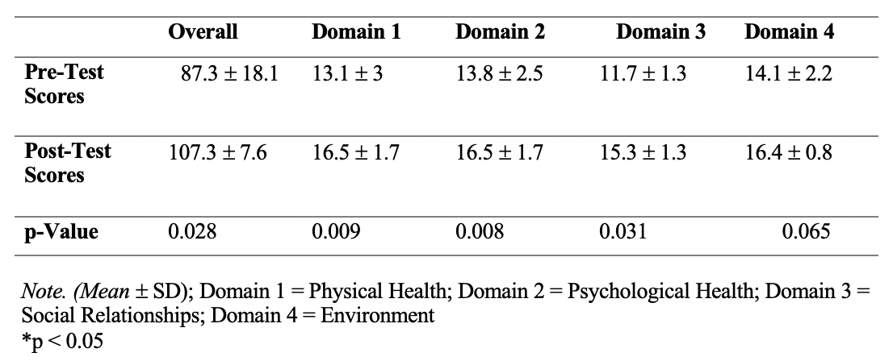
The Implementation of the Occupation of Play within Skilled Nursing Facilities Katie Jackson, OTS; Jason Vice, PhD, OTR/L, SCLV Department of Occupational Therapy | University of Alabama at Birmingham Raven Green, MSOT, OTR/L | Aspire Physical and Recovery Center at Cahaba River
Introduction
Results (continued)
Discussion (continued)
Current data reveals prevalent mental health issues, notably depression, in older adults in skilled nursing facilities (SNFs) (Stickle & Onedera, 2006; Fuss, 2010). This links closely to a lack of meaningful activities in these facilities (Morley et al., 2014). Despite attempts to provide recreational opportunities, research consistently shows their inadequacy, marked by inconsistent participation and poor emotional resonance (Mansbach et al., 2014). While play therapy has succeeded in addressing challenges in children (Bratton, 2000), its potential for older adults remains underexplored, necessitating additional research (Fuss, 2010; Ballard et al., 2001; Brooker et al., 2007).
This capstone project aims to explore how play, as a meaningful activity, enhances the overall quality of life (QoL) for nursing home residents. The findings contribute to existing knowledge by demonstrating the effectiveness of play therapy in improving QoL, reducing geriatric depression symptoms, and fostering increased social participation. This supports and extends previous research while holding promise for guiding future endeavors in play therapy for older populations.
WHOQOL-BREF Scores: Significant overall improvement with notable enhancements in 75% of domains (1-3), particularly in Physical Health, Psychological Health, and Social Relationships. However, Domain 4 revealed a non-significant difference (p = 0.065). Figures 1 and 2 and Table 2 present detailed results.
Thematic Analysis: Five overarching themes emerged: Meaningfulness and Novelty, Reduction in Isolation, Choice and Autonomy, Stimulation and Motivation, and Overall QoL Enhancement. Participants enjoyed novel activities, emphasizing positive impacts on happiness. Reduced social isolation, choice importance, mental stimulation, and overall QoL enhancement were recurrent themes, highlighting multifaceted benefits.
Implications for OT Practice: Positive study outcomes present an incentive for occupational therapists (OTs) to explore and integrate play therapy. OTs, uniquely positioned in leisure and play, can use play therapy as a co-occupation. Integrating it into sessions may enhance client participation, willingness for therapeutic activities, and positive assessment progress.
Limitations: Small sample size—only four participants—with a skewed gender distribution. Reliance on self-report questionnaires poses potential bias, as responses may be shaped under social desirability or perceived scrutiny. The study site's prevalence of patients with dementia and complex medical conditions, coupled with specific physical limitations, constrained the eligible participant pool. Additionally, the relatively short study duration warrants consideration.
Future Research: Discovering effective play activities tailored to older adults' cognitive abilities and preferences is crucial. Delving into the long-term impacts on QoL and depression promises a deeper understanding of play therapy's efficacy. Encouraging larger sample sizes and extended study durations is paramount for research consistency and validity, fostering the evolution and effectiveness of play therapy, particularly for older populations.
Table 2: WHOQOL-BREF Calculation Results
Methods
Figure 1: WHOQOL-BREF Overall Mean Score
Figure 2: WHOQOL-BREF Domain Mean Scores
Study design: Mixed-methods design using pre-test/post-test self-report questionnaires, including a leisure interest assessment (LIA), World Health Organization Quality of Life scale (WHOQOL-BREF), Geriatric Depression Scale (short form) (GDS), and a post-test exit survey.
Population: Focused on long-term residents aged 18 to 90+, excluding individuals with dementia or Alzheimer's disease.
Recruitment: Direct subject approach and word-of-mouth referral. Gathered simple demographic information. Utilized convenience sampling for group-based interventions.
Data Collection: Pre-test LIA, WHOQOL-BREF, and GDS questionnaires. Post-test re-administration of WHOQOL-BREF and GDS. Qualitative data collected through an investigator-created post-test survey.
Quantitative Assessments: LIA guided individualized activities. GDS and WHOQOL-BREF provided quantitative data on depression levels and QoL. Post-test survey captured qualitative data on program benefits.
Study Sessions: Study group participated in 60-minute play-based activity sessions twice a week over 10 weeks.
Data Storage: Securely stored in UAB's Qualtrics system for participant anonymity. Qualitative findings underwent coding and analysis for common themes. Data analysis involved descriptive statistics and significance assessment. Access to data is restricted, and data will be deleted after a five-year retention period.
Conclusion
The study addresses a notable research gap in play therapy for older individuals, highlighting its potential benefits within SNFs. Contrary to limited existing research, this study provides evidence that implementing play therapy significantly enhances QoL and reduces geriatric depression scores among residents. The outcomes underscore a promising trajectory, urging OTs to integrate recreational services with therapeutic practices. Despite limited current research, this study serves as a catalyst, inspiring future researchers to contribute to the evolving landscape of play therapy for older populations.
GDS Scores: Decreased or stagnant depression risk, with a non-significant difference (p = 0.941) between pre-test (M = 4.5, SD = 4) and post-test (M = 1.3, SD = 1.3). Refer to Table 3.
Table 3: Geriatric Depression Scale Scores
References
Investigator-Created Survey: Revealed 100% "yes" responses to 8 out of 10 questions, indicating improved self-esteem, decreased social isolation, and increased overall QoL; Themes from a 3-person coded thematic analysis emerged: Meaningfulness and Novelty, Group Participation Decreases Isolation, Choice and Autonomy, Stimulation and Motivation, and Engagement in Desired Activities Improves QoL.
Results
Discussion
Acknowledgement & Contact information
Demographics: 3 females, 1 male; M= 87.5 years (range: 82 to 94 years);Varying residency durations (3 months to 2+ years, M = 23.5 months, SD = 30.17; (n = 0) reported Alzheimer's disease or dementia, (n = 1) reported a history of depression
LIA: Identified common interests in games, creative expression, social outings, and nature across participants
Quality of Life: Statistically significant improvements occurred in 75% of assessed domains—Physical Health, Psychological Health, and Social Relationships. Play therapy notably influenced beliefs in physical, psychological, and social factors. However, Domain 4, evaluating the Environment, showed no statistically significant change.
Geriatric Depression: While there was not a statistically significant difference in scores, there was a consistent trend: scores either decreased or remained stable. Participants at risk of depression notably improved.
Special thanks to Raven Green, my site mentor, and the rest of the therapy staff at Aspire Physical Recovery Center at Cahaba River for their warm support. Gratitude to Dr. Jason Vice for guidance throughout this project. The success of this endeavor is a result of the collaborative efforts of all involved.
For inquiries, please contact Katie Jackson at ekjackso@uab.edu.

