Slide 1
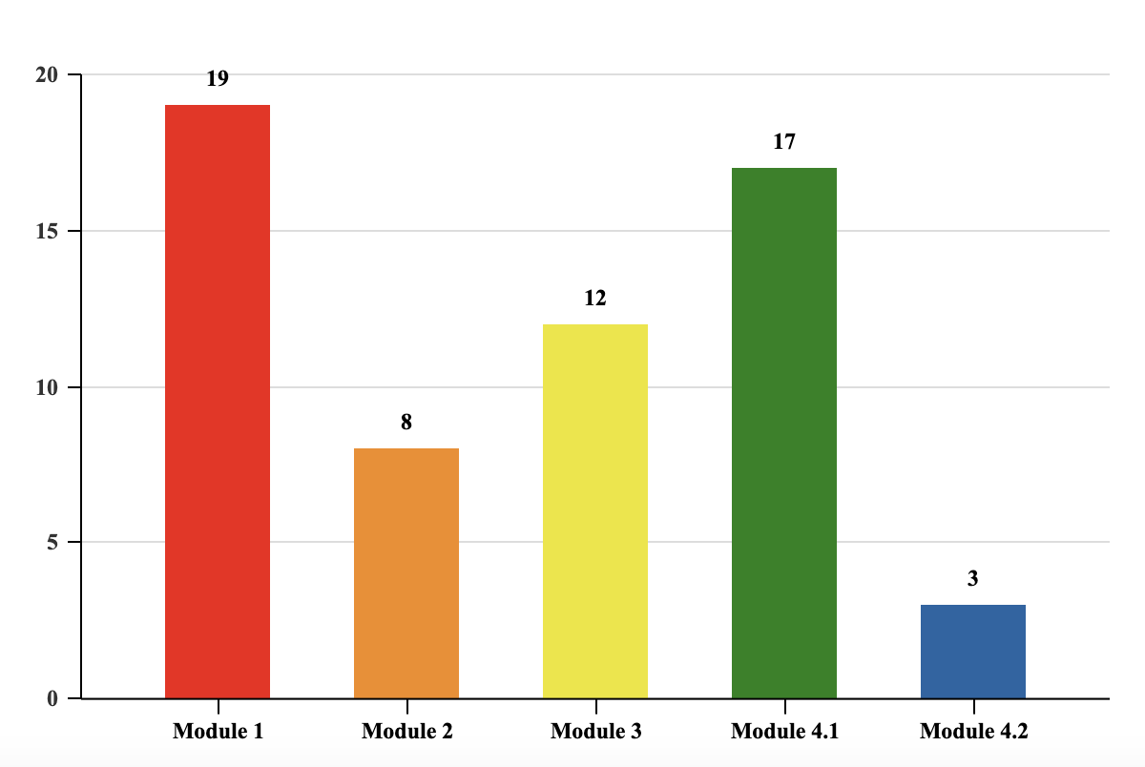
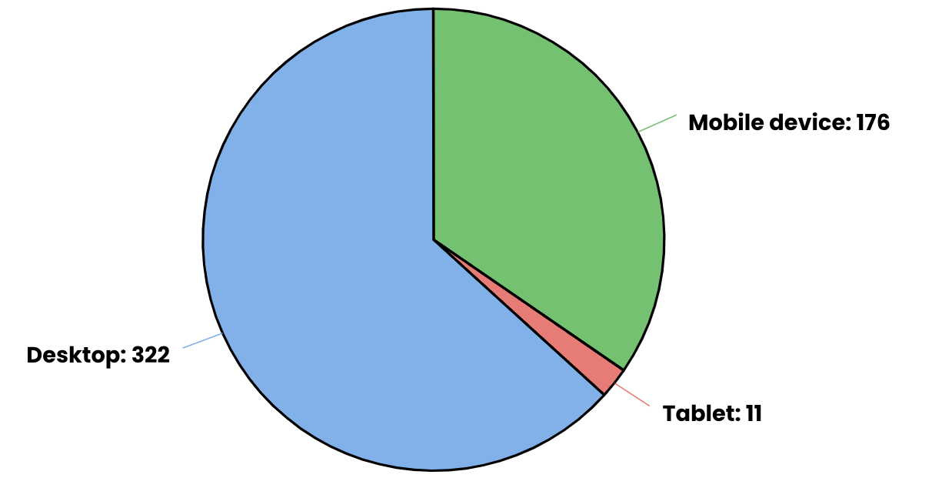
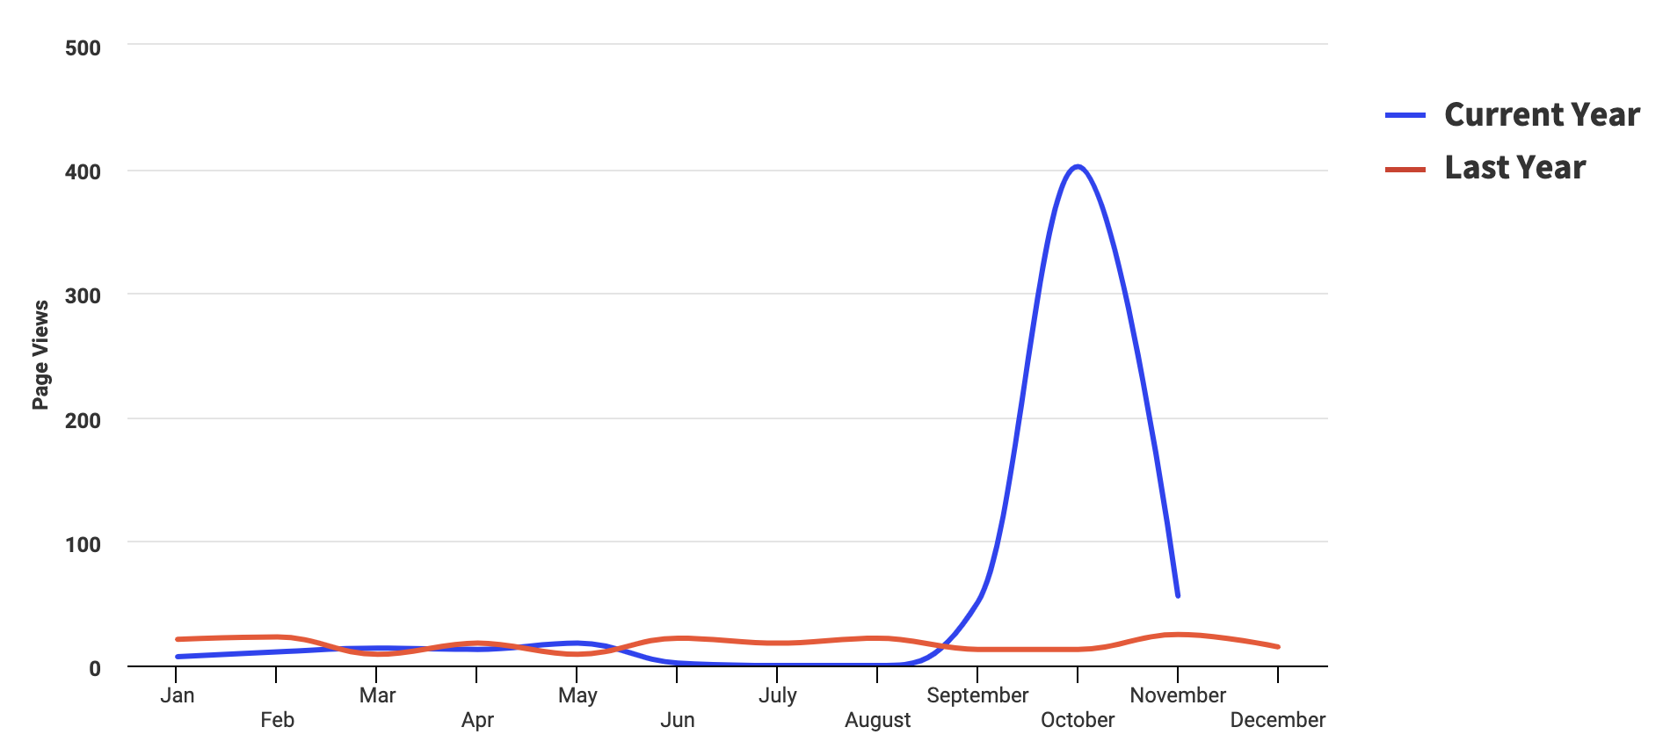
A Trauma Informed Education Program for Foster, Kinship, and Adoptive Caregivers Education for Adverse Feeding and Mealtime Behaviors, Early Condition Detection, Interventions, and Available Resources Carlee Leatherman, OTS; Megan Carpenter, OTD, OTR/L, SCFES Department of Occupational Therapy | University of Alabama at Birmingham Rachel Ashcraft, MS, OTR/L, TBRI® Practitioner | Foster the Future Alabama
Introduction
Results
Discussion
Research suggests that foster parents expressed interest in an at-home training program and had positive attitudes toward online training due to the flexibility it provides (Kaasbøll et al., 2019).
According to Helton et al., (2016), education is needed for foster parents that target specific nutritional information and preparing and presenting food, as well as a need for education on physical, emotional, and behavioral symptoms of over and undereating and ways to approach food-related difficulties.
The purpose of this project was to design and implement an online education program to foster, kinship, and adoptive parents on trauma-informed feeding practices aiming to assist the caregiver in addressing adverse mealtime and feeding behaviors, early condition detection, the implementation of practical skills, and the understanding of available resources. In addition, the program was evaluated based on caregivers’ perspectives.
Conditions and behaviors common in children with histories of trauma include:
Overeating
Undereating
Stealing
Hoarding
PICA and other eating disorders
Exhibiting extreme aversions to certain foods
Recognizing and addressing these issues through trauma-informed education is essential for promoting both physical and emotional health and reducing traumatization. It can lead to healthier eating habits, improved relationships, reduced behavioral issues and risk of mental health issues, and an overall higher quality of life.
Qualtrics
One survey was completed for Module One
Modules
The average watch time is based on the views of each video
Module One: average watch time 36 minutes
Module Two: average watch time 30 minutes
Module Three: average watch time six minutes
Module Four: Part One average watch time 48 minutes, Part Two average watch time zero minutes
Website
The website accumulated 509 page views and 140 site sessions during the capstone timeline
322 participants interacted with the website from a desktop,176 accessed the website on a mobile device, and 11 accessed the website from a tablet
Qualtrics
Limited survey participation; Lower average watch times compared to length of videos.
Modules
Module Four Part One had the longest average watch time and second-highest views despite being available for a little over one week before data collection, likely the most relevant topic for this population (Mealtime Related Behaviors)
Website
The increase in website engagement following the posting of the education modules suggests an interest in trauma-informed education and feeding topics
Limitations
Low average watch times may be due to
Inefficient recruitment
Lack of relevance
Unengaging presentation
Excessive video length
Participant time constraints or distractions
Language used in titles (modules 2 and 3)
Device used to access modules
Technical limitations of using a web-based platform
The specificity and niche nature of this topic may have contributed to lower overall engagement with the education modules, as not every caregiver may encounter issues related to feeding.
Number of Views on Module Videos
Conclusion
Methods
In the future provide continuing education, decrease video length, and provide other platforms for presentation such as a mix of zoom, in-person, and asynchronous sessions.
Despite low average watch times and limited engagement with the educational videos, the presence of engagement with the modules including average watch times and views as well as increased website engagement suggests that the information and resources provided through this capstone project may have been valuable to a small group of caregivers.
Even if the information was not immediately relevant to those who viewed the videos or looked at the website, having it accessible in the future allows caregivers to know where to look if the need arises.
The population for inclusion in this study was foster, adoptive, or kinship caregivers.
Modified Foster the Future Alabama’s website to host four education modules (no longer than 50 minutes each), along with a resource page. Modules consist of a video, links, PowerPoint, and written materials. See QR code
Module Topics:
Module One: Establishing Trust and Developing a Healthy Attachment through a Foster Family Relationship
Module Two: Interoceptive Awareness: The Body-Emotion Connection
Module Three: Understanding Sensory Processing in Mealtime, Feeding, and Oral Motor Skills
Module Four Part One: Food and Mealtime-Related Behaviors and Strategies
Module Four Part Two: Conditions Related to Negative Mealtime Behaviors and Poor Nutrition
Type of Device Used
References
Helton, J. J., Schreiber, J. C., & Fiese, B. H. (2016). Foster parents’ nutritional strategies and children’s well-being. Child & Adolescent Social Work Journal, 34(2), 159–169. https://doi.org/10.1007/s10560-016-0454-4
Kaasbøll, J., Lassemo, E., Paulsen, V., Melby, L., & Osborg, S. O. (2019). Foster parents’ needs, perceptions and satisfaction with foster parent training: A systematic literature review. Children and Youth Services Review, 101, 33–41. https://doi.org/10.1016/j.childyouth.2019.03.041
Goddard, A. (2021). Adverse childhood experiences and trauma-informed care. Journal of Pediatric Health Care, 35(2), 145–155. https://doi.org/10.1016/j.pedhc.2020.09.001
Website Page Views
Acknowledgement & Contact information
The online survey platform Qualtrics was used for this research study. The anonymous survey was be available by a link on the Foster the Future website following the completion of each module. The survey consisted of Likert scale, multiple choice, close-ended, and open-ended questions.
SPECIAL THANKS TO: Dr. K. Megan Carpenter and Rachel Ashcraft CONTACT INFO: Carlee Leatherman Carlee10@uab.edu

