Slide 1
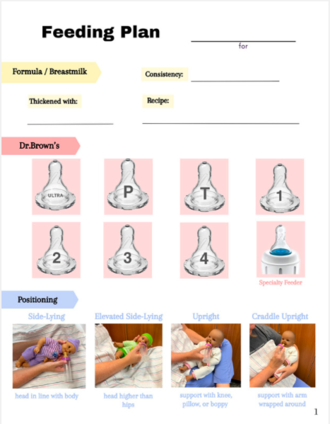
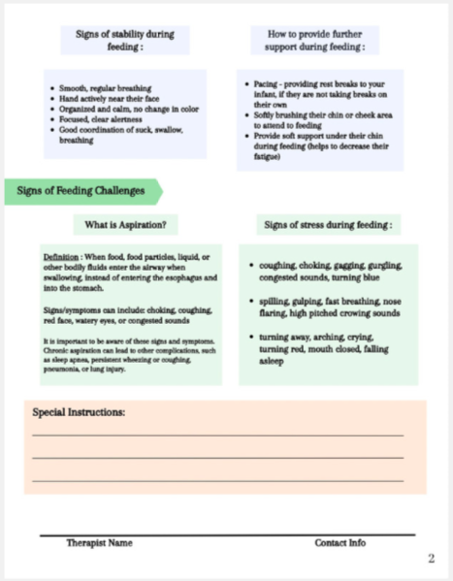
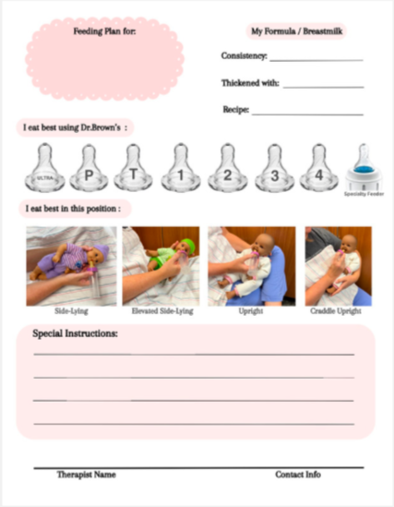
The Effect of a Detailed Infant Feeding Plan at Children's of Alabama Allie Lisby, OTD Student; Dr. Sarah C. Tucker, PhD, OTR/L Department of Occupational Therapy | University of Alabama at Birmingham Christy Moran, OTD, OTR/L, CNT, NLP | Children's of Alabama
Introduction
Results
Discussion
An immature and uncoordinated suck-swallow-breathe (SSB) pattern can interfere with an infant’s feeding ability or, more severely, result in aspiration (Kamity et al., 2021). The flow rate of a bottle nipple and the feeding position can also impact an infant’s feeding success (Pados et al., 2019). The biggest challenge and need reported by parents of infants in the hospital is for education on feeding (Furtak et al., 2021). Providing families with educational materials helps them understand stress cues, signs of aspiration, and ways to provide further support for their infant while feeding and improves the feeding experience for the infant and family (Fuhram & Ross, 2020).
The biggest impact was one not directly tied to the main outcome: Participants indicated room copies made a big difference in team carryover with feeding recommendations.
This can indirectly improve discharge education if the team is more aligned with the feeding plan.
Some benefit for family confidence with feeding; however, other factors could have played a role (absence of family, location in the hospital).
Certain areas of the hospital had better outcomes with the family discharge handout compared to other units in the hospital.
Limitations: Number of weeks implementing the project, number of participants, no direct communication with families, and implementation at only one site.
Confidence in Family Education
After implementation of the new feeding plan handouts, 5 participants stated families seem more confident than with previous education provided and 2 participants stated families seem about the same.
Faster Family Education
Purpose
6 participants stated the new handouts made the education process faster.
Conclusion
To determine if detailed infant feeding plan handouts make the family education process faster and more effective compared with previous handwritten education provided by occupational therapists (OT) and speech language pathologists (SLP) at Children’s of Alabama (CoA) hospital.
Carryover with Nurses/Other Staff
After implementation of this project, the largest benefit was with carryover of nurses and other staff with feeding infants in the hospital. Future research using these techniques for staff and family education regarding feeding is essential. This project showed the potential to positively impact feeding collaboration and discharge practices in a hospital setting.
The largest response was in this category, 7 participants stated the largest and most effective outcome of the handouts were with carryover among nurses/other staff with feeding.
Methods
References
Design Type: Pre-Post Survey
Participants: 4 OTs, 3 SLPs, and infants between the ages of 37 weeks corrected age and 4 months old
Project Design:
3 different feeding plan handouts, including different bottle brands and types (hospital bottles, Dr.Brown’s, Tommee Tippee, Philips Avent, and MAM).
In-person meeting with the infant OT and SLP team
12-question pre-survey
5 weeks of implementation
12-question post-survey
Results were presented to the SLPs, PTs, and OTs at CoA.
Fuhrman, L., & Ross, E. S. (2020). Parental concerns about newborn feeding post hospital discharge. MCN, The American Journal of Maternal Child Nursing, 45(1), 34–40. https://doi.org/10.1097/NMC.0000000000000590
Furtak, S. L., Gay, C. L., Kriz, R. M., Bisgaard, R., Bolick, S. C., Lothe, B., Cormier, D. M., Joe, P., Sasinski, J. K., Kim, J. H., Lin, C. K., Sun, Y., & Franck, L. S. (2021). What parents want to know about caring for their preterm infant: A longitudinal descriptive study. Patient Education and Counseling,104(11), 2732–2739. https://doi.org/10.1016/j.pec.2021.04.011
Kamity, R., Kapavarapu, P. K., & Chandel, A. (2021). Feeding problems and long-term outcomes in preterm infants - A systematic approach to evaluation and management. Children (Basel, Switzerland), 8(12), 1158. https://doi.org/10.3390/children8121158
Pados, B.F., Park, J., & Dodrill, P. (2019). Know the flow: Milk flow rates from bottle nipples used in the hospital and after discharge. Advances in Neonatal Care, 19(1), 32–41. https://doi.org/10.1097/ANC.0000000000000538
Acknowledgement & Contact information
Family Discharge Education Handout
Room Copy
Special thanks to my site mentor Christy Moran, OTD, OTR/L, CNT, NLP and faculty mentor Dr.Tucker, PhD, OTR/L for guidance throughout this project. My contact information: alliemh8@uab.edu

