Slide 1
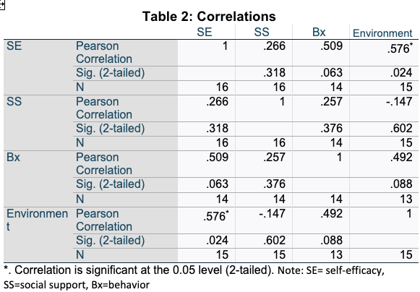
Correlation between Self-efficacy, Environment, and Dietary Behaviors in Adults with Multiple Sclerosis Katherine Martin, OT student; Dr. Brooks Wingo, PhD Department of Occupational Therapy | University of Alabama at Birmingham
Introduction
Results
Discussion continued
Obesity is a common co-morrbidity in adults with Multiple Sclerosis.
The larger study is examining if quality of diet and quantity of diet can improve symptoms.
To correctly assess if diet and weight loss can improve symptoms, participants need to adhere to assigned intervention.
It is important to identify barriers that can interfere with adherence to the interventions
Evaluating the correlations between self-efficacy, environment, behavior, and social support will allow better support to be given to participants in this study and others to result in higher retention and more quality outcomes.
Study Limitations
Small sample size
Study was not powered to indicate significant of calculations
Limited time d/t data collection timepoint and capstone experience
Errors in data sampling due to presentation of Theory questionnaire
Conclusion
These correlations are important to evaluate and research further to better benefit the participants in research. This is an area that could be studied further to enhance support and increase retention of participants and better adherence to interventions.
Methods
Discussion
References
Participants are given a theory questionnaire at baseline, midpoint, and follow up visits. This questionaries has multiple sections to assess social support, environment, behavior, and self-efficacy.
Participants came in for Baseline, Mid-point, and follow up testing
They were given Theory questionnaire at each of these points to measure correlations and changes to self-efficacy
Participants engaged in a dietary intervention where they were randomized to a low glycemic load diet and a standard American diet
Participants were given a Menu to choose from and food was sent to their home or designated spot each week via Shipt
Self-efficacy and Environment
Moderate correlation
Correlation supported by literature including a study done on participants with heart failure and their performance of ADLs
Self efficacy and Behavior
Moderate correlation
Correlation supported by literature including a study done examining COVID-19 environment and effect on exercise
Environment and Behavior
Moderate correlation
Correlation supported by literature including a study done on food desserts and the effect the food environment has on healthy eating behaviors
Self-efficacy and Social Support
Weak correlation
Contrary to literature, variety of studies find a strong correlation between social support and self- efficacy
Huang, Z., Liu, T., & Chair, S. Y. (2022). Effectiveness of nurse-led self-care interventions on self-care behaviors, self-efficacy, depression and illness perceptions in people with heart failure: A systematic review and meta-analysis. International journal of nursing studies, 132, 104255. https://doi.org/10.1016/j.ijnurstu.2022.104255
Jin, H., & Lu, Y. (2021). Evaluating Consumer Nutrition Environment in Food Deserts and Food Swamps. International journal of environmental research and public health, 18(5), 2675. https://doi.org/10.3390/ijerph18052675
Li S. Y. (2021). The relationships among self-efficacy, social support, and self-care behavior in the elderly patients with chronic pain (a STROBE-compliant article). Medicine, 100(9), e24554. https://doi.org/10.1097/MD.0000000000024554
Riegel, B., Dickson, V. V., & Vellone, E. (2022). The Situation-Specific Theory of Heart Failure Self-care: An Update on the Problem, Person, and Environmental Factors Influencing Heart Failure Self-care. The Journal of cardiovascular nursing, 37(6), 515–529. https://doi.org/10.1097/JCN.0000000000000919
Wang, F., Gao, S., Chen, B., Liu, C., Wu, Z., Zhou, Y., & Sun, Y. (2022). A Study on the Correlation Between Undergraduate Students' Exercise Motivation, Exercise Self-Efficacy, and Exercise Behaviour Under the COVID-19 Epidemic Environment. Frontiers in psychology, 13, 946896. https://doi.org/10.3389/fpsyg.2022.946896
Acknowledgement & Contact information
Kat Martin. Dr. Brooks Wingo
akbrian@uab.edu bwingo@uab.edu

