Slide 1
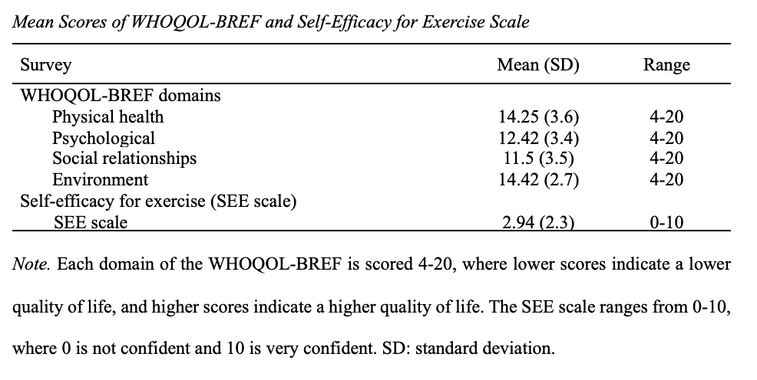
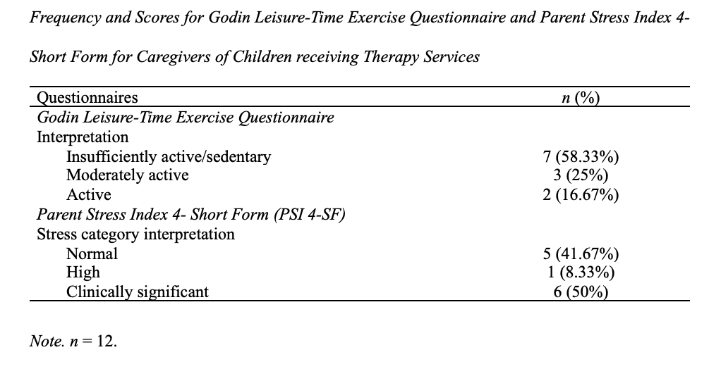
Needs, Barriers, and Facilitators of Physical Activity Engagement Among Caregivers of Children with Disabilities Melissa Pontius, OTS; Brooks Wingo, PhD Department of Occupational Therapy | University of Alabama at Birmingham Danielle Russo, MS, LMFT, CFLE; Laura Lee, MSPT | Child’sPlay Therapy Center
Introduction
Results
Discussion
According to the Centers for Disease Control and Prevention (CDC, 2022), an adult needs 150 minutes of moderate-intensity physical activity or 75 minutes of vigorous-intensity activity per week. There is evidence to suggest that caregivers are less likely to meet the recommended physical activity guidelines and more likely to participate in higher rates of sedentary behavior (Carpenter et al., 2020). Due to the demanding nature of the caregiving role, these adults are at risk for negative health outcomes such as chronic illness and have insufficient time for self-care tasks such as exercising regularly, eating a healthy diet, and stress management (Sabo & Chin, 2020). The purpose of this project is to investigate stress, quality of life, and physical activity engagement among caregivers of children with disabilities. The information gained from completing this project will allow health care professionals to better support health and wellbeing of families and caregivers of children with disabilities.
Caregivers who participated in this study had moderate quality of life, low self-efficacy for exercise, and reported being sedentary for the most part. Additionally, over half of the respondents had high to clinically significant stress levels per the PSI 4-SF. Many themes such as low satisfaction with PA levels and constant stress were identified in the interviews.
The self-efficacy scores revealed that respondents had low confidence in their ability to engage in physical activity if there were any barriers. Per the WHOQOL-BREF, environment was the domain with the highest satisfaction, followed by physical health, psychological, and then social relationships. These results indicate that social relationships are the area of lowest satisfaction among the caregivers of children with disabilities. Due to the demanding nature of the caregiving, especially for caregivers of children with disabilities, it can be assumed that these individuals have little time for social relationships outside of their caregiving role, causing dissatisfaction in this area of life. Half of participants had stress levels so high that they were considered clinically significant. More than half of the participants had a sedentary lifestyle, and these results are in line with data from other previous studies that suggested sedentary behavior is more common among caregivers.
Methods
Conclusion
To qualify for this study, one had to be a caregiver of a child who was receiving therapy from a PT, OT, or SLP at ChildsPlay Therapy Center. Caregivers qualified if they were 25-60 years old, and their child was 5-12 years old while attending therapy at the clinic. Participants had to be English speaking. This study utilized qualitative and quantitative methods by including in-person interviews and web-based surveys. Online surveys were completed through Qualtrics and consisted of questions regarding demographics, stress, quality of life, physical activity, and self-efficacy for exercise. Participants were sent a link to the survey or given a QR code to scan to access the survey. Interviews were recorded on Zoom and transcribed for analysis.
In conclusion, this study was conducted to gain a better understanding of the caregiver population and assess the need for intervention. The findings of this study indicate that there is a need for additional caregiver support due to the increased stress, reduced quality of life, low self-efficacy for exercise, and decreased amounts of physical activity within caregivers. This project can be utilized by healthcare professionals such as therapists, physicians, and many others to conduct further research and has the potential to guide creation and implementation of support programs for caregivers of children with disabilities to reduce stress and improve overall quality of life within this population.
Results continued
Contact information
References
mpontius@uab.edu
1. Carpenter, C. A., Miller, M. C., Xuemei Sui, & West, D. S. (2020). Weight status and sedentary behavior of alzheimer’s disease caregivers. American Journal of Health Behavior, 44(1), 3–12. https://doi.org/10.5993/AJHB.44.1.1
2. CDC. (2022, June 2). How much physical activity do adults need? Centers for Disease Control and Prevention. https://www.cdc.gov/physicalactivity/basics/adults/index.htm
3. Sabo, K., & Chin, E. (2021). Self-care needs and practices for the older adult caregiver: An integrative review. Geriatric Nursing, 42(2), 570–581. https://doi.org/10.1016/j.gerinurse.2020.10.013

