Slide 1
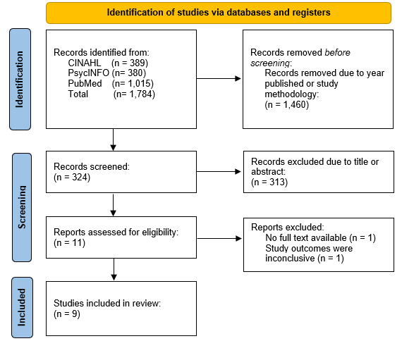
Snoezelen: It’s Not A Bore! Emma K. Sullins, OTS; Dr. Valley McCurry, PhD, MBA, OTR/L, FAOTA Department of Occupational Therapy | University of Alabama at Birmingham Tad Parker, OTR/L, MPA| Huntsville Hospital
Introduction
Results
Discussion continued
As of 2021, it is estimated that in the United States, one out of every five adults, or 57.8 million people, live with some form of mental illness (National Institute of Mental Health 2). Of those 57.8 million, only 26.5 million, or 47.2%, received any form of mental health service in the previous year (National Institute of Mental Health 2). Before the year 2050, it is expected that the world’s population of adults over the age of 60 will increase from 12% to 22% (World Health Organization, 2017). This means there will be an increase in the number of older adults that will need some form of psychiatric care. It is currently reported that 20% of adults that are 55 or older have some form of mental health concern (Centers for Disease Control, 2008). The most common diagnoses are anxiety and depressive disorders (World Health Organization, 2022). The purpose of this paper is to look at how we currently treat these concerns, how Snoezelen rooms have been proven to be effective, and how implementing this treatment method could be beneficial to the general and geriatric psychiatric populations in acute care.
Nine studies were found to be appropriate for the content of this project. These studies span from 2010 to 2022. Studies used in this review were found using a two-stage screening process. First, the investigator searched through databases for studies whose title and abstract seemed appropriate for the review. Second, articles that had been gathered were reviewed by a reading of the full text for relevant information regarding the topic. Articles were removed if: (a) they were a systematic review or meta-analysis; (b) they used virtual reality to create the multisensory room; (c) the outcomes of the study were inconclusive. Table 1 presents summarized data from the assessment of the selected articles in the following areas: Author and Year published, Aim of Study, Methods used, Sensory Instruments Used, and Findings.
Limitations:
Any articles that were missed or were unable to be included due to not having their full text available.
Only articles that were written or available tin English were used.
Time allotted to research was limited to 14 weeks.
Conclusion
As evidenced by the information in this paper, Snoezelen therapy has been proven as an effective method of treatment across all ages and many different settings, including the general and geriatric psychiatric populations. This research shows that Snoezelen and multisensory room therapy would continue to be an effective treatment for these populations and would benefit hospitals and patients if implemented in the acute care setting. If Snoezelen rooms have been proven as an effective method for decreasing unwanted behaviors in dementia patients and patients with autism spectrum disorder as well as reducing stress in healthcare workers, and if there is a need for a new non-pharmacological treatment method in the general and geriatric psychiatric fields, then OT practitioners, Psychiatrists, and hospital boards should consider implementing this multisensory environment into this setting.
Discussion
Methods
Geriatric patients with a diagnosis of dementia showed a significant improvement in mood and behavior, as well as an improvement in certain social skills such as spontaneous speech and relating to others better after one or more sessions in a Snoezelen room (Maseda et. al 1, 2014; Maseda et. al 2, 2014). These effects are present both in the short term after just one session, as well as in the long term, with outcomes being re-tested as late as 8 weeks after their final follow-up.
General population patients of varying ages with different diagnoses or conditions also show significant improvement after multisensory room treatments. This intervention was able to decrease anxiety levels in patients with Schizophrenia, improve brain function in patients with brain injuries, and decrease the numbers of repetitive behaviors in children and adults with Autism Spectrum Disorder (ASD) (Cheng et. al, 2017; Gómez et. al, 2016; Novakovic, 2019). There is also evidence to support that giving a patient control over their session in a multisensory environment can lead to decrease in repetitive behaviors, vocalizations, activity level, and more as shown by Unwin when working with children with ASD (Unwin, 2021).
Evidence suggests that multisensory room therapy is not only beneficial for patients but can be beneficial for staff as well. Lykkeslet found that when preparing a multisensory room for patients, staff members who gathered the information on the patient felt as if they saw more of their personalities, and felt a strengthening in the relationships (Lykkeslet, 2014). Lorusso found that staff who used multisensory room therapy with patients perceived there to be benefits in mood and behavior, not just a measurable difference (Lorusso, 2020). Putrino found that when staff used a multisensory “recharge room” one time, their perceived stress levels decreased 59.6% (Putrino et. al, 2020).
Occupational Therapists can provide mental health services in many different settings. The role of OT in mental health is to help patients manage physical and mental health needs, develop healthy and effective daily routines to promote well-being, and learn and utilize strategies to navigate the stresses of life (AOTA). Snoezelen room therapy is a tool that OTs can use to help psychiatric patients manage their stress levels, while using the instruments in the room as examples of ways they can manage their stress on their own. It is possible for OT to take the already-known benefits of Snoezelen therapy and find new ways to use this intervention to help improve quality of life for their patients.
The articles used in this review were retrieved through a two-stage screening process. In the first screening, titles and abstracts were reviewed to determine their relevance to the topic. If the article met the criteria for eligibility in the first stage, the full text was then downloaded to be reviewed in the second stage. The full-text version of the studies were then read through in order to determine whether the information was relevant to this study.
The studies used in this review were examined by the author using Preferred Reporting Items for Systematic Reviews and Meta-Analysis (PRISMA) guidelines. A flow diagram of the steps of study selection is shown in Figure 1.
References
The state of Mental Health and Aging in America - Centers for disease ... Centers for Disease Control and Prevention. (n.d.). https://www.cdc.gov/aging/pdf/mental_health.pdf
U.S. Department of Health and Human Services. (n.d.-b). Mental illness. National Institute of Mental Health. Retrieved October 20, 2023, from https://www.nimh.nih.gov/health/statistics/mental-illness
World Health Organization. (2017, December 12). Mental health of older adults. World Health Organization. Retrieved June 12, 2022, from https://www.who.int/news-room/fact-sheets/detail/mental-health-of-older-adults
World Health Organization. (2022, June 8). Mental disorders. World Health Organization. Retrieved September 15, 2023, from https://www.who.int/news-room/fact-sheets/detail/mental-disorders
Acknowledgement & Contact information
Special Thanks to: Dr. Valley McCurry, PhD, MBA, OTR/L, FAOTA Tad Parker, OTR/L, MPA Contact Info: Emma Sullins – emma1999@uab.edu

