Slide 1
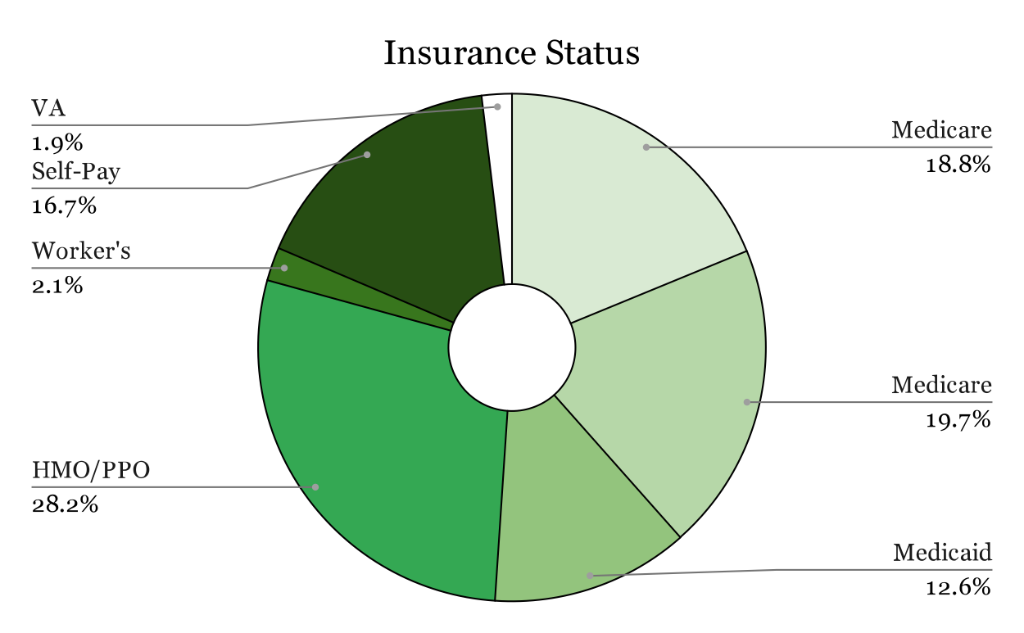
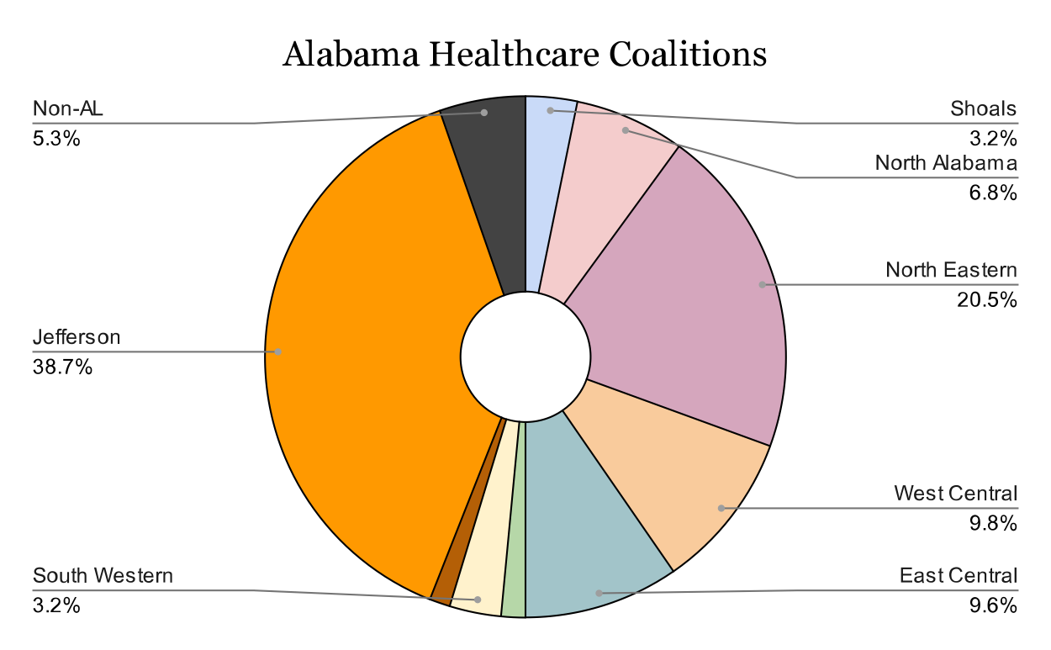
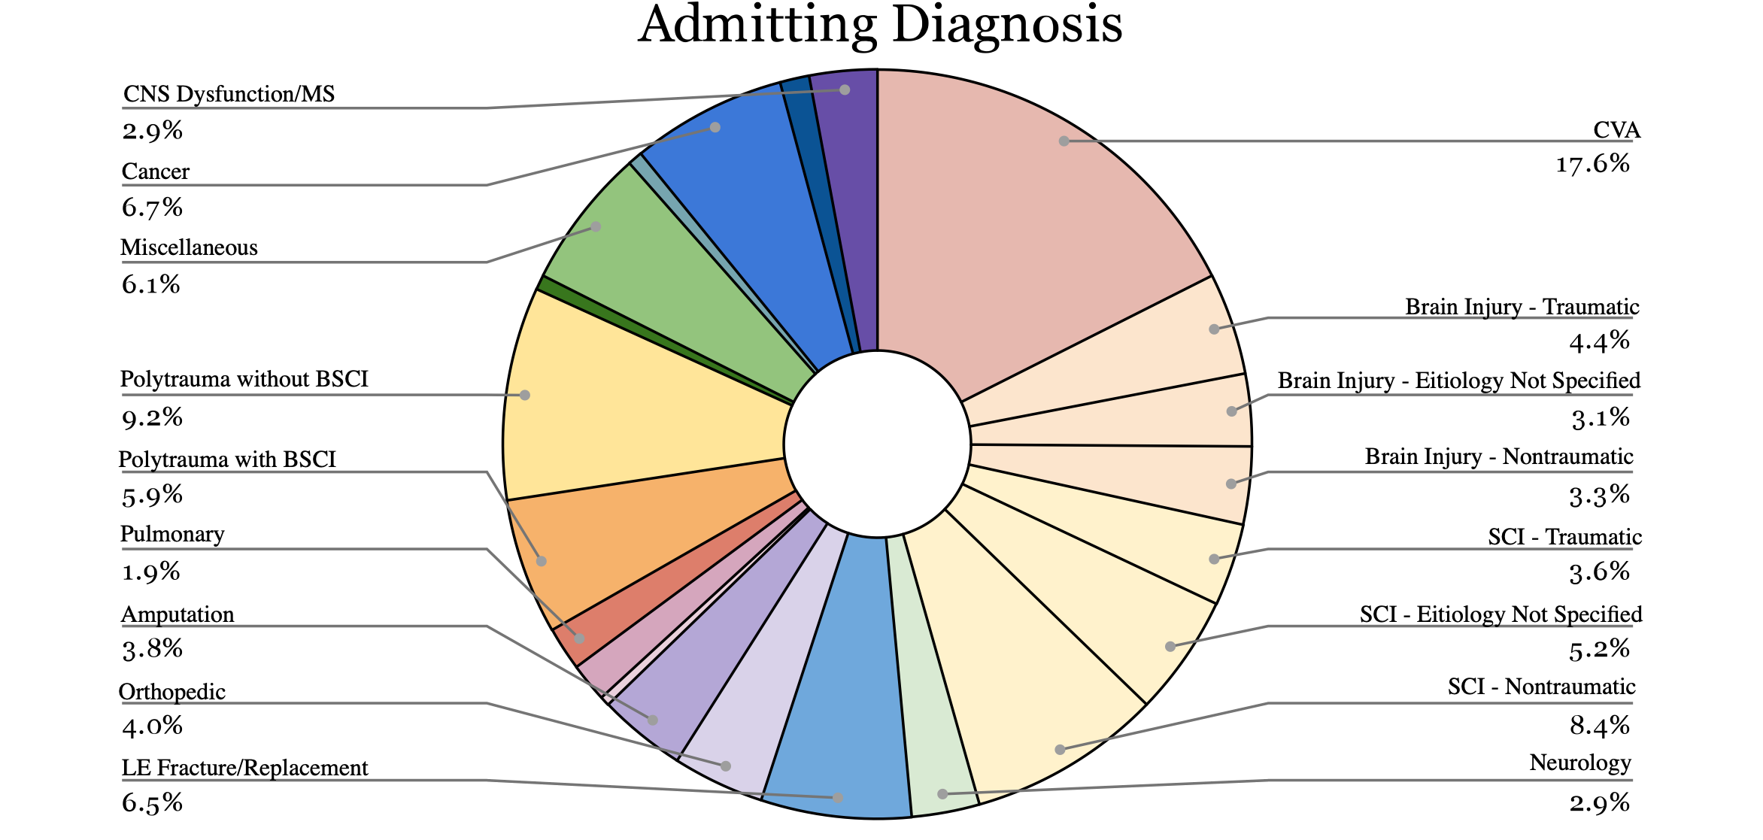
Resources for Patients Discharging from an Inpatient Rehabilitation Facility Rachel Summerlin, OTD-S; Jewell Dickson-Clayton, OTD, MPH, OTR/L, ATP, FAOTA
Department of Occupational Therapy | University of Alabama at Birmingham Jil Sea, MS, OTR/L, CCM | UAB Spain Rehabilitation Center
Introduction
Results
Discussion
This project aimed to update and add to the digital and physical resource databases housed within the rehab case management department at The University of Alabama’s Spain Rehabilitation Center. These resources address factors to support safety and the highest level of independence after discharge, address the social determinants of health, and promote occupational justice through accessible housing and transportation, decreased healthcare costs, in-home caregivers, and adaptive equipment, among other barriers to care identified throughout a patient’s stay.
The average total cost of Inpatient Rehabilitation (IPR) in the United States is $46,128. This does not include expenses prior to their IPR stay or any expenses accrued after discharge. While some individuals can utilize health insurance to cover these costs, this is not the case for many Americans. The Commonwealth Fund Commission on a National Public Health System 2022 Biennial Health Insurance Survey found 43.0% of Americans had inadequate health insurance coverage for all or part of the previous twelve months. Within this group, 11% currently held health insurance but had experienced a gap in coverage within the past year, 9% currently had no health insurance, and 23% of people surveyed were classified as underinsured. The criteria for underinsured status were a) having out of pocket costs over the prior 12 months, excluding premiums, equal to or greater than ten percent of household income, b) out of pocket costs over the past 12 months, excluding premiums, equal to or greater than five percent of income when the household falls below 200% of the federal poverty level, or c) deductibles of five percent or more of household income. Over half (54%) of uninsured or underinsured individuals were in the South. Alabama Department of Public Health (2022) states that 17.5% of individuals in Alabama are uninsured.
The Occupational Justice Framework framework demonstrates three ways occupational therapy practitioners can advocate – increasing accountability for justice, advocating for institutional changes, and working to develop programs to enrich the lives of those with disability or injury.
The framework used to guide this project was the Model of Occupational Empowerment, which correlates adverse social determinants of health such as poverty, abuse, or poor socioeconomic status with outcomes related to occupational deprivation. Occupational deprivation is lack of meaningful occupational engagement, or inability to participate in activities that form part of an individual’s identity.
Insurance Status of Patients
16.67% of patients within the study population identified“self-pay”
59.8% higher than the U.S. average in 2022
52.9% more likely to be uninsured than the general population in Alabama
Barriers to Discharge
Financial concerns reflective of average American experience
About half of Americans state they would not be able to pay an unexpected $500 bill in full
Mental health concerns
Aligns with finding that 22% of patients demonstrate symptoms of depression, anxiety, or post-traumatic stress disorder (PTSD) after physical injury
Availability of Resources
Globally, the availability of resources in a particular area is proportionally less than the percentage of patients in this same area.
Due to the extent of the Rehab Case Managers’ workloads, a liaison would be beneficial to research novel resources or complete the administrative tasks of calling, emailing, and/or visiting the resources to ensure they are up to date.
Limitations
Time constraint on study
Sample from one geographic location
Lack of standardized assessment to identify patient needs
Response time of community resources
Preferred Language
Language | Number
English | 459
Spanish | 7
Chinese | 2
487 MRNs Collected
19 excluded for multiple admissions
468 MRNs analyzed for trends
Discharge Locations 1
State | Number
Alabama | 440
Florida | 3
Georgia | 10
Tennessee | 2
Mississippi | 12
Indiana | 1
Conclusion
Implications
Continued advocacy needed for well-being of patients prior to discharge from OT services
OTPs should encourage further development of community-based resources which promote occupational participation among all populations
Future Research
Broader population sample
Study other demographic variables’ impact on barriers to discharge
Utilize data from National Spinal Cord Injury Statistical Center or the Traumatic Brain Injury Model Systems National Data and Statistical Center
Validity of standardized assessments used in case management departments
Streamlined system for healthcare professionals to organize and share community resources
Methods
This project consisted of four stages.
In the first stage, the investigator will conducted a retrospective chart review of patients seen at Spain Rehabilitation Center from February 2023 to July 2023. This review consisted of identifying general patient demographics, such as diagnoses, insurance status, preferred patient language, discharge location, and stated discharge concerns. Data was grouped by these demographics, and the percentage of total patient cases for each demographic was found.
In the second stage of the project, the investigator reviewed the current database of post-discharge handouts utilized at Spain Rehab. Data was collected on the name of the resource, diagnoses and demographics addressed, language of the resource, location of the resource (city, county, state, or national), and date last updated. This review was conducted on both the digital database located on the Spain Rehabilitation OneDrive as well as the resources in the filing cabinet located in the case management office. After collecting data on the resources and handouts, the investigator input data into Qualtrics, and resources were sorted into categories.
The third stage of the project involved cross referencing the data from stage one and stage two. The investigator compared demographic percentages to the number of resources for that specific demographic. This allowed the investigator to identify which patient areas contained the highest gap in coverage or the most out-of-date resources. After identifying these gaps, demographics were be prioritized based on need to provide a system for stage four.
Stage four made up the majority of this project. Using the order created in stage three, the investigator verified availability and details of current resources, as well as new resources. This verification was primarily be done via internet searches; however, phone calls were utilized if needed. When available, resources in languages other than English were added to meet the needs of the stated population. After filling in the noted gaps for one section, the investigator moved on to the next section in the prioritized list. This continued until the entire database was updated. No data or identifiable information was passed to another individual.
References
Identification of Gaps
Geographic Area | Percent of Patients | Percent of Resources
Alabama | 94.02% | 75.74%
Jefferson County | 38.68% | 17.70%
Northeast | 20.51% | 29.18%
West Central | 9.83% | 5.90%
East Central | 9.62% | 1.97%
North Alabama | 6.84% | 6.23%
Southwest | 3.21% | 4.59%
Shoals | 3.21% | 2.30%
Southeast | 1.50% | 1.97%
Mobile | 1.28% | 2.62%
Florida | 0.64% | 3.28%
Georgia | 2.14% | 1.31%
Tennessee | 0.43% | 2.30%
Mississippi | 2.56% | 1.31%
Indiana | 0.21% | 2.95%
Alabama Department of Public Health. (2022). Access to care. https://www.alabamapublichealth.gov/healthrankings/access-to-care.html
Collins, S. R., Bhupal, H. K., & Doth, M. M. (2022). The state of U.S. health insurance in 2022: Findings from the Commonwealth Fund, Sept. 2022. 2022 Biennial | Commonwealth Fund. https://www.commonwealthfund.org/publications/issue-briefs/2022/sep/state-us-health-insurance-2022-biennial-survey
Durocher, E., Gibson, B. E., & Rappolt, S. (2013). Occupational justice: A conceptual review. Journal of Occupational
Science, 21(4), 418-430. https://doi.org/10.1080/14427591.2013.775692
Kaiser Family Foundation. (2020). Hospital adjusted expenses per inpatient day. KFF. https://www.kff.org/health-costs-/state-indicator/expenses-per-inpatient-day/
van der Vlegel, M., Polinder, S., Toet, H., Panneman, M. J. M., Geraerds, A. J. L. M., &
Haagsma, J. A. (2022). Anxiety, depression and post-traumatic stress symptoms among
injury patients and the association with outcome after injury. 13(1), 2023422.
https://doi.org/10.1080/20008198.2021.2023422
Acknowledgement & Contact information
Patient Percentage > Resource Percentage
Patient Percentage < Resource Percentage
Rachel Summerlin | resummer@uab.edu
Thank you to UAB Spain Rehabilitation Center, Jil Sea, and the Rehab Case Management team for the resources provided to complete this capstone project.

