Slide 1
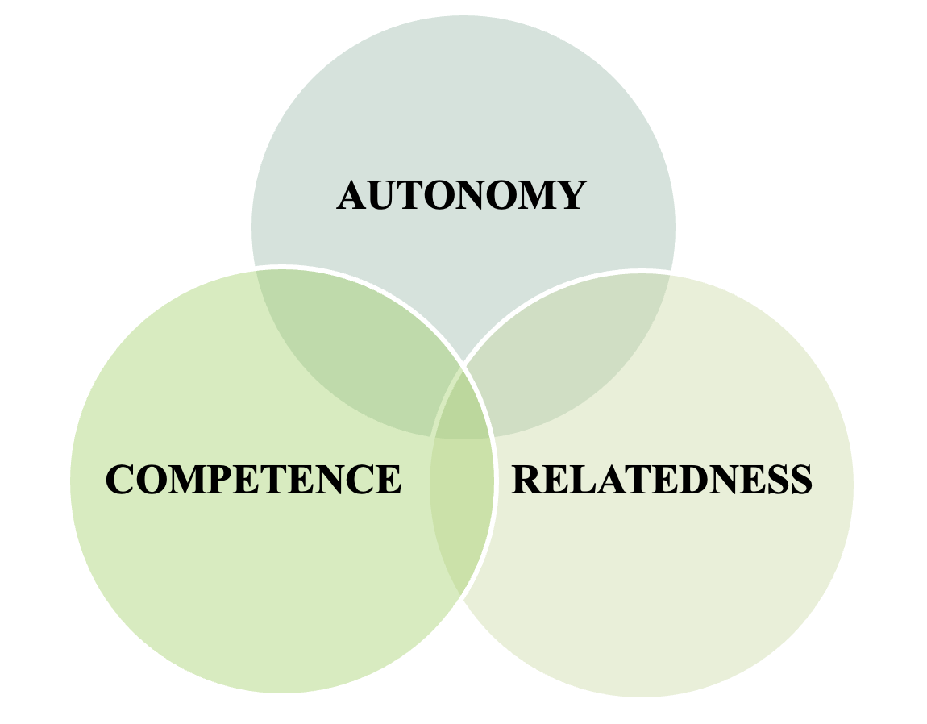
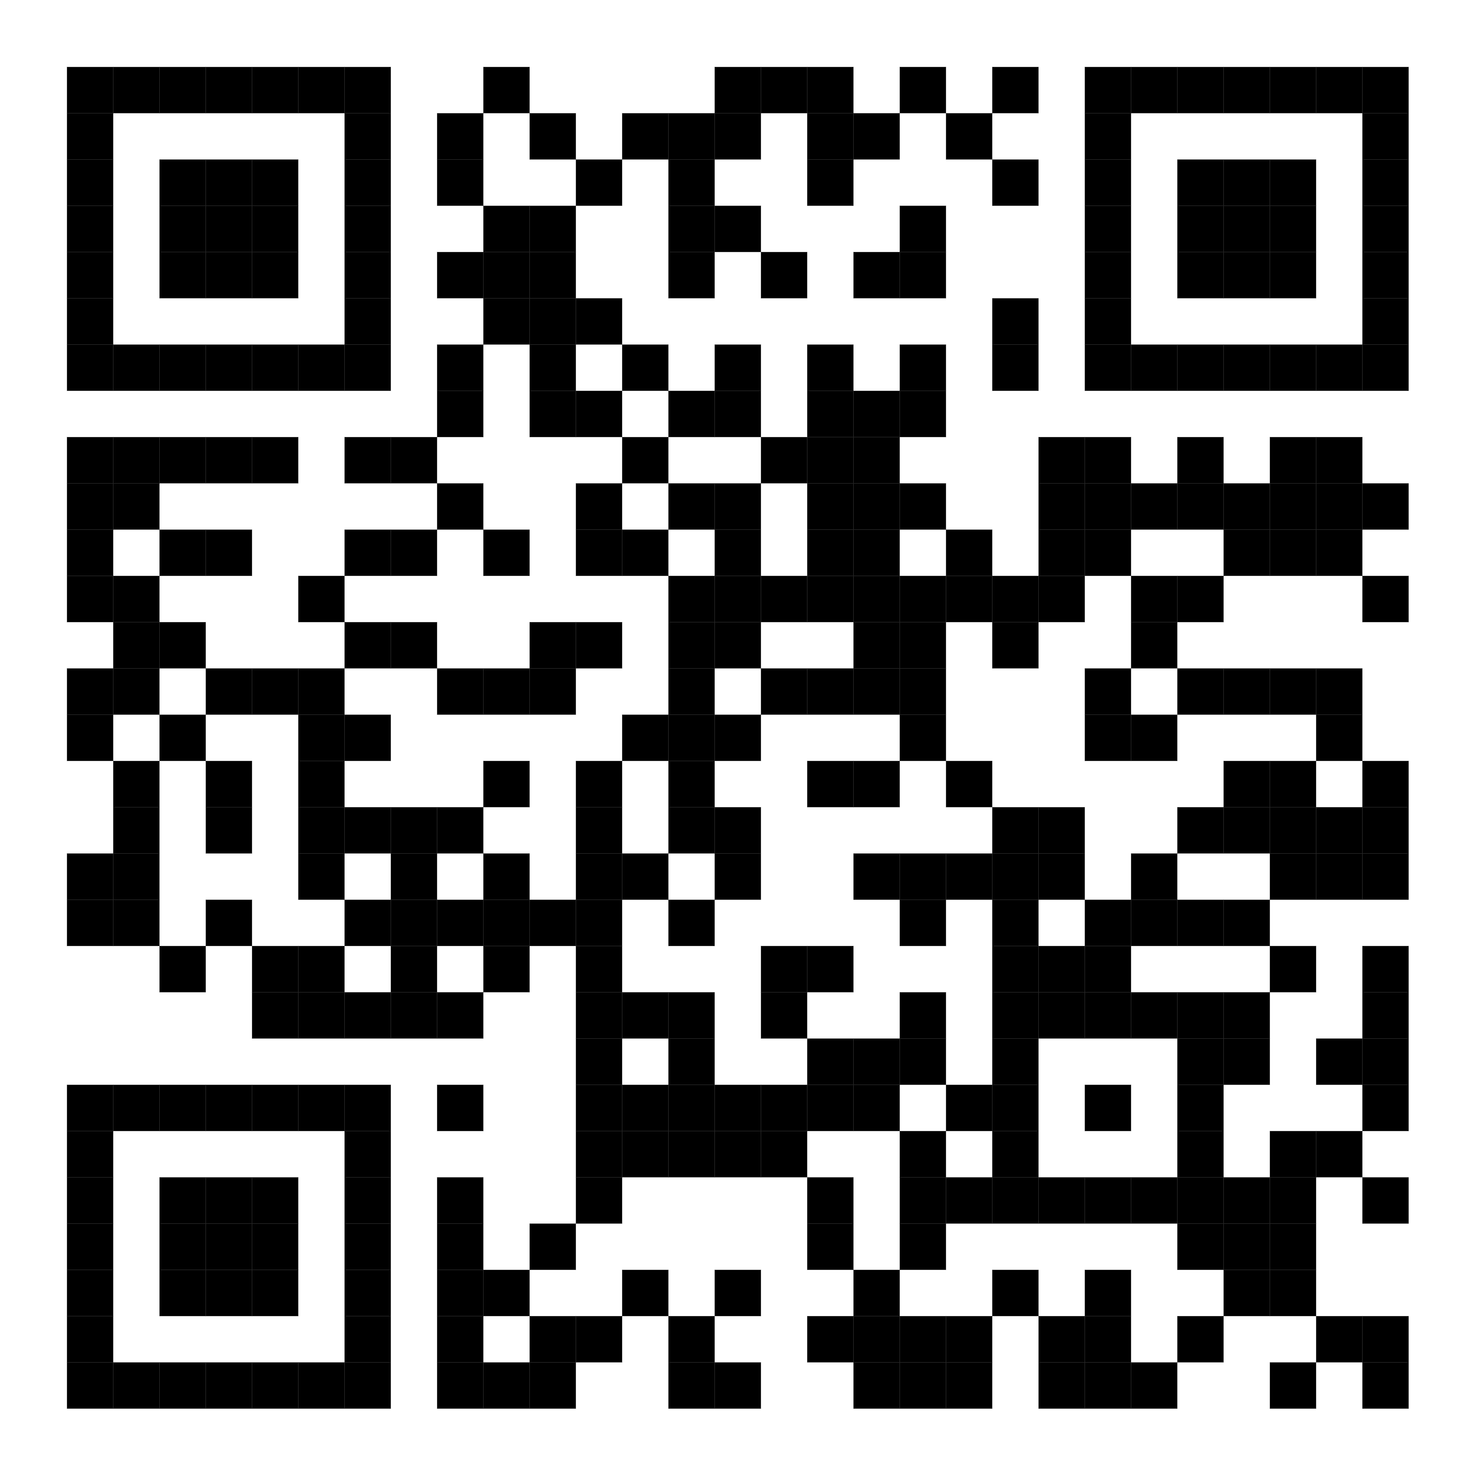
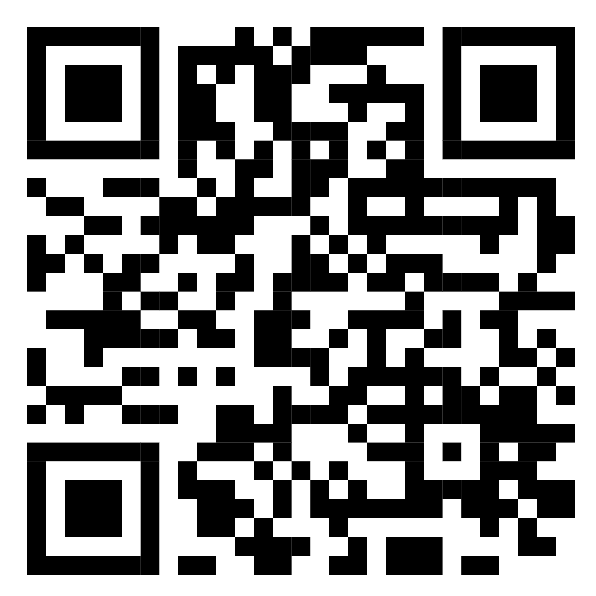
Assessing the Self-Determination of Foster Youth & Alumni to Obtain Post-Secondary Education
Hannah C. Turner, OTS |  | Department of Occupational Therapy
Sarah C. Tucker, PhD, OTR/L |  | University of Alabama at Birmingham
Victoria Johnson, EdD |  | Grace House Ministries
Introduction
Results
There are ≥ 400,000 children in the foster care system, and 23% are teens approaching the age of transition, known as emancipation (USDHHS, 2021).
Foster youth (FY) often transition out of care with minimal support and face societal barriers (Blakeslee et al., 2020; Miranda et al., 2020).
Only 2% of foster alumni (FA) obtain a post-secondary education (PSE), from a college or vocational program due to the lack of support, guidance, and stability given to FA (ABA, 2022).
It is vital to understand the lived experiences of individuals currently and previously in the foster care system to gain an accurate representation of the Child Welfare System’s (CWS) effect on this population.
Grace House Ministries (GH) is a Department of Human Resources (DHR) sponsored residential facility. GH provides a home to girls in foster care as well as developmental and transitional support.
Sense of Family
The continuum of support from one’s various familial groups and its contribution to their well-being.
Identity Formation
The impact an individual’s lived experience has on their thoughts, attitudes, behaviors, and self-value.
Motivation
“So, I will incorporate a lot of my experience into my books and stuff so I can hopefully lie reach out to children because I have stories to tell that possibly help other children, the system, or even dealing with like different abuses.”
Social Inadequacy
“I just can’t do normal kid things. And that’s okay. I don’t have control over if I get to go and visit a friend. I don’t have control over what I do on the weekends. All I have control over is how I react to those things.”
Perceived Support & Influence
The perception of encouragement, assistance, and/or resources and their impact on one’s abilities to self-govern their thoughts, attitudes, behaviors, or decisions.
Increased
“Well, I do love the connection between my brothers and me. Like, we bonded together. But, you know, it's been separated a little bit. There's still that connection.”
Environmental Regulation
“Every part of your day is controlled [in foster care]…I feel like I’m still a child and I talk to [staff members] like, ‘hey, like, what do I do?’ And I kind of revert back to me not wanting to make decisions because I know I can depend on them. So sometimes I have to remember that like you're an adult and you don't have to like, ask them for a play-by-play on everything.”
Balance of Feedback
“Like people [at school] are really nice. Like people were not so nice before, if I raise my hand to a teacher, I feel like she’s going to be like what you know I get the answer wrong but that’s okay. Everybody does.”
Impact of Support System
“We have that bond, and we have that trust in each other because we’ve known each other for a long time, and because we've been through stuff together. And we know that we can really only trust each other.”
Decreased
“So, I felt like I was separated, not only in my school life, but in my family life. I feel like the only person I could depend on was my mother, and you know, honestly, I didn't. I felt so unloved by her, sometimes it just honestly hurt.”
Self-created
“I mean yeah, they, like the house parents, they kind of treat you like they child so like this was like already my home.”
Coping Mechanisms
“This person’s not even trying their hardest for me, and sometimes I just give up. Sometimes I skip, I give up, and I don't try anymore. So, I'm just like, well, what’s really the point.”
Self-Determination Theory
A theory for understanding human motivation, well-being, and personality development (Ryan & Deci, 2022).
Organismic Theory – assumes humans have an innate tendency to grow and integrate within their supportive environments.
Basic Psychological Needs (BPNs) – three universal needs that need to be supported in one’s environment for optimal functioning.
–– Supportive environments → create increased self-regulation,
social relationships, and well-being
Motivation & Perceived Locus of Causality (PLOC):
–– Autonomous: Internal PLOC → volitionally-regulated behaviors
–– Controlled: External PLOC → externally-regulated behaviors
Note: The interview transcripts were thoroughly reviewed, descriptively coded, and grouped by common themes. Frequent responses in this study generated the important themes listed above. Participant names and unique identifiers have been removed for privacy purposes.
Phenomenological Methods
Discussion
Future Directions
Research Question: Only 2%–6% of foster youth obtain a degree at the post-secondary level. Do the lived experiences of foster youth and foster alumni impact their development of the basic psychological needs outlined by self-determination theory that are needed to obtain this level of education?
Research indicates that the identified themes of identity formation, perceived support and influence, and sense of family significantly influence emerging adults’ academic motivation and success (Kim, 2014; Skhirtladze et al., 2019). The results of the study align with current literature, which concludes that frustration of the BPNs can not only lead to poorer academic outcomes (Alamer et al., 2023), but can create manifestations of maladaptive coping, i.e., aggression, dishonesty, obsessive thinking, and internalizing and externalizing behaviors (Davis & Humphrey, 2012; Ryan & Deci, 2018; Vansteenkiste et al., 2020). Harmonious support of BPNs produces the greatest functioning and well-being. Positive relationships are noted to be the most impactful when referring to the satisfaction of autonomy, competence, and relatedness among the sample population. Pecora (2012) reports findings that support these results, concluding that positive, reciprocal adult connections among FY positively correlate with self-concept, adjustment, and educational outcomes. It is also noted that, when FY and FA exhibit volitional academic behavior, educational interest, motivation, and retention follows (Powers et al., 2018).
Self-determination is a vital component of post-secondary success. Over 60% of high school graduates in 2021 attended a variation of post-secondary education immediately after high school (Digest of Education Statistic, 2022); 2%–4% of FY obtain an education at the post-secondary level (National Foster Youth Institute, 2022). Since FY experience increased adversity in comparison to their peers when seeking post-secondary education, it is important to create environments supportive of their BPNs to promote the resilience necessary for their success after foster care and in post-secondary pursuits (Abualkibash & Lera, 2017; Liu & Huang, 2021).
Literature from the perspective of current FY is very limited. It is important to understand their perspective to accurately build supports tailored to their needs, especially for needs associated with aging out of the foster care system. The study results prove that there is a need for increased occupational therapy services within this population. The concept of self-determination is within the scope of practice of occupational therapy, as outlined by the Occupational Therapy Practice Framework (American Occupational Therapy Association, 2020). Therapeutic interventions specific to the self-determination of FY are a need recognized by practitioners within the field of occupational therapy (Angell et al., 2019; Ziviani, 2015). Future research should examine the benefits of trauma-informed care among FY (Crabill & Hanson, 2018) and its impact on post-secondary pursuits.
Eligibility criteria: Individuals must:
Be currently receiving care from GH.
Have received care from GH within the past 5 years (2018-2023).
Be ≥ 16 years of age
Have access to Zoom (if unable to come to the GH campus)
Provide written assent/consent. DHR assent provided for participants < 19 years
Sample Population: 9 participants.
Methods: One-to-one, semi-structured interviews. Each interview was 1 hour in duration. During the interview process, participants were encouraged to discuss their experiences in foster care in their entirety rather than focusing solely on their placement at GH.
Interpretive Phenomenological Analysis (IPA): All interviews were recorded and transcribed via a HIPAA-approved Zoom platform. Once transcriptions were corrected for accuracy and de-identified, the following steps were followed to develop themes. Dr. Sarah Tucker assisted in the IPA portion to decrease implications of bias.
References
Step 1: Immersion becoming familiar with the data
Step 2: Investigation initial notations of any major and minor themes
Step 3: Development emergent themes are noted
Step 4: Patterns Search for connections across themes
Step 5: Repeat
Move to next case & repeat process.
Step 6: Analyzation look for patterns across cases.
Scan for Additional Quotes
Scan for References
Acknowledgements & Contact Info
Thank you to my mentors, Dr. Sarah Tucker and Dr. Victoria Johnson, the UAB OT department, and to my friends and family for supporting me during this project and throughout my academic career. I would also like to express my gratitude to the girls at Grace House for their participation and for accepting me into their family over the 14 weeks of my project.
(Alase, 2017)
Hannah C. Turner, OTS | hcturner@uab.edu

