Slide 1
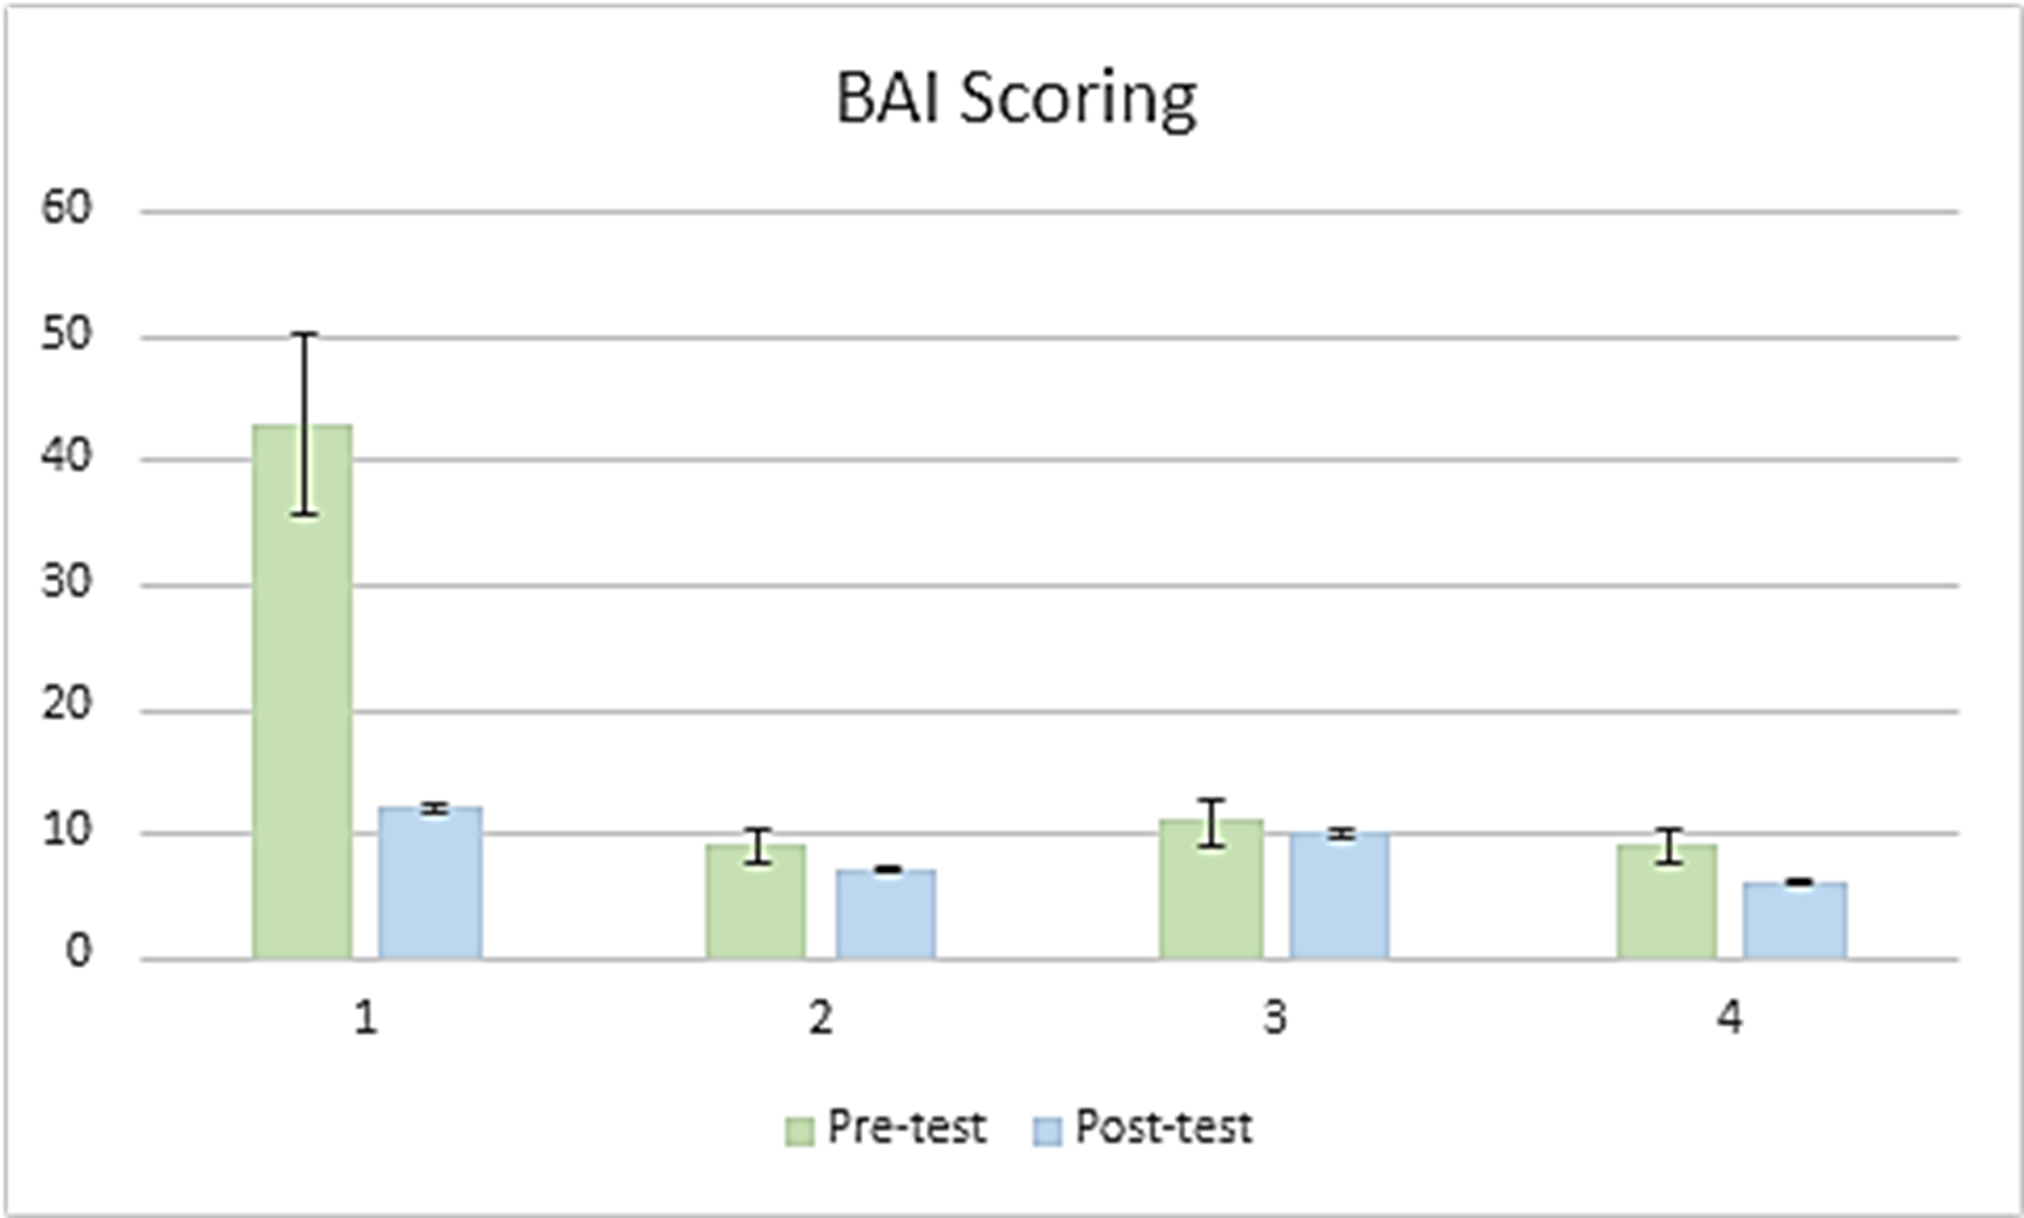
The Influence of Education on Behavioral Patterns and Decision Making in Individuals Referred to Pelvic Floor Therapy Hannah Rae Turner, OTS & Elizabeth Barstow, PhD, OTR/L, SCLV, FAOTA Department of Occupational Therapy | University of Alabama at Birmingham Tori Rowell, MSOT, OTR/L | Benchmark Physical Therapy in Fairhope, AL
Introduction
Qualitative Results
Discussion
Pelvic floor disorders (PFDs) are seen in 25% of all women in the United States (Dieter et al., 2015). Rehabilitative treatment for PFDs can be obtained through pelvic floor therapy (PFT) which is known to be an effective intervention in terms of strengthening pelvic floor muscles, managing pain, and increasing the return to meaningful activities (Ghaderi et al., 2019); (Verbeek & Hayward 2019). Even with available services, the issue remains that individuals with PFDs are not seeking out or initiating PFT. Research suggests that while PFT non-adherence is multifactorial in nature, it can be partly attributed to anxiety and a decreased understanding of the available interventions. Looking at these factors led researchers to ask whether education played an important role in PFT adherence (Zoorob et al., 2017).
THEME 1: Time Management
“If I am not working or taking care of the kids, I’m running errands for work or my kids.” – ID2
“Before retirement I wouldn’t have had time to come to these appointments.” – ID3
“I just had a baby, and my husband works full-time.” – ID1
“I’m usually watching my grandkids, so I don’t have much time to myself during the week.” – ID4
“Well, I am a part of a couple community clubs so I have something planned just about every day.” – ID3
THEME 2: Awareness of Therapeutic Utilization
“My doctor said that my symptoms were common…[A] common [symptom] does not equal normal functioning.” – ID2
“I was having to advocate for therapy because my doctor wasn’t familiar with it.” – ID2
“I didn’t know therapy was an option.” – ID4
“My doctor cleared me [after giving birth] but I was not ready to return to my activities.” – ID1
“I had a friend tell me about [PFT], but my doctor wanted to try other things first.” – ID3
THEME 3: Emotional State
“I was depressed for a while after [multiple UTIs].” – ID3
“I wonder why others don’t have these symptoms after [giving birth].” – ID2
“I would sit on the toilet and cry because of [all my symptoms].” – ID1
“I thought I would have to live with this pain forever.” – ID1
“I have to pack pads and extra underwear with me wherever I go. At this point I don’t even want to leave the house.” – ID4
THEME 4: Perception of PFT
“I looked it up [online] and I just thought I would come in and do a bunch of Kegels.” – ID2
“With pregnancy everyone got to see me exposed. I thought therapy would be the same.” – ID3
“I figured that it would take a year’s worth of therapy to get better. It’s been six weeks and I’m almost back to my old self.” – ID1
“I didn’t realize how beneficial it would be to be doing my exercises at home as well as coming into these appointments.” – ID4
While this mixed-methods study showed no significance regarding the effects of education on anxiety, all participants reported a decrease in BAI scores from pre- to post-test measures. Additionally, participants reported personalized viewpoints regarding the PFT process including factors that influence therapy initiation and perspectives surrounding their knowledge of provided services. Identified themes from interviews suggests that an increase in PFT education could increase therapy initiation for individuals with pelvic floor disorders. Furthermore, PFT advocacy in doctor and physician practices could decrease the need for invasive procedures and pharmacological intervention. As pregnancy and childbirth are major risk factors for developing PFD, it is imperative that habilitative and rehabilitative means are made known (Zoorob et al., 2017). Neels et al (2016) reports that education regarding PFT in nulliparous women could influence care-seeking behavior in women looking to become pregnant.
The main implications and limitations observed include small sample size and a single location for study administration (i.e., clinic size and patients referred to clinic). Attrition bias was also noted for participants who dropped from the study following the initial session. Confirmation bias could also pose as a limitation. While the qualitative data shown is indicative of a lack of education in the field of PFT, additional research would be beneficial to determine the most effective ways to disseminate PFT relevance into the appropriate settings (i.e., doctor/physician offices).
Methods
Participants include individuals referred to an outpatient therapy clinic that administers PFT interventions. Primary scores of the Beck Anxiety Index (BAI) were taken at baseline and educational materials were presented to participants prior to therapy initiation. Post intervention (1-6 weeks) the researcher met with participants to readminister the BAI and complete a face-to-face interview to learn perspectives of their diagnoses and PFT. Interviews were transcribed verbatim, cleaned and analyzed using open coding and constant comparison method to identify themes.
Conclusion
Quantitative Results
This mixed-methods study did not indicate a significant decrease in anxiety following the presentation of PFT related educational materials among participants in quantitative data measures so no direct relationship can be linked between education and anxiety. Throughout interviews the identified themes in participant answers may suggest that education surrounding PFT could improve care-seeking behavior among individuals at risk for PFDs. Further research in education dissemination should be completed to increase PFT knowledge in patients and providers as well as increase therapy adherence.
A total of four participants completed the entirety of the study. Participants all identified as female and aged in range from 24 to 75 years. Referred diagnoses were varied among all participants but consisted of pelvic organ prolapse (50%) and varied deficits with urinary continence. Seventy-five percent of participants resided in rural locations that varied in relation to the home clinic (Fairhope, AL). Two participants reported full-time employment and the remaining two were recently retired. All women reported previous pregnancies as well as going through childbirth.
References
Dieter, A. A., Wilkins, M. F., & Wu, J. M. (2015). Epidemiological trends and future care needs for pelvic floor disorders. Current Opinion in Obstetrics & Gynecology, 27(5), 380–384. https://doi.org/10.1097/GCO.0000000000000200
Ghaderi, F., Bastani, P., Hajebrahimi, S., Jafarabadi, M. A., & Berghmans, B. (2019). Pelvic floor rehabilitation in the treatment of women with dyspareunia: A randomized controlled clinical trial. International Urogynecology Journal, 30(11), 1849–1855. https://doi.org/10.1007/s00192-019-04019-3
Neels, H., Wyndaele, J. J., Tjalma, W. A., De Wachter, S., Wyndaele, M., & Vermandel, A. (2016). Knowledge of the pelvic floor in nulliparous women. Journal of Physical Therapy Science, 28(5), 1524-1533. https://doi.org/10.1589/jpts.28.1524
Verbeek, M., & Hayward, L. (2019). Pelvic floor dysfunction and its effect on quality of sexual life. Sexual Medicine Reviews, 7(4), 559–564. https://doi.org.ezproxy3.lhl.uab.edu/10.1016/j.sxmr.2019.05.007
Zoorob, D., Higgins, M., Swan, K., Cummings, J., Dominguez, S., & Carey, E. (2017). Barriers to pelvic floor physical therapy regarding treatment of high-tone pelvic floor dysfunction. Female Pelvic Medicine & Reconstructive Surgery, 23(6), 444-448. https://doi.org/10.1097/SPV.0000000000000401
Acknowledgement & Contact Information
A special thanks to my mentors, instructors, Benchmark Physical Therapy, and UAB for helping to facilitate and administer my research. I want to also thank the participants included for I could not have completed this semester without your participation. For additional information please contact Hannah R. Turner at hrt2@uab.edu.
Pre-test mean±SD = 18±16.69; Post-test mean±SD = 8.75±2.75; p-value=0.32

