Slide 1
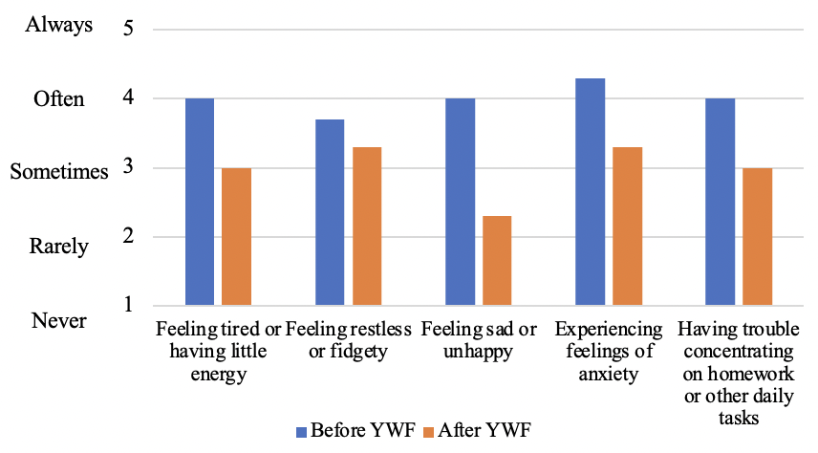
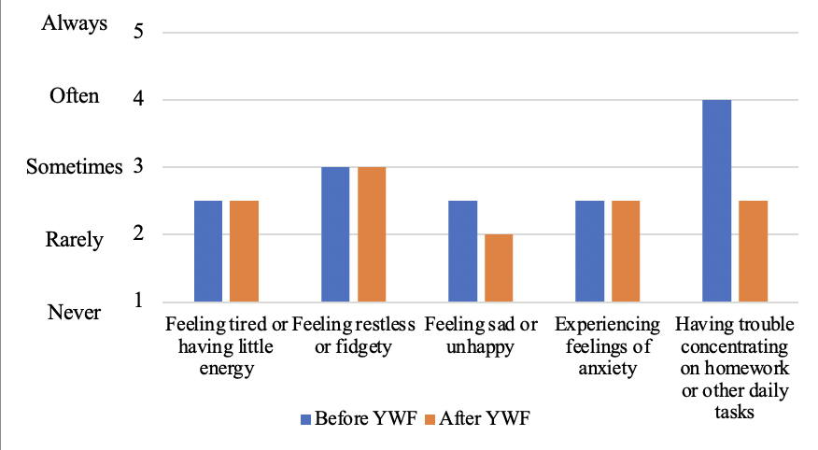
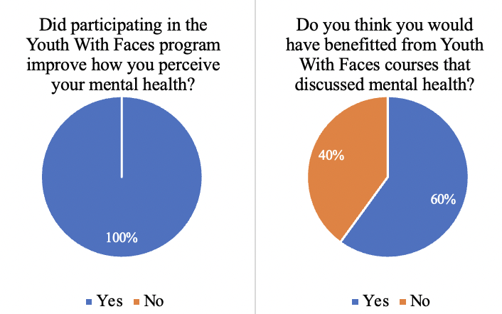
Mental Health Of Juvenile Offenders Post-Release Participating in a Community Re-Integration Program Meri Wheeler, OTS; Jewell Dickson-Clayton, OTD, MPH, OTR/L, ATP, FAOTA Department of Occupational Therapy | University of Alabama at Birmingham Jazminda Ryan, Ed. D | Youth With Faces
Introduction
Results continued
Discussion continued
Approximately 696,620 children are arrested each year in the US (Children’s Defense Fund, 2021). Up to 80% of these children will be re-arrested within 3 years of release (The Council of State Governments, 2022).
Mental health difficulties and diagnoses are prevalent throughout this population. Approximately 50-75% of youth involved in the juvenile justice system meet the criteria for a diagnosable mental health disorder (Underwood & Washington, 2016).
To combat high incarceration and recidivism rates, Youth With Faces (YWF) in Dallas, TX. was developed to provide justice-impacted youth with the skills needed to break the cycle of incarceration and forge positive futures. Past program evaluation results have supported that YWF is successful in reducing recidivism rates, however, the mental health impacts of the program have yet to be studied.
The purpose of this project is to conduct a research study to determine if the community re-integration program, YWF, is effective in improving mental health outcomes for juvenile offenders.
Female Responses:
Figure 1 displays the average responses provided by female participants before and after completing YWF.
Female participants indicated an overall greater improvement in mental health following completion of a YWF course compared to males, as evidenced by improvement in all 5 symptoms.
Male Responses:
Figure 2 displays the average responses provided by male participants before and after completing YWF.
Male participants indicated improvement in only two symptoms, including decreased feelings of sadness/unhappiness and less difficulty concentrating on homework or other daily tasks.
Positive language when describing the impact YWF had on participants’ mental health, implies YWF may have an overall positive impact on mental health. Participants may be unsure about a potential YWF mental health course due to misunderstanding what this course may entail.
Implications for OT Practice:
Developing and delivering evidence-based mental health interventions to YWF participants and collaborating with clients to provide relevant community resources to decrease recidivism rates and improve mental health.
Limitations:
Small sample size, participants ages ranged from 17-18 although YWF serves youth as young as 14, no previous mental health history considered, and possible changes in perceptions of mental health between time of incarceration and post-release.
Future Research:
Examine differences in mental health across the two detention centers, consider pre-existing mental health conditions, examine overall quality of life after participation in YWF, development of mental health-focused courses, and development of additional community supports to promote improved outcomes.
Methods
Figure 1: Average Frequency Responses of Mental Health Symptoms of Female Participants
Conclusion
Study Design:
Mixed Methods
Recruitment:
Surveys were distributed to past YWF participants.
Population:
Past juvenile offenders that have been released from one of two detention centers – Collin County Juvenile Probation Services or Dallas County Juvenile Department.
Survey:
The one-time survey included 15 questions asking participants about their perceptions of their mental health. This was completed via a 5-point Likert scale to indicate how frequently participants experienced various mental health symptoms before completing a YWF course and after completing a YWF course.
Participants also responded to 2 yes/no and open-ended questions inquiring further about the perception of their mental health and their perspective on a potential mental health YWF course.
Data Analysis:
Analysis of Likert-scale responses were completed via identification of mean scores amongst males and females before completing YWF and after completing YWF. The two averages were then compared to determine progression, regression, or consistency of mental health symptoms before vs. after completing YWF.
Commonalities in open-ended responses were used to interpret qualitative data by identifying common themes, language, and opinions.
Figure 2: Average Frequency Responses of Mental Health Symptoms of Male Participants
Open-Ended Responses:
Figure 3 displays the percent of participants that indicated yes or no to the two open-ended questions.
Rationales provided for question 1 included positive language to describe their YWF experiences, with terms such as “happier,” ”fun,” “interactive,” “[providing a] stronger support system.”
Of those that responded “no” to question 2, ” they provided rationales such as “I was in jail.”
The preliminary results of this study indicate that YWF programs may improve the mental health of students who participate in their programs. Due to the limited number of responses, results may not be generalized to all past YWF participants, however, current data shows favorable findings that YWF may improve aspects of one’s mental health.
This study represents the foundational work to better understanding the mental health of juvenile offenders and should continue to be studied to provide the most favorable long-term outcomes for this under-researched population.
Figure 3: Frequency of Responses of Yes/No Mental Health Questions
Acknowledgements & Contact Information
Discussion
Special thank you to Dr. Jazminda Ryan and the rest of the Youth With Faces staff for supporting me and my project and for your consistent efforts to provide improved outcomes for this population. Additional thank you to Dr. Jewell Dickson-Clayton for your support and assistance for the duration of this project, this couldn’t have been done without you.
For additional questions or information, please contact Meri Wheeler at mwheeler@uab.edu
Results of this study support the original hypothesis that the community re-integration program, YWF, may be effective in improving mental health of students who participate in their courses. Results may indicate that participating in YWF could either improve overall mental health or not negatively impact any aspects of mental health.
Females indicated a greater average improvement in frequency of symptoms, which may indicate that males and females experience different psychological responses to YWF interventions provided within the juvenile detention centers.
Male participants indicated change in only two of the five symptoms. Factors that could have influenced male participants’ responses may include stigma associated with mental health, peer relationships in the male vs. female units within the detention center, and buy-in to the program.
All participants indicated feelings of sadness/unhappiness decreased and that ability to concentrate on homework or daily tasks improved. These changes may be due to:
Concentration improving secondary to participating in one-hour long classes two times per week, requiring additional studying, assignments, homework, and certification exams.
Sadness or unhappiness decreasing due to increased sense of belonging, improved peer relations, improved sense of self, and long-term resources to promote success in the community.
References
Results
Children's Defense Fund. (2021). The State of America's Children 2021 - Youth Justice. Retrieved from https://www.childrensdefense.org/state-of-americas-children/soac-2021-youth-justice/
Council of State Government Justice Center. (2021, March 5). Reducing juvenile recidivism. CSG Justice Center. Retrieved June 28, 2022, from https://csgjusticecenter.org/publications/reducing-juvenile-recidivism/
Underwood, L. A., & Washington, A. (2016). Mental illness and juvenile offenders. International journal of environmental research and public health, 13(2), 228. https://doi.org/10.3390/ijerph13020228
Participant Demographics:
3 females and 2 males
1 participant 17 years of age and 4 participants 18+ years of age
All 5 participants were graduates of the Collin County Juvenile Probation Services YWF program

