Slide 1
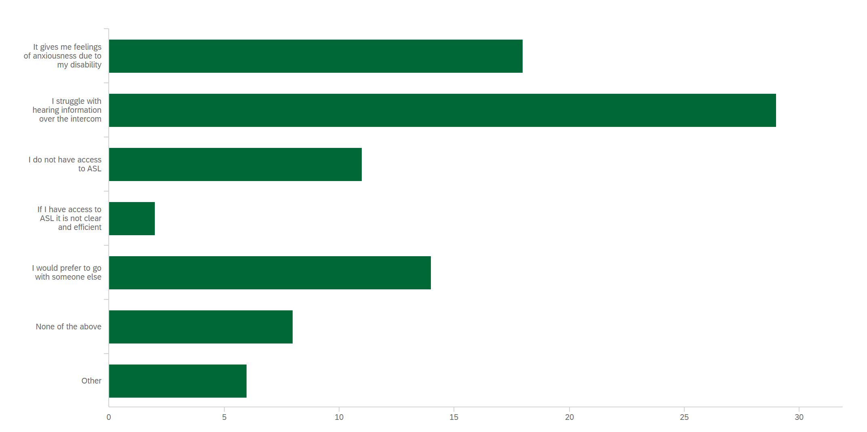
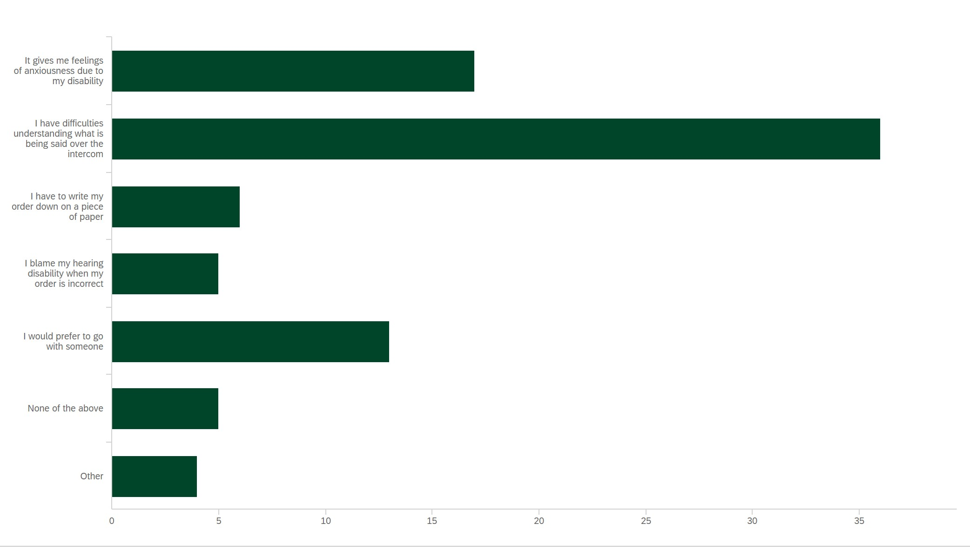
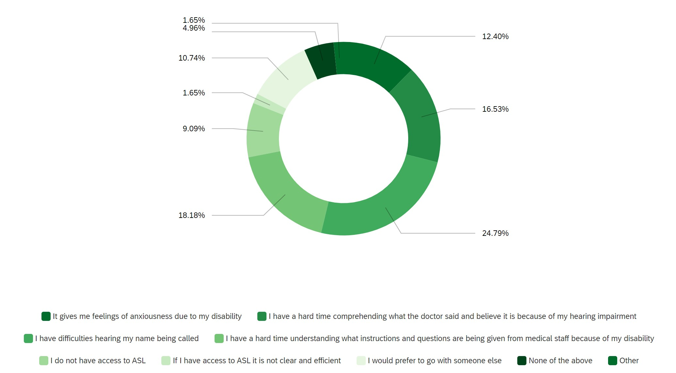
Is There A Need for Live Captioning in Healthcare, Transportation, and Retail Settings? McKenzie Williams, OTS; Gavin Jenkins, PhD, OTR/L, ATP Department of Occupational Therapy | University of Alabama at Birmingham Kevin Braswell, CEO | Smart Solutions
Introduction
Results continued
Discussion
Social participation is a factor that is essential to clients’ health and identity and to their ability to find meaning and value in life (American Occupational Therapy Association, 2020). However, communication difficulties limit the deaf and hard of hearing (DHH) population's capacity to participate in preferred occupations completely and successfully. These barriers include a lack of communication accommodations (Curt et al., 2021), visibility of lips (Giovanellie et al., 2021), and high noise levels (Furst & Vogelauer, 2012). This leads to miscommunication in health care (Stevens et al., 2019), retail (Edwards et al., 2018), and transportation services (Lucas et al., 2018).
Aim: to gain a thorough understanding of the challenges that the DHH population experience and their opinion on whether live captioning should be implemented in public and private sectors.
Figure 2 Emotions and barriers when flying commercial independently
Barriers such as loud acoustics, complex conversations, inaccurate ASL, limited access to ASL, and unclear intercoms make it difficult for the DHH population to comprehend information and communicate efficiently. The lack of access to a solution that improves social participation for the DHH population negatively affects their roles as family members, restaurant customers, retail store consumers, employees, employers, students, educators, and plane passengers. However, based on the results from this study, it is evident that the DHH population has a strong desire and need for the implementation of live captioning in public and private sectors. These settings include sporting events, churches, public events, classrooms, theaters, restrooms, hotels, grocery stores, banks, pharmacies, and the Department of Motor Vehicles. Furthermore, professionals must be better informed about the requirements of persons with hearing disabilities to provide an inclusive environment.
Limitations included not incorporating data on whether participants identified as deaf and wore cochlear implants, the limited duration of access to the study survey, and the lack of policies allowing larger organizations to release surveys.
Future research ideas include investigating potential benefits of live captioning for DHH individuals in an educational setting, comparing their comprehension with and without captioning, and observing if there is an increase in independence and social participation for this population with live captioning
Methods
Design: a quantitative survey was developed in Qualtrics to obtain data regarding demographic information, type of hearing disability, emotional aspects of having a hearing impairment, barriers that individuals face in various settings, personal experience with subtitles, and DHH individuals’ opinion on the need for implementing live captioning in different environments. The survey also gave participants the option of providing narrative feedback on other settings in which captioning options are needed. All data were evaluated to assess the frequency of common responses and draw conclusions about challenges faced by DHH individuals and the implementation of live captioning.
Population: 46 participants with a hearing disability aged 18–87 years.
57% (n = 34) described themselves as hard of hearing (HOH) and wore hearing aids.
8% (n = 5) identified as HOH and had cochlear implants.
12% (n = 7) identified as deaf and used American Sign Language (ASL) as their primary form of communication.
Recruitment Process: A flier was created with information about the study and access for participation. It was distributed to audiologists, support groups, colleges, and government agencies that provide services to the DHH community.
Figure 3 Emotions and barriers when utilizing a drive-through service independently
Conclusion
The world is intended for hearing people, however, integrating live captioning in diverse settings could improve inclusion for the DHH population. Live captioning could also decrease this population’s barriers to occupational participation and improve their independence, comprehension, social involvement, and anxiety.
References
Results
Table 1 Opinions on the implementation of live captioning
American Occupational Therapy Association. (2020). Occupational therapy practice framework: Domain and process (4th ed.). American Journal of Occupational Therapy, 74(Suppl. 2), 7412410010. https://doi. org/10.5014/ajot.2020.74S2001
Curt, A. M., Kanak, M. M., Fleegler, E. W., & Stewart, A. M. (2021). Increasing inclusivity inpatient centered research begins with language. Preventive Medicine, 149, 106621.https://doi.org/10.1016/j.ypmed.2021.106621
Edwards, K., Rosenbaum, M. S., Brosdahl, D., & Hughes, P. (2018). Designing retail spaces for inclusion. Journal of Retailing and Consumer Services, 44, 182–190. https://doi.org/10.1016/j.jretconser.2018.06.013
Fürst, E., & Vogelauer, C. (2012). Mobility of the sight and hearing impaired: barriers and solutions identified. Qualitative Market Research, 15(4), 369–384. https://doi.org/10.1108/13522751211257060
Giovanelli, E., Valzolgher, C., Gessa, E., Todeschini, M., & Pavani, F. (2021). Unmasking the difficulty of listening to talkers with masks: Lessons from the COVID-19 pandemic. i-Perception, 12(2), 2041669521998393. https://doi.org/10.1177/2041669521998393\
Huyck, J. J., Anbuhl, K. L., Buran, B. N., Adler, H. J., Atcherson, S. R., Cakmak, O., Dwyer, R.T., Eddolls, M., El May, F., Fraenzer, J. T., Funkhouser, R., Gagliardini, M., Gallun, F.J., Goldsworthy, R. L., Gouin, S., Heng, J., Hight, A. E., Jawadi, Z., Kovacic, D., Kumar,
R., … Steyger, P. S. (2021). Supporting equity and inclusion of deaf and hard-of-hearing individuals in professional organizations. Frontiers in Education, 6, 755457. https://doi.org/10.3389/feduc.2021.755457
Stevens, M. N., Dubno, J. R., Wallhagen, M. I., & Tucci, D. L. (2019). Communication and healthcare: Self-reports of people with hearing loss in primary care settings. Clinical Gerontologist, 42(5), 485–494. https://doi.org/10.1080/07317115.2018.1453908
Question | Strongly Agree (%, n) | Agree | Neither agree nor disagree | Disagree | Strongly Disagree | Total
I believe that live captioning should be implemented in fast food drive thru services. | 67.39% (n = 31) | 26.09% (n = 12) | 4.35% (n = 2) | 0.00% (n = 0) | 2.17% (n = 1) | 46
I believe that live captioning should be implemented in health care settings. | 76.09% (n = 35) | 17.39% (n = 8) | 4.35% (n = 2) | 0.00% (n = 0) | 2.17% (n = 1) | 46
I believe that live captioning should be implemented in airports. | 78.26% (n = 36) | 15.22% (n = 7) | 4.35% (n = 2) | 2.17% (n = 1) | 0.00% (n = 0) | 46
I believe that live captioning should be available and easy to access in all movie theaters. | 67.39% (n = 31) | 23.91% (n = 11) | 8.70% (n = 4) | 0.00% (n = 0) | 0.00% (n = 0) | 46
I believe that implementing live captioning in health care, transportation, and retail settings would improve inclusiveness for the deaf and hard of hearing population. | 76.09% (n = 35) | 17.39% (n = 8) | 6.52% ( n = 3) | 0.00% (n = 0) | 0.00% (n = 0) | 46
I believe that implementing live captioning in health care, transportation, and retail settings will improve my Independence. | 71.74% ( n = 33) | 15.22% (n = 7) | 13.04% (n = 6) | 0.00% (n = 0) | 0.00% (n = 0) | 46
I believe that implementing live captioning in health care, transportation, and retail settings will improve my self-esteem and confidence | 56.52% (n = 26) | 28.26% (n = 13) | 15.22% (n = 7) | 0.00% (n = 0) | 0.00% (n = 0) | 46
If I had an option between businesses providing live captioning or using an app on my cellular device, I would choose the live captioning program. | 54.35% (n = 25) | 34.78% (n = 16) | 10.87% ( n = 5) | 0.00% (n = 0) | 0.00% (n = 0) | 46
This is a report of the findings collected regarding emotions, barriers, and participants’ opinion on implementation of live captioning in health care, retail, and transportation settings (Table 1).
Figure 1 Emotions and barriers when visiting a health care setting independently
Acknowledgement & Contact information
Thank you to Dr. Jenkins, Emily Delzell, Kevin Braswell, Ashley McLeroy, Elizabeth Stewart, Jessica McKay, Hank Poore, friends, and family for your support during this research period.
Email McKenzie Williams at mwillia2@uab.edu if you have questions or comments.

