Slide 1
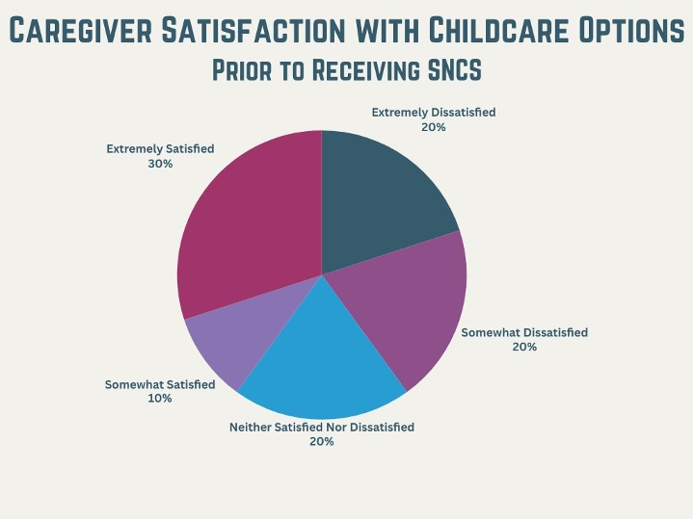
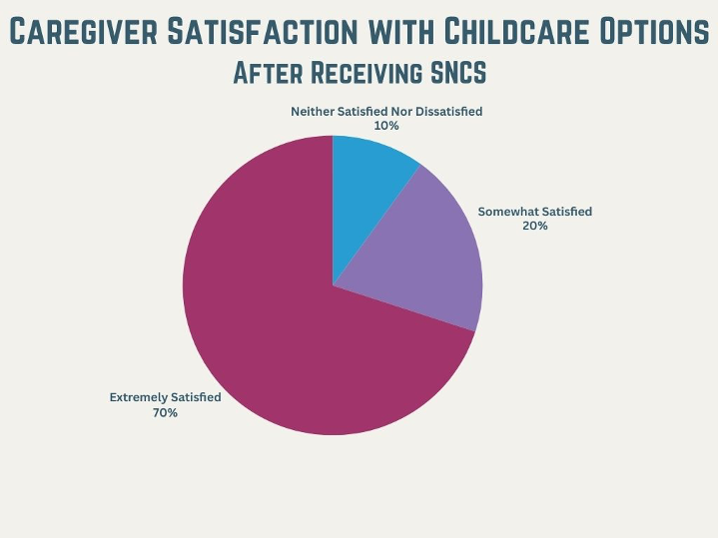
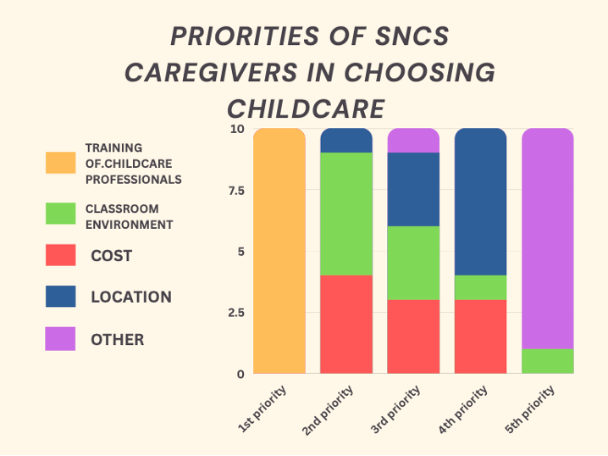
The Special Needs Childcare Subsidy, Inclusivity Training, and Caregiver Satisfaction with Childcare Services in Alabama Mackenzie Steger Wilson, OTS; K. Megan Carpenter, OTD, OTR/L Department of Occupational Therapy | University of Alabama at Birmingham Samantha Davidson | United Cerebra Palsy of Mobile
Introduction
Results
Discussion
The Special Needs Childcare Subsidy provides tuition assistance to the families of children with disabilities for childcare purposes​. This survey examines the relationship between the Special Needs Childcare Subsidy, inclusivity training, and caregiver satisfaction with childcare services in Alabama
Alabama does not require inclusivity training for childcare providers or directors in licensed childcare centers, regardless of whether the center is a recipient of the Special Needs Childcare Subsidy (SNCS) (Alabama Department of Human Resources, 2021).​
More parents of children with disabilities were dissatisfied with their occupational participation in childcare centers. Parents also found features and resources within the environment to be inadequate for their child’s needs (Benjamin, et al., 2016). ​
Caregivers desire a strong support system and community due to the lack of understanding between service providers, early childhood educators, and caregivers regarding their children’s disabilities (Walters and Friesen, 2019).​
Childcare providers benefit from further training regarding disability education, service provider education, child-provider interactions, and inclusion of children with disabilities to increase their self-efficacy in providing care for children with disabilities (Bryant, 2018; Weglarz-Ward, Santos, & Hayslip 2019).
Caregivers
100% female
60% 35-44 years
40% $50,000-74,999 AHI
Children
60% male; 40% female
50% 3-5 years; 40% 1-2 years; 10% <1 year
Childcare Satisfaction
60% increase in satisfaction post-receiving SNCS
#1 priority of caregivers is training of childcare providers (100%)
80% of caregivers reported considering inclusivity training of providers when choosing a childcare center
Survey Results
Supports dissatisfaction with childcare procurement options experienced by the families of children with disabilities
Supports caregivers supporting further inclusivity training for childcare providers
Supports further research on childcare provider satisfaction with inclusivity training requirements
Limitations
Small sample size
Limited survey completion window
Improved system for contact information and survey distribution to childcare providers and caregivers
Conclusion
Implications
OTPs are in unique position to advocate for increased inclusivity training in childcare centers
OTPs should practice transdisciplinary teamwork to avoid role confusion for childcare providers and caregivers (Welgarz-Ward, Santos, and Hayslip, 2019).
Future Research
Relationship between poverty, childcare, disability, and inclusion
Limited research on Inclusion in childcare environments and early childhood
Relationship between caregiver burden and quality childcare
Methods
Completed in collaboration with UCP Mobile's CCEP
Survey-based research; Quantitative, investigator developed, web-based survey
Survey
4 Sections: Eligibility, Caregiver Demographics, Child Demographics, and Childcare and Subsidy Data
Participants
107 DHR Licensed Childcare Centers receiving SNCS
19 respondents accessed surveys
10 eligible and complete surveys analyzed
Inclusion Criteria
SNCS Recipient
ages 16-89 years
Primary caregiver of a child with a disability currently enrolled in a DHR licensed childcare center
References
Alabama Department of Human Resources. (2021). Childcare licensing and performance standards for day care centers and nighttime centers: Regulations and procedures. https://dhr.alabama.gov/wp-content/uploads/2021/06/PROPOSED-Centers-Child-Care-Licensing-and-Performance-Standards-8-26-21.pdf
Benjamin, T. E., Lucas-Thompson, R. G., Little, L. M., Davies, P. L., & Khetani, M. A. (2016). Participation in early childhood educational environments for young children with and without developmental disabilities and delays: A mixed methods study. Physical & Occupational Therapy in Pediatrics, 37(1), 87–107. https://doi.org/10.3109/01942638.2015.1130007
Bryant, J. P. (2018). A phenomenological study of preschool teachers’ experiences and perspectives on inclusion practices. Cogent Education, 5(1), 1549005. https://doi.org/10.1080/2331186x.2018.1549005
Waters, C. L., & Friesen, A. (2019). Parent experiences of raising a young child with multiple disabilities: The transition to preschool. Research and Practice for Persons with Severe Disabilities, 44(1), 20–36. https://doi.org/10.1177/1540796919826229
Weglarz-Ward, J. M., Santos, R. M., & Hayslip, L. A. (2019). What early intervention looks like in childcare settings: Stories from providers. Journal of Early Intervention, 42(3), 244–258. https://doi.org/10.1177/1053815119886110
Acknowledgement & Contact information
The authors have no interests that might be perceived as representing any conflict or bias.
The authors thank Samantha Davidson and Melissa Anderson for advice on experimental design.
The authors thank United Cerebral Palsy of Mobile for their collaborative review efforts.
Contact Information: Please email Mackenzie Wilson at mfsteger@uab.edu for questions or comments

